Slide 1




NATO Modeling and Simulation Efforts in MOVES
Curtis Blais, PhD
24 May 2023
clblais@nps.edu

Slide 2
Agenda
NATO Modeling and Simulation Organization
Activities of Interest
Direct MOVES Engagement
Future Work
Discussion

Slide 3
NATO Modeling and Simulation Organization
“The mission of the NATO Modelling and Simulation (M&S) Group (NMSG) is to promote co-operation among Alliance bodies, NATO member nations and partner nations to maximise the effective utilisation of M&S.”
Operates as part of the NATO Science and Technology Organization (STO)
  e.g., see current STO activities at https://www.sto.nato.int/Pages/activitieslisting.aspx
Oversees numerous efforts related to M&S

Slide 4
NMSG Activities of Interest to MOVES*
Human Behavior Modeling
Cyberwarfare Modeling (just starting)
C2 System, Simulation System, Robotic System Interoperability
M&S in NATO Federated Mission Networking
* At this time…

Slide 5
Direct MOVES Engagement
MOVES researchers have participated in (and led) various NMSG activities (as well as an invited paper/presentation in Rome in 2016 on “Challenges in Representing Human-Robot Teams in Combat Simulations”)
Human Behavior Modeling (MSG-127 and MSG-198)
C2-Simulation Interoperability Studies (MSG-085, MSG-145, MSG-193, MSG-201)
Led MSG-194 Lecture Series on the C2 Systems – Simulation Systems Interoperation (C2SIM) international standard
  Conducted courses in the Spring and Fall of 2021 and 2022 for over 200 NATO members
  Included separate hands-on instruction in use of C2SIM software in the Fall of 2021 and 2022

Slide 6
Human Behavior Modeling
Participated in / contributed to the following efforts:
MSG-127 Reference Architecture
for Human Behaviour Modelling (2018)
MSG-198 Composable Human
Behaviour Representation in
Constructive Simulation Systems (2023)
…with interest in the proposed follow-on activity…

Slide 7
Interoperability
Participated in proof-of-concept studies MSG-085 and MSG-145 contributing to development and approval of the C2SIM international standard
Command and Control Systems – Simulation Systems Interoperation (C2SIM) standard approved in 2020 by the Simulation Interoperability Standards Organization (SISO)
Addresses information interchange across C2 systems, simulation systems, and robotic and autonomous systems (RAS) while providing the conceptual foundation for interoperability across other classes of systems (e.g., cybersecurity systems, sensor systems, logistics systems, etc.)
Identified by NATO in 2021 as one of the M&S standards for use in the Federated Mission Networking (FMN) program
Adopted by NATO as Standardization Agreement (STANAG) 4856 in March 2023

Slide 8
NATO Federated Mission Networking (FMN)
Concept for bringing together diverse systems from multiple nations in support of coalition operations.
Key concept is “Day Zero” interoperability
  Enabling minimum capabilities required to support the needs of the Commander during the pre-deployment and initial deployment phases of an operation
  Supporting rapid, smooth, and efficient transition from pre-deployment to initial operations
Dependent on application of agreed-upon standards

Slide 9
Need for M&S Standards in NATO FMN
Requirements for interoperation of C2 systems with Simulation systems include:
Force Readiness and Training – M&S provides the synthetic environment to support collective training
  Stimulates C2 systems for “train as you fight”
Support to Operations – M&S provides alternative timings and schemes of maneuver to evaluate current and future plans
Wargaming
Mission Planning
Mission Rehearsal

Slide 10
M&S Standards in NATO FMN
Participating in MSG-211 on integrating M&S standards and best practices into FMN (annual spiral development)
Information exchange content and protocols are governed by a number of established standards and best practices within NATO and across the international M&S community:
  Command and Control Systems – Simulation Systems Interoperation (C2SIM), NATO STANAG 4856 Ed 01
  High Level Architecture (HLA), NATO STANAG 4603 Ed 03
  NATO Education and Training Network Federation Object Model (NETN-FOM)
  Modeling and Simulation as a Service (MSaaS)
Includes annual participation in the Coalition Warrior Interoperability Exercise (CWIX)

Slide 11
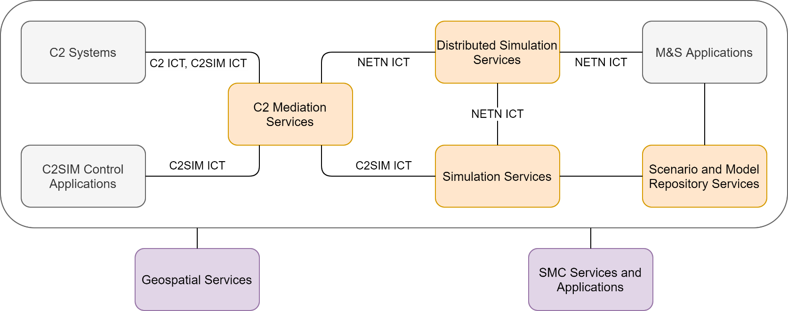
M&S Architecture in NATO FMN
Source: FMN Spiral 5 Service Instructions for Modelling and Simulation, 2022.
C2: Command and Control; C2IS: C2 Information System; C2SIM: C2 Systems – Simulation Systems Interoperation; ICT: Initialization, Control, Tasking and Reporting interactions; M&S: Modelling and Simulation; NETN: NATO Education and Training Network

Slide 12
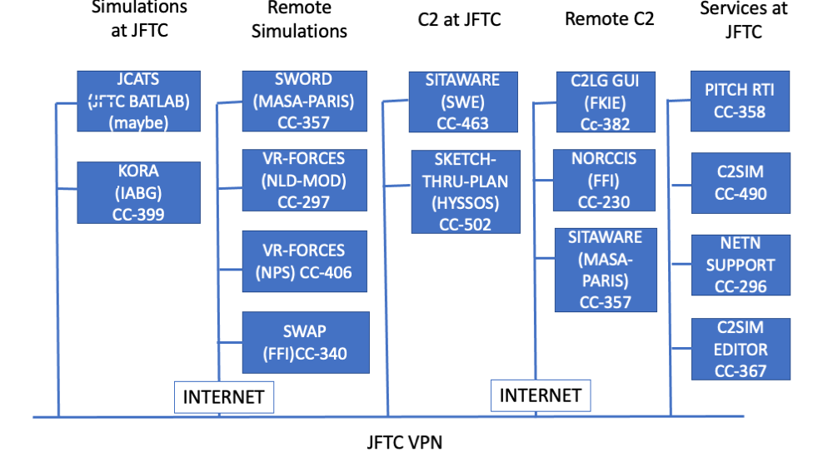
Coalition Warrior Interoperability Exercise (CWIX) 2023: Planned Configuration

Slide 13
Future Work
Leading MSG-211, Lecture Series on Modeling and Simulation Standards for NATO Federated Mission Networking (FMN)
First-year effort begins in July 2023
  Leading a team of 5 lecturers to cover key standards and best practices adopted by NATO for FMN
Initial course will be conducted in coordination with the NATO Modeling and Simulation Group (NMSG) Business Meeting and Symposium at NPS October 16-20, 2023
Spring 2024 offering may be conducted in concert with IT2EC in London

Slide 14
Discussion
NATO M&S Efforts in MOVES

Slide 15
Backup Slides

Slide 16
Command and Control Systems – Simulation Systems Interoperation (C2SIM)
International standard produced by the Simulation Interoperability Standards Organization (SISO)
SISO-STD-019-2020 & SISO-STD-020-2020
NATO STANAG 4856 Ed 01
Specifies information for exchange across C2 systems, simulation systems, and robotic and autonomous systems (RAS)
  Core data model with methodology for domain extensions, with an example Land Operations Extension
  Other domains explored or under consideration: Air Operations, Tactical Data Links, Sensor Systems, Cybersecurity Systems, Combat Systems, Electronic Warfare Systems

Slide 17
High Level Architecture (HLA)
International standard produced by SISO through the Institute for Electrical and Electronic Engineers (IEEE)
IEEE Standard 1516
STANAG 4603 Ed 03: MODELLING AND SIMULATION ARCHITECTURE STANDARDS FOR TECHNICAL INTEROPERABILITY: HIGH LEVEL ARCHITECTURE (HLA)
Interoperability framework for exchange of data and interactions across distributed simulation systems, including a set of run-time infrastructure services (see next slide)
Supported by the Distributed Simulation Engineering and Execution Process, IEEE 1730

Slide 18
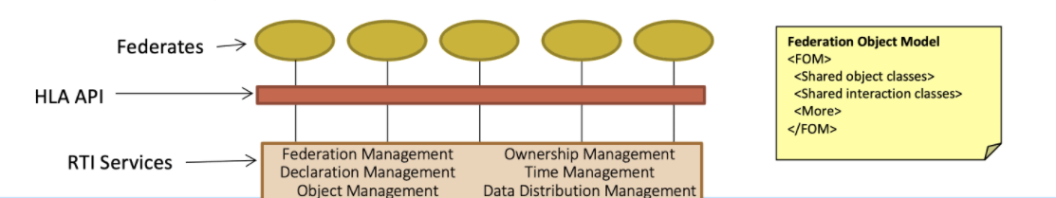
HLA Concept
API: Application Program Interface; FOM: Federation Object Model; RTI: Run-Time Infrastructure
Source: 2021 Simulation Innovation Workshop HLA Tutorial

Slide 19
NATO Education and Training Network Federation Object Model (NETN-FOM)
Data model for exchange of data and interactions across a NATO federation of simulations running under HLA
Designed as a set of function-specific modules
Source: Lofstrand, B., Herzog, R., Kuhn, T., Behner, H., and van den Berg, T.: “Evolution of NATO Standards for Federated Simulation,” Paper 2020-SIW-025, Simulation Innovation Workshop, February 2020.

Slide 20
Modeling and Simulation as a Service (MSaaS)
Cloud computing technology and service-oriented architectures offer opportunities to better utilize M&S capabilities to satisfy NATO critical needs
M&S as a Service (MSaaS) combines service orientation and the provision of M&S applications via the as-a-service model of cloud computing to enable more composable simulation environments that can be deployed and executed on-demand (see next slides)
NATO has established the Allied Framework for MSaaS:
  Operational Concept Document: intended use, key capabilities and desired effects of the Allied Framework for MSaaS from a user’s perspective
  Technical Reference Architecture: architectural building blocks and patterns for realizing MSaaS capabilities
  Governance Policies: MSaaS stakeholders, relationships and guidance for implementing and maintaining the Allied Framework for MSaaS
Source: Siegfried, R., J. Lloyd, T. van den Berg, “A New Reality: Modelling and Simulation as a Service,” CSIAC Journal, 6:3, November 2018.

Slide 21
Summary: M&S in NATO FMN
Modeling and Simulation (M&S) supports military operations through training, analysis, testing, planning, and execution
M&S is an identified requirement for Federated Mission Networking (FMN)
Interoperability is achieved through application of established standards
Instruction in “M&S Standards for NATO FMN” by the MSG-211 team will equip FMN developers and users in essential knowledge to ensure success
First course presentation planned for October 2023 during NMSG in Monterey, CA
Source: Siegfried, R., J. Lloyd, T. van den Berg, “A New Reality: Modelling and Simulation as a Service,” CSIAC Journal, 6:3, November 2018.

