Slide 1
Opening Remarks
MOVES Open House 2023
24 May 2023
Navy Modeling and Simulation Office
Dr. Ivar Oswalt, CMSP
Plans, Policy, Standards, Education, and Outreach – NMSO
The MIL Corporation: Senior Analyst
Jonathan Stergiou, ST
Director [acting] – NMSO
Dist. Engr. for Hull & Mech. System/Ship Integration M&S – NSWCCD
Approved for public release: distribution is unlimited.

Slide 2
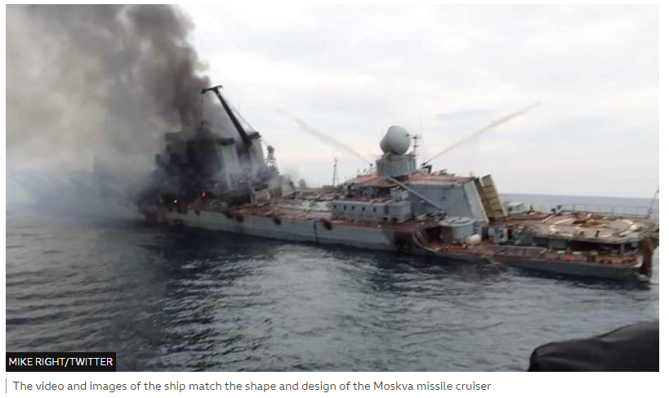
Taking a Fix on Where We Are
What we have today isn’t generating the advantage we need
Risk aversion is stifling Enterprise-wide action and innovation
We no longer dominate in computing technology
Overconfidence must be avoided
The Moskva - Sank 14 April 2022 – Mike Right, Twitter, BBC News, “Sunken Russian warship Moskva: What do we know?” Published 18 April
Notes:
I must start by saying that what we are doing today isn't generating the advantage we need.
We are also overly fearful of failure and this risk aversion is stifling Enterprise-wide action and innovation.
The US is now facing near-peer and peer competitors that we may need to engage and overcome in dynamic multidomain joint and coalition operations.
We do not know it all and we must avoid being overconfident. We need to learn a lot more and a lot more quickly.
Briefing themes deduced from:
Acquisition Innovation Research Center (AIRC) Sponsor Research Review. (9 November 2021). Speech by Paul Mann, 30:25-39:30, https://www.youtube.com/watch?v=hyZdhKO1kr0&t=2377s
Mann, P.D., & Acevedo, R.A. (2018). A View From the Bridge, briefing.
NSWC PHD Change of Command. (30 June 2020). Speech by Paul Mann, 7:00-33:20, https://www.facebook.com/nswcporthueneme/videos/193691388719859/
NSWC PHD Surface Warfare Engineering Facility (SWEF) LVC Initiative Technical Interchange Meeting. (17 March 2022). Keynote by Paul Mann
Re bullet #3: https://sciencenode.org/feature/the-5-fastest-supercomputers-in-the-world.php

Slide 3
DON M&S Vision
  M&S will provide a robust and credible capability to create synthetic environments that accurately represent platforms and systems, predict outcomes, and provide inputs to naval decision makers and Fleet users in support of numerous areas including acquisition, operations, and training.

Slide 4
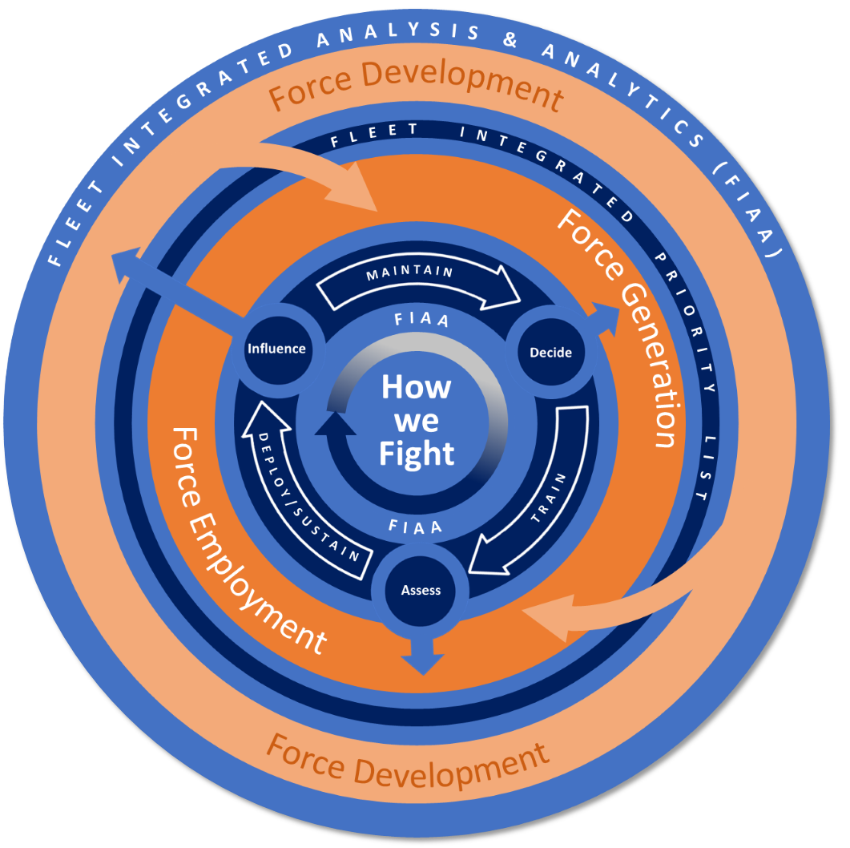

DON Engineering Initiatives
Critical to move from focusing on delivering platforms predictability to Enterprise-wide initiatives and innovation – especially in AI/ML
Increasing system complexity and interconnectedness requires significant advances across DON in DE, etc.
Essential to have shared repositories to stamp-out duplication and maximize collaboration
We are only as good as our people… DE and M&S are technology areas that need dedicated SMEs: uniform (e.g., 6202s), GS, and contractors
Must focus on data and outcome-based metrics that are assessed in real-time and used to constantly improve
All have significant, sometimes profound, impact on M&S!
Data analytics to integrate the seams in and across:
Force Development
Force Generation
Force Employment
Articulate the holistic picture of readiness across all phases that measures not just readiness outputs but also the health of the readiness production and capability development cycle with
Force Readiness
Notes:
Part of that change is to move from delivering platform-based warfighting systems and assets in a system that focuses on predictability to taking an Enterprise-oriented approach where the focus is on innovation, evolution, and adaptation, at the speed of relevance!
The increasing complexity and interconnectedness of the warfighting systems being deployed requires significant advances across the Department of the Navy to include learning, engineering, acquisition, training, and support to operations.
It is critical to have shared repositories / ecosystems to minimize duplication and maximize collaboration.
We are only as good as our people. And in DE and M&S they have unique, valuable, and yet perishable skills. Those skills need to be developed, honed, and maintained within a robust DE and M&S HCM/WFD/E&T Strategy.
We must focus on data and outcome-based metrics that are measured and analyzed in real-time and used constantly and continually to improve our systems acquisition system and warfighting techniques, tactics, and procedures.
Every one of these important changes will have significant and sometimes profound impact on the discipline and technological development of modeling and simulation (M&S).
(Picture from: Revolutionizing Readiness, RADM Paul Spedero, Fleet Readiness Officer (N02R) USFFC, 22 January 2020, UNCLASSIFIED, slide 2)

Slide 5
M&S Imperatives
Intelligently integrate M&S across community boundaries (R&D, T&E, Training, etc.)
Drive M&S to analyze system trades earlier in design
Improve and balance warfighting / scenario representation - AKA Fair Fight
Interfacing Fleet, training, and R&D assets to enhance LVC
Provide timely M&S validation and system accreditation
Improve early definition of down-stream simulation use
Include unmanned / autonomous representation in M&S
Integrate AI/ML, big-data analytics, distributed ops, etc.
Notes:
So, what are our M&S imperatives? They start with intelligently integrating M&S across traditional boundaries. For instance, interoperating simulation-based training capabilities with M&S based capabilities that reside within our Warfare Centers and Systems commands.
Next, it is important to drive the use of M&S to analyze system performance tradeoffs earlier in the acquisition process (on the right side of the Systems Engineering V). It is also critical to improve and balance warfighting scenario representations so that they accurately reflect blue and red force capabilities within an environment and scenario context that provides a fair fight.
A key enabler for such developments is associating operational, training, and research and development assets. It is also required to provide timely M&S verified and validated systems within a construct of comprehensive and persistent ATOs.
Having such capabilities in place when needed requires the consideration and definition of downstream simulation requirements as early as possible in their design and development.
Finally, the last set of imperatives are to include unmanned, autonomous, and autonomic representations and functionality in M&S while also effectively incorporating artificial intelligence, machine learning, big data analytics, distributed operations, and similar advanced technologies and techniques.
(Picture from: Undersea Warfighting Development Center, RADM Butch Dollaga, Commander, SENEDIA “Defense Innovation Days” 27AUG2019, UNCLASSIFIED Slide 19)

Slide 6
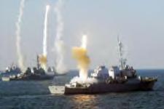
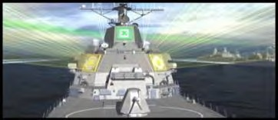
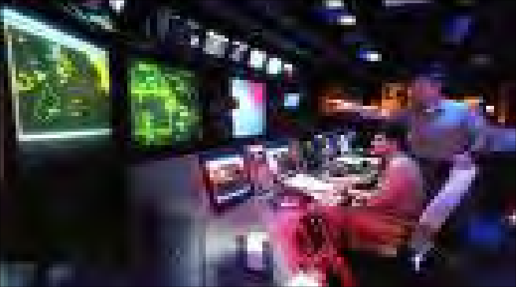
Areas of M&S Investment
Enterprise collaboration and engineering environments
Red M&S enhancements & commonality
Force-Level Blue system technical baseline
Representation of warfighting maneuver and interactions
Force/campaign M&S selection and standardization
LVC federation connecting cross-community assets
Physics-based modeling improvements and applications
Enterprise Digital Battlespace
Notes:
We are leaning forward and investing in eight topic areas that will help meet each of these imperatives and that will deliver M&S functionality that directly supports long range fires, non-kinetic weapons, and supporting ISR&T/C5ISR/JADC2. First, we are working to improve red or threat M&S capabilities.
Next, there is the need to enhance the representation of the interactions between forces as they maneuver and engage across the battle space and timeline. At the force and campaign level, the top of the M&S pyramid, there is a need to narrow the number of tools used and increase the standardization across and among these tools.
In the area of data, specifically to represent force level blue systems, it’s important to develop a technical baseline that provides an authoritative source of truth, appropriately abstracted and scaled to the simulation systems that need to ingest it.
Another important area of investment will improve the ability of M&S and live, virtual, and constructive (LVC) simulations, to interconnect capabilities and assets that exist within and across the acquisition, R&D, and the operational and warfighting commands.
There is also always a need to improve the representation of phenomenology, or physics-based M&S, as it often used to provide fundamental inputs to platform, engagement, and mission level simulations.
Finally, as in any large enterprise-scale engineering industrial, academic, or governmental organization, distributed collaborative environments (complete within necessary tools, data, and standards) are essential. This is true in general, but also as it applies to specific instantiations, for instance the Aggregated Digital Ecosystem for Naval Advantage.
(Picture from: A View From the Bridge, CAPT Ray Acevedo, Mr. Paul Mann, May 9, 2018, DISTRIBUTION A, slide 20)

Slide 7
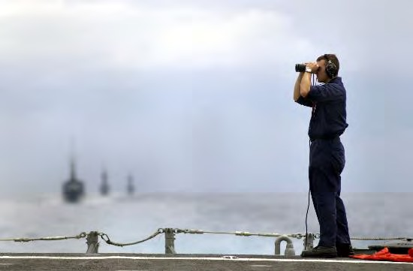

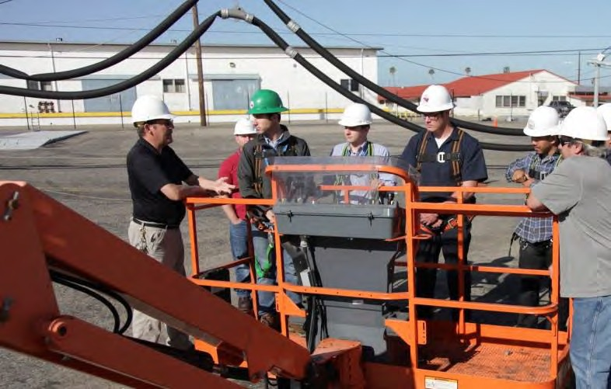
Way Ahead…
Continue to improve culture & personnel
Discover, connect, and integrate M&S across DON
Enable efficient and effective decision making at all levels
Focus on metrics that reflect outcomes
Exploit innovation – outpace our adversaries
Develop, align, and employ world class M&S
Accelerate and improve outcomes in all naval mission areas
Agility, Velocity, Capacity, Capability
Produce Outcomes!
Notes:
So given our status, M&S imperatives and areas of investment what is the way ahead?
It begins with people - within the Department of the Navy, the other services, DoD, and our industrial and academic partners to improve our culture in a way that provides leadership, empowers all participants, and takes bold action to improve current capabilities and to become the benchmark against which others compare themselves.
Then, it's about the data; making sure we understand what we should track, tracking it, and converting it into metrics that reflect outcomes and allow us to operationalize the changes that improve our warfighting capabilities.
Next, it is critical to exploit innovation, which is something we've been good at historically, but that we need to get even better to outpace our adversaries.
Part of these innovations will occur in M&S where we must design, develop, align, and employ world class capabilities (personnel, technology, organizational focus, infrastructure, and funding).
M&S provides the experimental and engineering T&E environments that turns what-if into what will be.
But individual even highly capable M&S systems are suboptimal if they're not discoverable, connectible, interoperable, and integrated across the Department of the Navy.
Only with such advanced, and at times revolutionary, improvements in capability can we enable efficient and effective decision making at all levels and accelerate and improve outcomes in all naval mission areas - warfare and support. All of these enable agility, velocity, capacity, and capability to produce winning outcomes.
Again, thank you for the opportunity to provide these remarks at the beginning of this important Open House. My team and I welcome this dialogue and our continuing collaboration in the future to improve the capabilities of the Naval Sea Services.
(Picture from: A View From the Bridge, CAPT Ray Acevedo, Mr. Paul Mann, May 9, 2018, DISTRIBUTION A, slides 13 and 14)

Slide 8
QUESTIONS / DISCUSSION

Slide 10
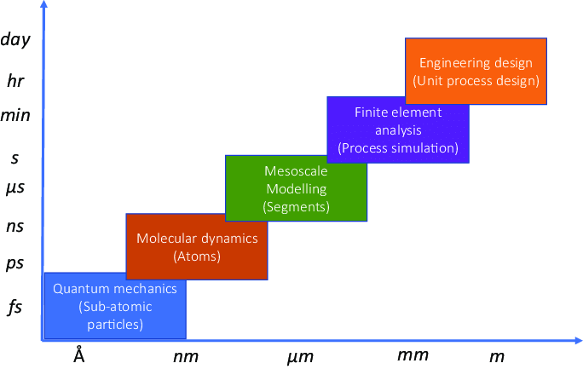
What is and what isn’t…
Congress directs DoD to establish a JPO for Simulation
NAVMSMO is established in OPNAV C4I/SEW (N6) as N6M
NMSO reports to DASN (RDT&E) T&E Executive
SECNAVINST 5200.46 DON M&S and VV&A Management
NMSO assume DISC-led DON M&S responsibilities
OCT 1990
JUN 1991
AUG 1995
JUL 2005
MAR 2012
OCT 2013
MAR 2019
JUN 2020
MAY 2022
DoD Memo issued on the establishment of DMSO
NAVMSMO (N6M) becomes NMSO under CHENG (ASN (RD&A))
NMSO reports to DON M&S Executive
ASN (RD&A) CHENG becomes DON M&S Executive
SECNAVINST 5200.46: M&S management shall establish common and crosscutting guidance and capabilities; promote the efficient and effective use of M&S tools, data, and services; implement M&S processes that ensure asset visibility and access; and advance increased M&S interoperability, standardization, and reuse. M&S management shall also guide M&S investments and assist in collaborative research, development, acquisition and operation of M&S per reference (a). Processes for M&S management shall assess the status and plan for: future M&S requirements, development of M&S applications, representation of threats, DON operational capabilities, and the implementation of an M&S strategy within the DON.
M&S management shall ensure that M&S and VV&A manuals, standards, guidebooks, reference guides and templates are readily available and used throughout Navy and Marine Corps installations, commands, activities, field offices, programs and other entities within the DON. It shall also collaborate with M&S stakeholders across the DON to effectively execute and govern M&S and shall ensure SECNAV, CNO, and CMC have insight into M&S investments across all DON activities
We primarily focus on the upper right two levels of the computational methodologies, but we integrate with other simulation methods for specific applications.

Slide 11
Navy M&S Office (NMSO) Responsibilities
Develop and align policy to promote:
  Interoperability of M&S capabilities throughout the DON
  Use and reuse of M&S capabilities
  R&D activities to respond to emerging challenges
  Appropriate balance of data and application distribution rights
Develop and provide updates to supporting manuals, guidebooks, and best practice guides
Oversee core Service M&S projects
Support the development and use of enabling Publications Collaborative environments Portfolio management activities
Support the development of common M&S and VV&A tools, interfaces, services, and capabilities throughout DoD
Review and provide recommendations on M&S and VV&A issues
Support and expand M&S workforce education and strengthen M&S training and education content and capabilities
Conduct and participate in M&S technical exchanges and workshops to promote collaboration, coordination, etc.
Synchronize M&S S&T, RDT&E, and training to maximize unity of effort across the DON
Assist DON M&S efforts in maintaining asset visibility and interoperability with the other Services and applicable Agencies

Slide 12
NMSO Office Structure
DASN RDT&E CHENG / DON M&S Executive
Mr. Rick Quade, SES
Cores Services
  M&S and VV&A manuals, standards, guidebooks, reference guides and templates
Physics Based M&S
  Physics-based modeling in support of naval applications (analysis capability & tool/process development)
Collaboration and Discovery
  Improvement and enhancement tool and data discovery & digital engineering and collaboration environments
Enterprise Engineering
  Develop/sustain Naval enterprise environments and tools for supporting model based system engineering / digital engineering activities
M&S and LVC Tools
  Connect and stimulate live HWIL, SWIL, and/or constructive sim for priority capabilities; develop informed, persistent, adaptable federation of M&S capabilities
PP&S
Business Management
Outreach
Security
Workforce Development
VV&A
DON M&S Director
Dr. Denisse Soto
Core Services
Physics Based M&S
High fidelity M&S
Collaboration & Discovery
(LIFT / AMP)
Enterprise Engineering
IME (MBSE)
M&S and LVC Tools
Digital Battlespace / Force Campaign M&S
Community Services, Experiments and Prototypes
Notes:
Based on that we re-structured the office based on navy priorities and identified thrust areas to focus in 2023. Here is a basic org structure for the office.

Slide 13
Functional Area Descriptions
Physics Based M&S
  Improvement and enhancements in ability to conduct physics-based modeling in support of naval application such as: fluid/structure interaction for severe conditions, dispersion of energy, multi-body interactions, multi-physics phenomena. Includes not only analysis capability but also tool and process development.
Collaboration and Discovery
  Develop improvements and enhancements of M&S tool and authoritative data discovery and digital engineering and collaboration environments to include infrastructure, licensers, and environment design and built-out and data population in support of Naval M&S and Analytic Master Plan activities.
Enterprise Engineering
  Develop/sustain Naval enterprise environments and tools for supporting model based system engineering / digital engineering activities utilizing models and simulations. Provide improvements in the ability to model and simulate blue/red threat systems and environments that span application areas across force level analysis, high fidelity applications, digital engineering applications, and test and evaluation. Provide non-proprietary method of integrating models and simulations without the need to change the underlying system being modeled or simulated.
M&S and LVC Tools
  Improvements/advancements in ability to connect and stimulate live hardware in the loop, software in the loop, and/or constructive simulation in support/fielding of priority capabilities such as long range fires and naval operation architecture. Develop an informed, persistent, adaptable federation of M&S capabilities to efficiently examine all domain warfighting capabilities and concepts to support maritime warfighting advancement. Prototype means, methods, and processes that apply artificial intelligence and/or machine learning to enhance red/blue simulation and simulation environments
Cores Services:
  M&S and VV&A Plans, Policy, and Standards will be updated / developed where appropriate. Relevant training and technical support available to M&S community. Execution, advocacy, and oversight of NMSO Functional Areas.

Slide 14
FY23 Strategy
VISION
M&S will provide a robust and credible capability to create synthetic environments that accurately represent platforms and systems, predict outcomes, and provide inputs to naval decision makers and Fleet users in support of numerous areas including acquisition, operations, and training.
MISSION
Enhance efficient and effective decision making and mission accomplishment by Improve M&S Interoperability and Reuse Provide authoritative representations and behaviors Incorporate Subject Matter Experts Throughout M&S development and use Enable Discovery and Minimize Duplication
LINES OF EFFORTS
Core services Community Services Community Experiments and Prototypes
EXECUTION
Red modeling Enhancement Red/Blue maneuver Force/Campaign M&S Tools Selection Force Level Blue Tech Baseline LVC Connectivity & use case with Acquisition & Operational Assets Physics based modeling improvements/applications Enterprise level collaboration discovery and engineering environments
STRATEGY MAP
LVC Digital Battlespace LIFT VV&A FFC IDS PPSE&O
INITIATIVES
Supporting AMP M&S Pillar through development of LIFT requirement Revising DON M&S Procurement Guidebook and support the OSD M&S guidebook Authoring a DON VV&A Implementation Handbook Developing M&S SAG Defining and Relating DON M&S to DE, LVC, Test Beds, Emulation, Etc.
STRATEGIC PRIORITIES
Support and Enhance the 24-7 365 Naval LVC Capabilities Balance the Red/Threat M&S Processes and System Representation Guide the Service-Level M&S Improvements and Capability Enhancements Guide the Education and Workforce Development / Human Capital Management Lead/promulgate Cross-Community / Organization coordination and execution of M&S products
METRICS
KPs Leading metrics Lagging metrics

Slide 15
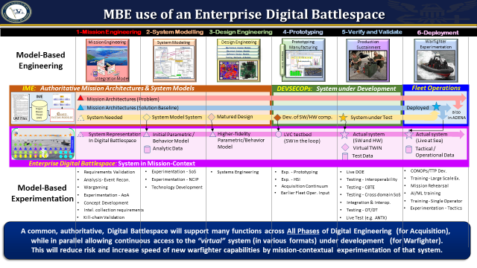
FY24 Priorities and Request for Projects
FY24 Request for Projects seeks to identify and promote projects addressing new M&S tools, technologies, infrastructure, and models that promote cross-cutting benefit to the Naval M&S enterprise as a whole.
This call for proposals seeks to fund projects that help to provide Government-owned environments to support Analysis, Acquisition, Training, and Experimentation communities.
FY23 Approach
FY24 STRATEGIC PRIORITIES
Force-Level Modeling Advancements Live-Virtual-Constructive Enhancements Red Modeling Advancements Enterprise Model-Based Systems Engineering Discovery and Collaboration Standards and Policy

