Slide 1




Scaling Intelligent Combat Behaviors Through Hierarchical Reinforcement Learning
LtCol Scotty Black, USMC
23 May 2023
scotty.black@nps.edu

Slide 2
Agenda
Problem
Background
Proposed Research
Research Progress
Recent Accomplishments

Slide 3
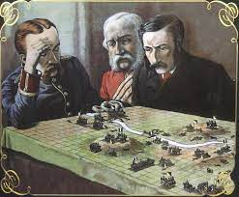
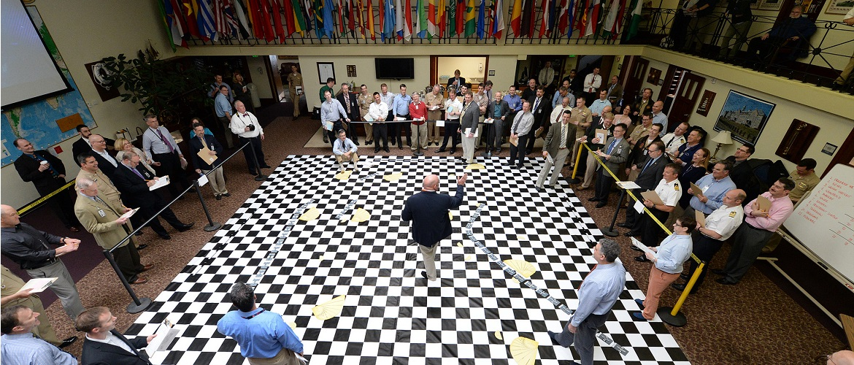
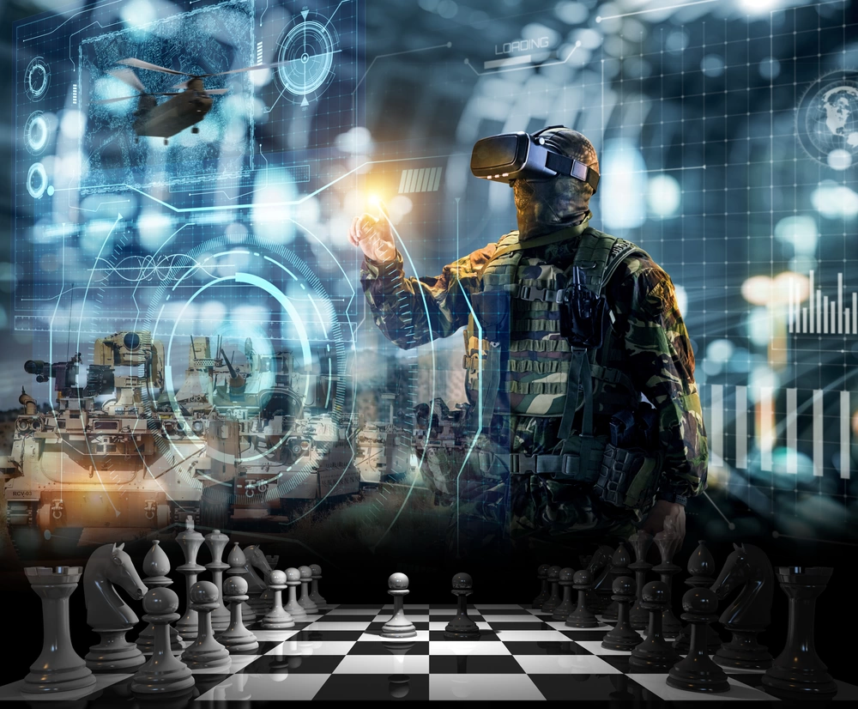
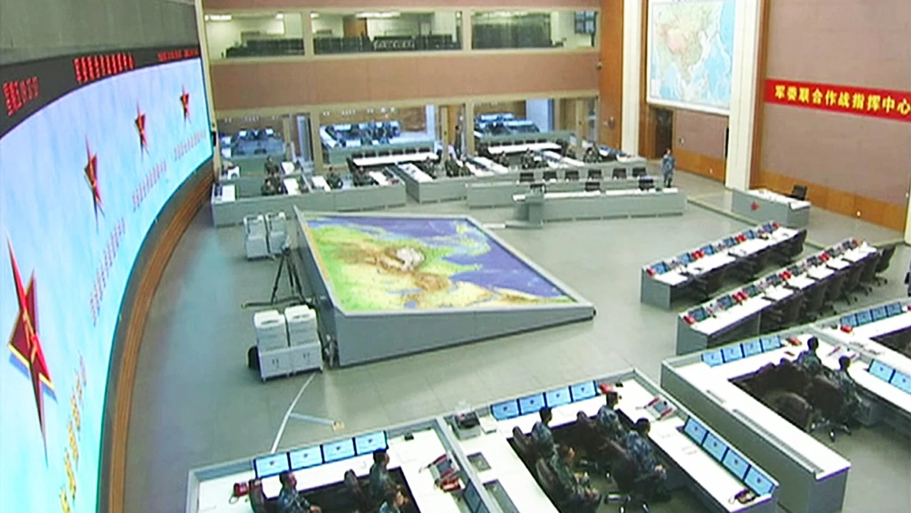
The Need to Evolve Wargaming
We need to evolve the current paradigm of wargaming—both in terms of technology and methodology
The People’s Republic of China (PRC) are beginning to understand the importance of wargaming
  Pursuing innovation in platform and techniques for wargaming
  Leveraging AI for wargaming
  Nationwide competitions involving civilian and military
Machine learning is key to achieving super-human performance in complex, realistic wargames

Slide 4
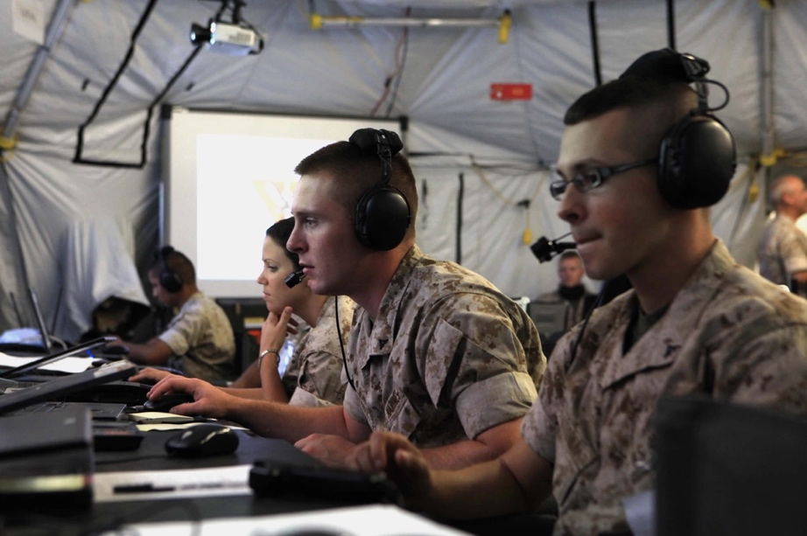

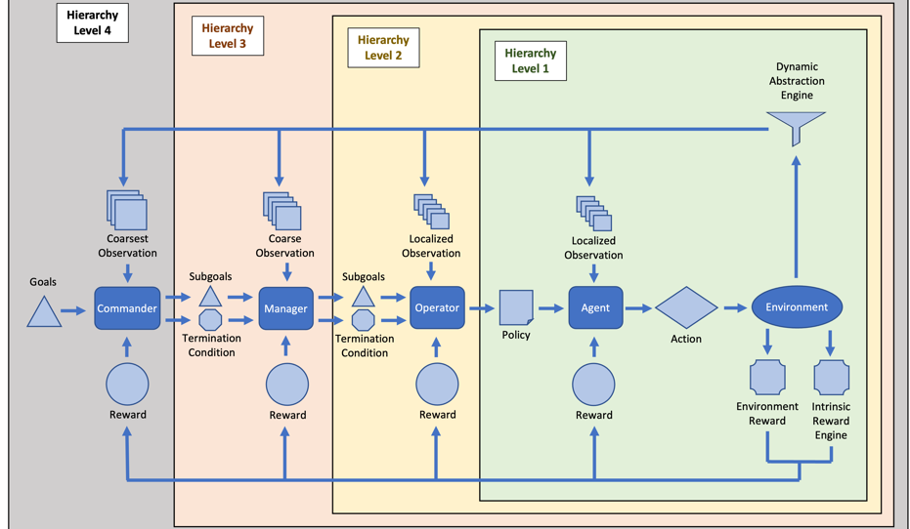
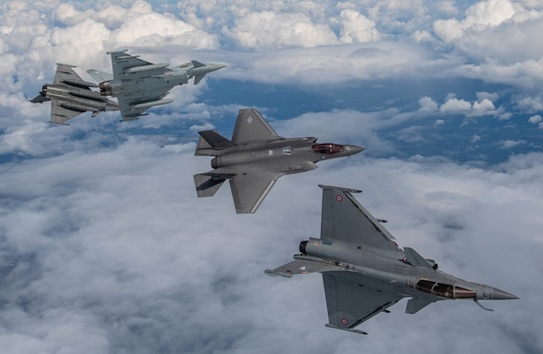
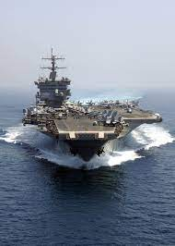
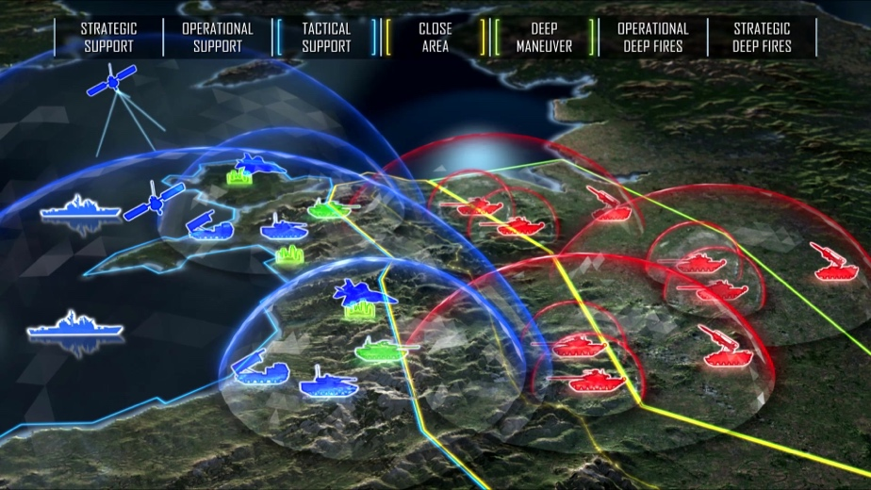
Vision
Human Input
AI + Sim
Input
Decision Advantage
— Quality + Speed —
*Image sources: DVIDS or NPS
A superhuman wargaming agent serves as the foundation necessary to ultimately leverage AI as advisor to commanders, military planners, and decision-makers

Slide 5






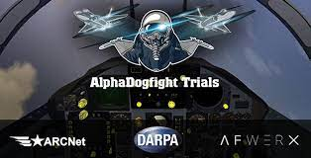
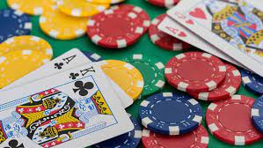
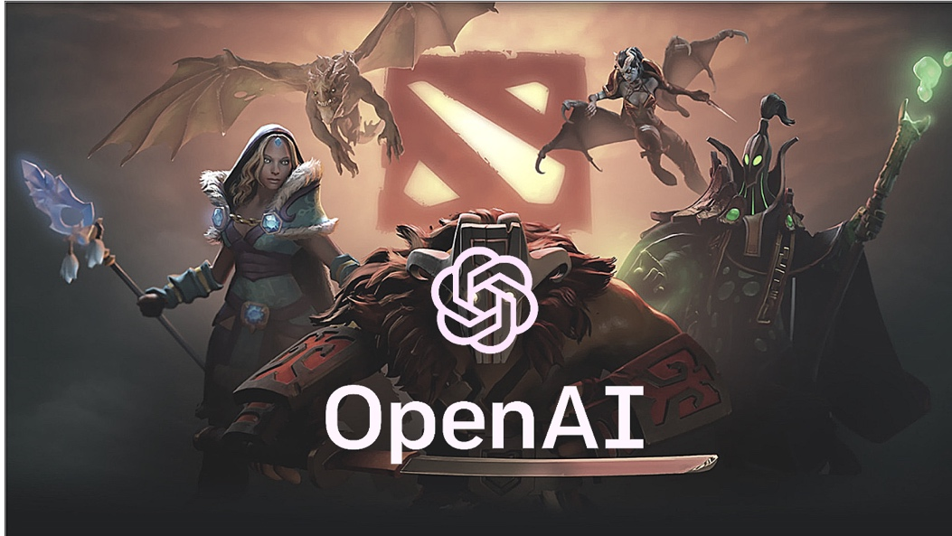
Related Research Background

Slide 6
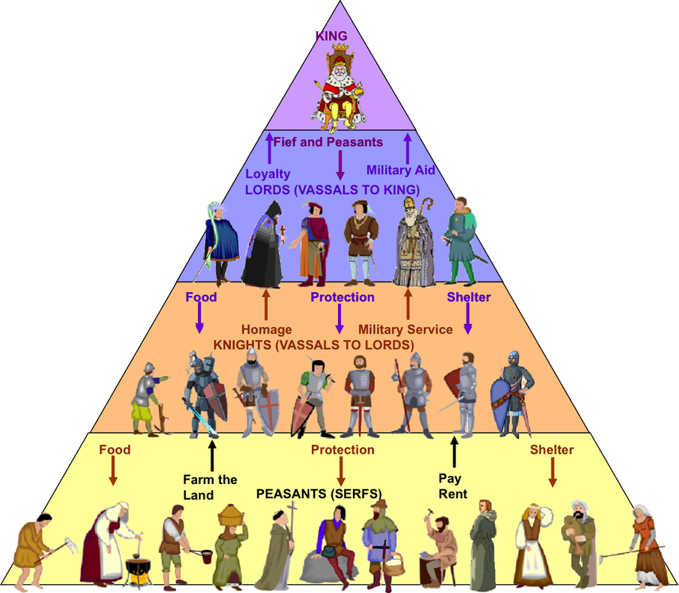
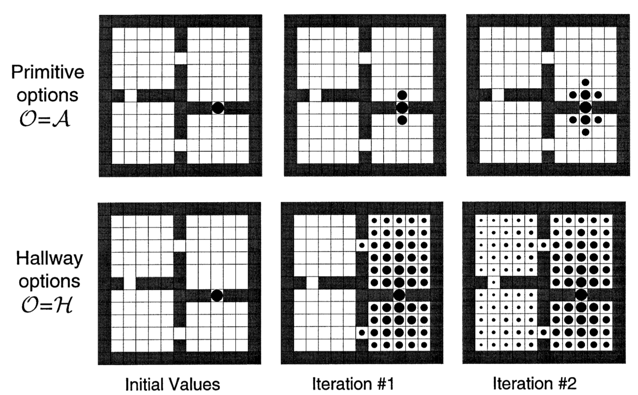
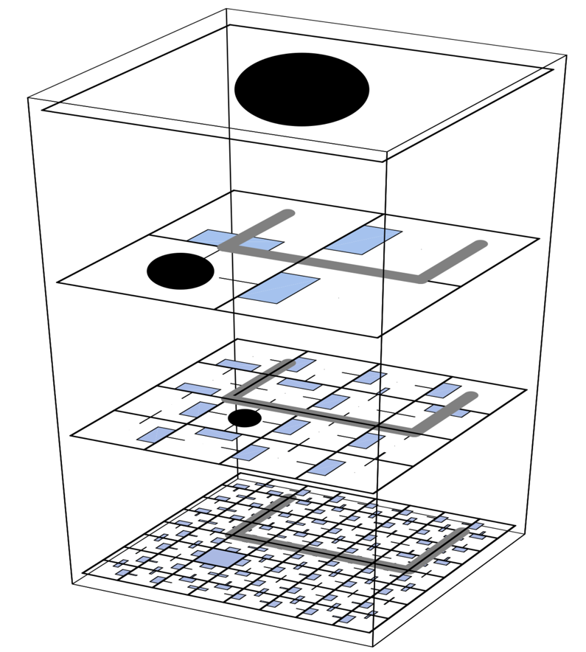
Hierarchical Reinforcement Learning (HRL)

Slide 7
Proposed Research
Further the research in ML for combat modeling and simulation by leveraging an HRL approach to develop unscripted, intelligent agents capable of operating in large, complex environments while limiting the number of training episodes to a reasonable amount
Develop a new agent architecture and training framework that allows for training multiple hierarchical layers of agents, decisions, and policies.
Manage the exponential growth in computations of the state-action space by employing hierarchical decomposition of agents, decisions, and policies.
Achieve scalability and re-use of RL models by processing large state-action spaces using hierarchical, dimension-invariant observation abstractions.
Develop a multi-model approach by dynamically leveraging different behavior models (e.g., machine learning, expert systems, rule-based, optimization algorithms, game solving) during training and execution.
Demonstrate the scalability of the framework and architecture developed using Atlatl by implementing it in a higher-fidelity combat model.
Enable the scaling of AI to be effective in large constructive combat simulation scenarios

Slide 8
Research Focus
Research Area 2
State Abstraction to Enable Scaling HRL for Combat Modeling and Simulation
Research Area 3
HRL Agent Architecture and Training Framework Implementation into a High-Fidelity Combat Simulation
Research Area 1
HRL Agent Architecture and Training Framework for Combat Units

Slide 9
Research Progress

Slide 10
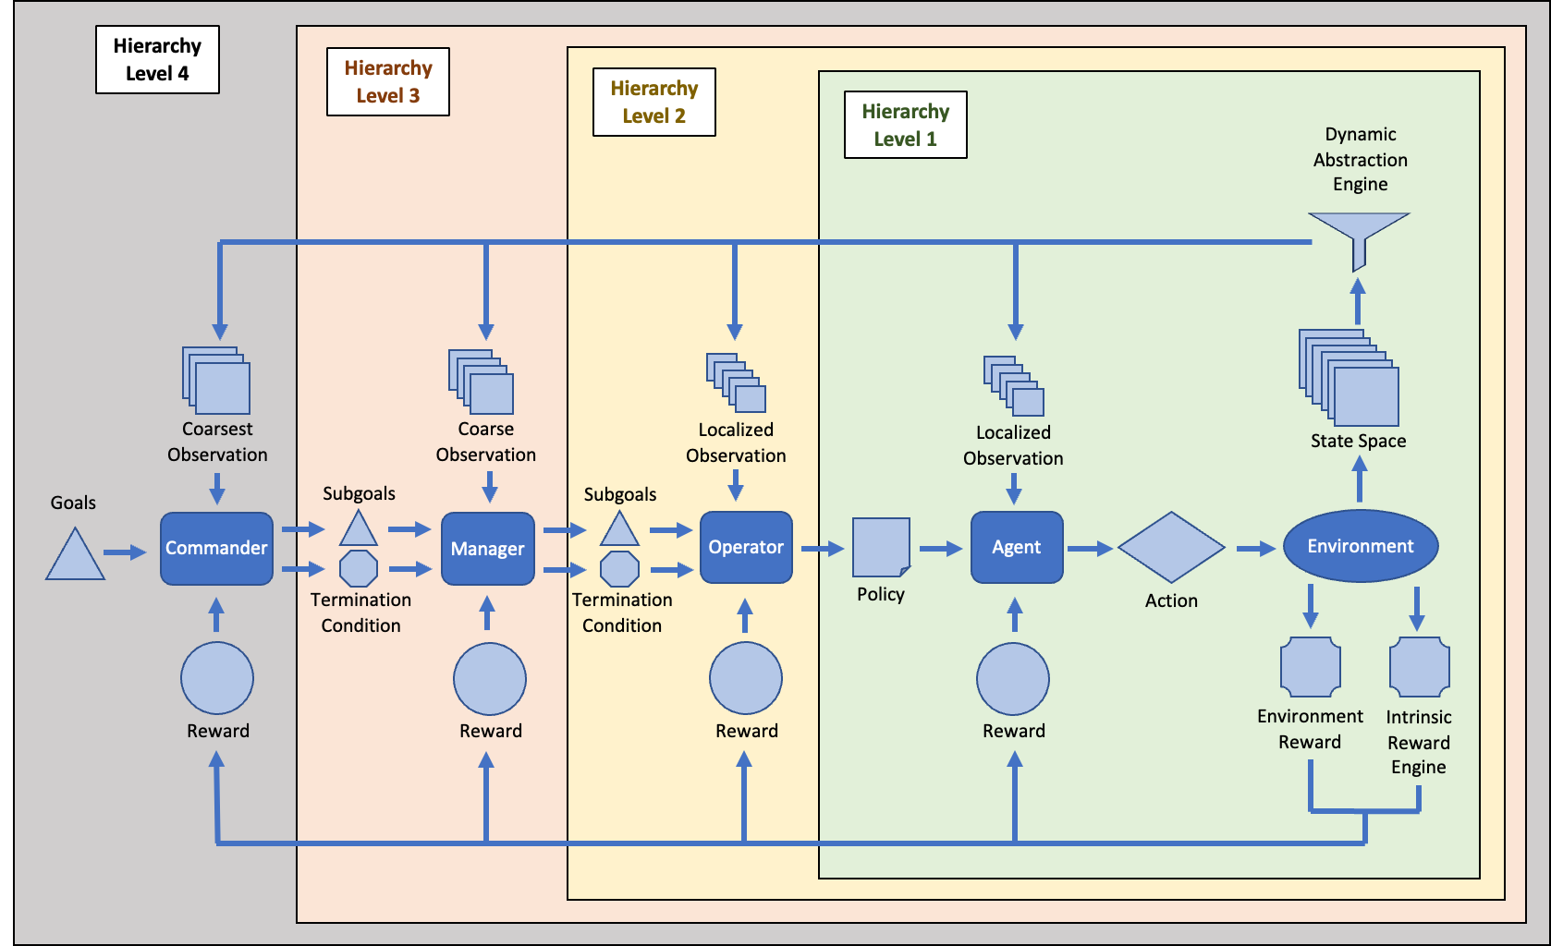
HRL Framework

Slide 11
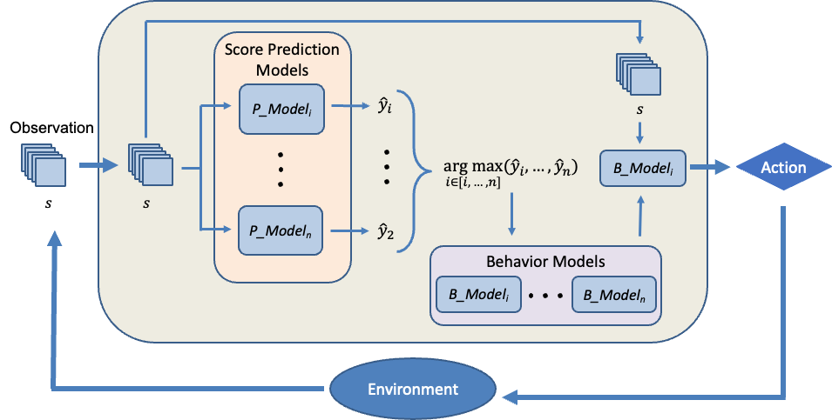
Multi-Model Framework
At each action-selection step, the multi-model receives an observation as input, and passes it to each of its score prediction models. Each score prediction model outputs a predicted game score, which is passed to an evaluation function. Based on this evaluation function, a behavior model is then selected. Finally, the original observation is passed to the selected behavior model and an action is output.
A multi-model approach improved the mean score by 62.6% over the mean game score of the best-performing single-model.
A multi-model with more embedded behavior models outperforms a multi-model with fewer behavior models.

Slide 12
Mean Scores Compared
Composition of Multi-Models
Multi (3)
Pass-Agg
Pass
Agg
Multi (4)
Pass-Agg
Pass
Agg
Burt-Plus
Multi (6)
Pass-Agg
Pass
Agg
Burt-Plus
RL-Boron
RL-Scotty
Multi (8)
Pass-Agg
Pass
Agg
Burt-Plus
RL-Boron
RL-Scotty
RL-S-Killer
RL-S-City
 | Scripted Agents |  |  |  | RL Agents |  |  |  | Multi-Models
 |  |  |  |  |  |  |  |  | Scripted Only |  | RL + Scripted
Model | Pass-Agg | Pass | Agg | Burt-Plus | RL-Boron | RL-Scotty | RL-S-Killer | RL-S-City | Multi (3) | Multi (4) | Multi (6) | Multi (8)
Mean Score | 68.96 | 74.96 | 42.99 | 80.28 | 21.82 | -11.47 | -18.22 | -103.28 | 82.81 | 93.83 | 125.49 | 130.54
Multi-Model (8) showed 61.8% better performance over the best single model

Slide 13
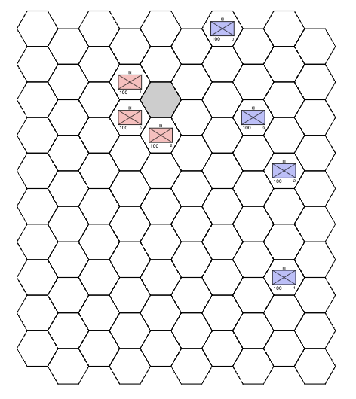
Abstraction Example
Global
State Representation
of Blue Force Channel only
(one of 17 total image channels currently)
Local 5x5
State Representation
of Blue Force Channel only
(one of 17 total image channels currently)
10x10 Scenario
0
0
0
0
0
0
1
0
0
0
0
0
0
0
0
0
0
0
0
0
Observation Centered on Agent On-Move
0
2
0
0
-1
0
0
0
0
0
0
0
1
0
0
0
0
0
0
0
0
0
0
0
0
0
0
0
0
-1
0
0
0
0
0
0
0
0
1
0
Inner Layer captures information next to agent as-is
0
0
1
0
-1
0
0
0
0
0
0
0
0
0
0
0
0
0
0
-1
0
0
0
0
0
0
0
0
0
0
Outer Layer captures all information outside of local 3x3
0
0
0
0
0
0
0
0
1
0
0
0
1
0
-1
0
0
0
0
0
0
0
0
0
0
*** Also experimenting with 7x7 and other dimensions
0
0
0
0
0
0
0
0
0
0
*Blue box represents agent on-move
Example scenario to demonstrate concept, but scenarios can be even larger
An extremely hard problem to solve as-is, and can quickly become an intractable problem for bigger, more realistic scenarios
Can potentially make any problem more tractable

Slide 14
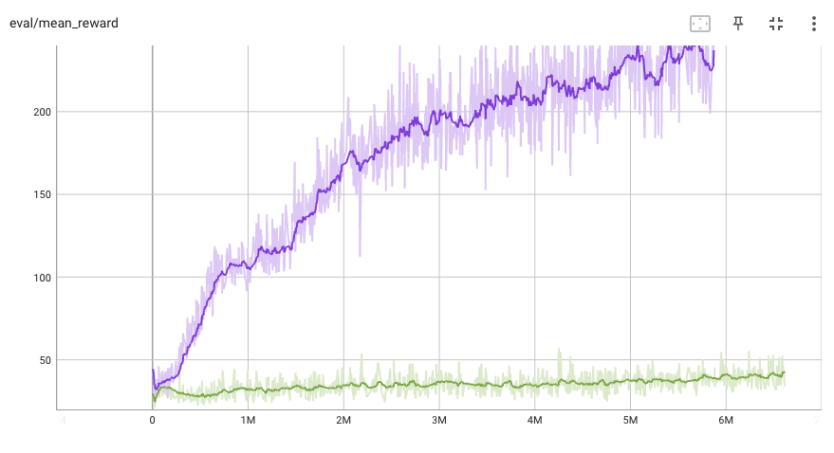
Comparing Global vs. Local Observation
On a 10x10 Scenario
Local 5x5 Observation
Global 10x10 Observation
Agent can learn using only a 5x5 observation of the 10x10 state space
Agent struggles to learn using the entire 10x10 observation of the state space
*** Training unfinished, running to 10M steps

Slide 15
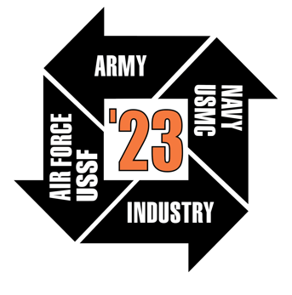



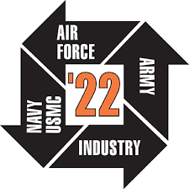







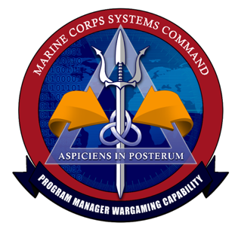
Research Accomplishments
Awards / Honors
Papers
Student Emerging and Disruptive Innovation Award
ITSEC 2023
Abstract
Selected for Paper
NeurIPS 2023
Paper Submitted
NATO M&S Group
Symposium 2023
Abstract Submitted
Research Fellowship
Expertise Contributions
Collaborations
CRADA
Collaboration
Pending new program
collaboration
Wargaming
Panel Member
Connections Wargaming Conference 2023
Panel Member
“The Future of Human Machine Teaming in Wargaming”
Report Reviewer
Collaboration
Digital Transformation
Panel Member
Collaboration
Potential Sponsor
AI for Wargaming Priority

Slide 16
Discussion
AI for Wargaming

