Slide 1
Sim Behavior AI
Chris Darken
23 May 2023
cjdarken@nps.edu

Slide 2
Agenda
Research goals
Obstacles
Approach
Recent results

Slide 3
Research Goal
AI-driven unit behavior in simulations for:
Cheaper and more available training
More accurate analyses
Faster wargaming and operational planning

Slide 4
Obstacles
Cultural
Lack of quantitative MoEs (and even rigorous mechanics)
Lack of adequate AI interfaces to DoD sims
Technical
Search space is vast. Current search methods are inefficient

Slide 5
Approach
How do we improve AI through better search?
Make better use of hardware (cluster computing)
Faster methods that search less, and only important states

Slide 6
Results
AlphaZero
STOMp
Ongoing student work

Slide 7
AlphaZero
Developed by DeepMind as a superior alternative to AlphaGo
Algorithm overview
Monte Carlo Tree Search-like algorithm
Neural net predicts best moves and their ultimate scores
Serial implementation fails except for smallest problems
Parallel implementations in work
Ray
Python multiprocessing

Slide 8
STOMp (Short-Term Optimal Maneuver)
Goal: sensible reflexive behavior
AI’s “mental model” is...
Targeting-free (all possible targets attacked)
Infinite ranging, but with exponential damage falloff
Moves to maximize current differential attrition
Model advantages
Zero behavior parameters to set
Low computation requirement
Advances and retreats opportunistically

Slide 9
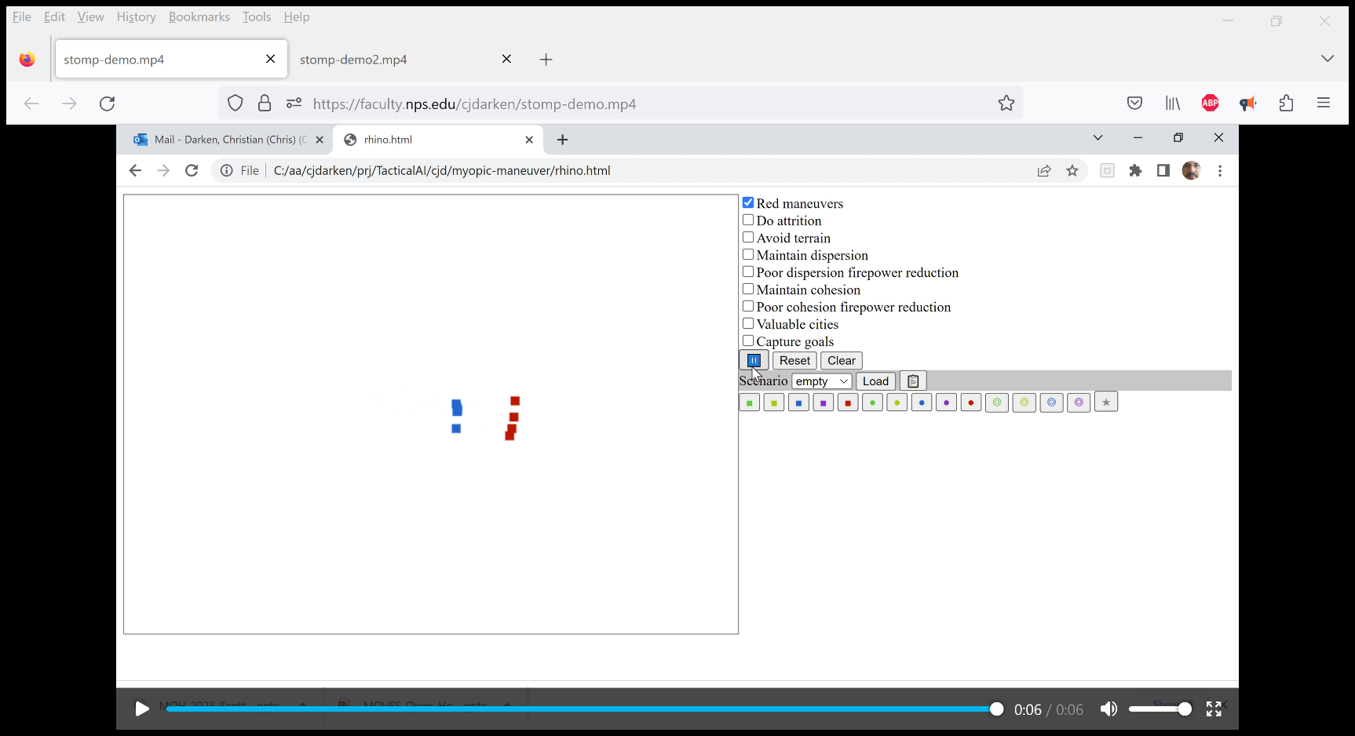
STOMp Demo
Link1 Link2

Slide 10
Recent Student Work
Master’s
Coble: multiple algorithms on multiple naval scenarios
Finley: parallelized and Bayesian RL, cloud deployment
PhD
Black: stay tuned!

Slide 11
Discussion
Sim Behavior AI

