Slide 1
Live Virtual Constructive Learning Laboratory
Mr. Christian Fitzpatrick
23 May 2023
Email: christian.fitzpatrick@nps.edu
Phone: (831) 656-6992

Slide 2
Agenda
Strategic Vision
Purpose of the LVC Learning Laboratory
Research Thrust Areas
Network Connectivity
Organization
LVC Workshop
Current Lines of Effort Supporting the Vision

Slide 3
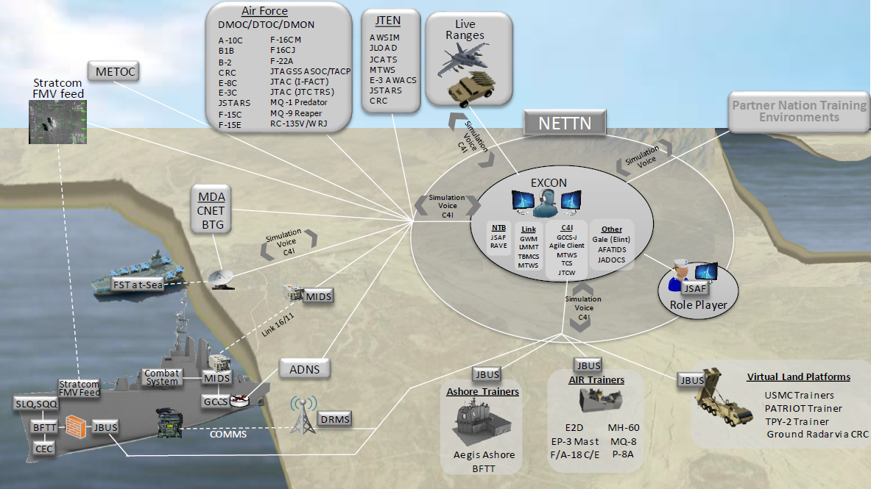
Strategic Vision
The strategic vision for the Naval Live, Virtual, Constructive (LVC) Learning Laboratory (LVCLL) is to provide the entire Naval Research Enterprise (NRE) a persistent forum to conduct early-stage research, development, test, and evaluation (RDT&E) of emerging naval concepts in a readily available integrated synthetic environment (ISE)
On and off campus, the LVCLL will become a distributed laboratory, classroom, and think tank where Sailors, Marines, Navy scientists, and industry partners can work together to build the future force
We are starting this process with MV4504 in the Winter

Slide 4
Purpose of the LVC Learning Laboratory
The purpose of the Naval LVCLL is to create a research, development, experimentation, and education crossroads for the Navy, Marine Corps, academia, and industry
Our focus will initially be on Project TRIPOLI, the Marine Corps Training and Education Command’s (TECOM) LVC-Training Environment (LVC-TE) development effort
We will be investigating the utility of Tactical Cloud Architectures and 5G Communications networks to support distributed LVC events during MV4504
Since it is a comprehensive M&S program that integrates all the major concerns of future large-scale enterprise M&S, it helps us identify our initial thrust areas that are universal across the armed services and industry within the DoD industrial base

Slide 5
Research Thrust Areas
Thrust Area I
Architecture and Interoperability
Open, modular, microservices architecture
Distributed Interoperability
C2 System Integration
Portability/Deployability
CLASSIFIED/UNCLASSIFIED Compatibility
Reconstruction/Playback
Government/Industry Collaboration
Thrust Area II
Operational and Environmental Content
Human Behavior Simulation
Whole Earth Multiscale Database
Integration of Real World Data
Composable Model Aggregation
Constructive Simulation
Live Sensing and Integration
Virtual Simulation
AR/VR
Autonomous Entities
Scenario Authoring
Cyber, EW, and Logistics Domains
Thrust Area III
Performance Assessment
Training Effectiveness
VV&A
Exercise Design
Wargaming
Automated AAR Analytics
Individual/Collective Feedback
Field Experimentation
Searchable Experiential Archives
Performance Assessment Tools

Slide 6
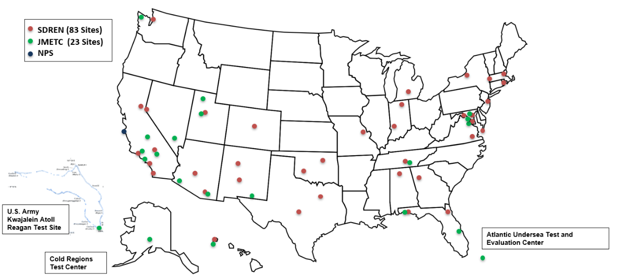
Network Connectivity
NPS will be on the SDREN in Dec 2023
First test will be with the Integrated Battlespace Arena (IBAR) at China Lake
I MEF is expecting connectivity at the end of FY23
This connection will allow MOVES to participate in future NILEX events

Slide 7
LVC Learning Laboratory
The LVCLL will enhance collaboration by conducting sponsored research within three research thrusts: Architecture and Interoperability, Operational and Environmental Content, and Performance Assessment
Sponsored research will be enabled through the execution of five (5) joint projects between NPS and industry, 5 projects between NPS and Naval Labs, and two (2) projects between NPS and academia
The projects must support one of the research thrusts mentioned above
Each will be funded for $200,000 through a $2.4M allocation of funds for the Naval LVCLL from a Fleet sponsor
The funds will be distributed based on a review of submitted proposals which will be requested 4 months prior to the beginning of the fiscal year (FY)

Slide 8
LVC Learning Laboratory
The MOVES Director will lead the Naval LVCLL and will report significant events, Fleet engagements, and research progress quarterly to the NPS President
The Naval LVCLL Advisory Board will support the MOVES Director with project selection, Fleet integration, and sharing RDT&E findings across the services
The Advisory Board will be chaired by the Commanding General, TECOM and Deputy Chief of Naval Operations for Warfighting Development, N7
Other representatives include the Navy Modeling and Simulation Office (NMSO), the Marine Corps Modeling and Simulation Management Office (MCMSMO), Office of Naval Research (ONR), Marine Corps Warfighting Lab (MCWL), and the Naval Warfare Studies Institute (NWSI)
The Naval LVCLL will publish an annual report providing an overview of funded research executed during the previous FY.

Slide 9
Upcoming LVC Workshop
Planned to host LVC community leaders across the Fleet to begin the development of a focused Science and Technology (S&T) Master Plan for the execution of LVC events in the testing, training, and evaluation communities
We anticipate this to be an annual event where the LVC community can meet to discuss current projects, on-going research, and actual TT&E events in an effort to update the LVC S&T Master Plan
We seek to use this document to guide student thesis and dissertation selection
In addition, we will try to align the workshop with end-of-year reporting on the 12 research projects planned for the LVCLL
We have been working on building content for the LVC Workshop in MV4460 Management of Modeling & Simulation Development
Definition of LVC: A set of integrated, interoperable simulation tools including live, virtual, and/or constructive components to meet joint and coalition testing, training, and evaluation needs, developed to create more collaborative, economical, safer, and secure conduct of events.

Slide 10
FY22-23 Projects
ONR Tech Solutions Project #913: Small Unit Mission Planner (Dr. Blais and Major Hickey)
NPS-23-N255: Improving Identification of Ship Tracks Using a Data Driven Approach (Dr. Balogh)
NPS-23-M197A: Enhancing the USMC VTOL Family of Systems (Mr. Scot Miller)
Systems Engineering Capstone: Assessing Pilot Task Saturation in the Future Vertical Lift (FVL) during Expeditionary Advanced Base Operations (EABO) (Dr. Bonnie Johnson)
Modeling the Value of Naval Presence (Dr. Jerry Hendrix and Dr. Balogh)
CRUSER: Interactive Synthetic Environment (ISE) to Evaluate Zero-Carbon UAS Launch Platforms in the Arctic (Dr. Dew and Dr. Balogh)
NMSO: Integrated Naval Testing, Training, and Evaluation Environments (Dr. Balogh)

Slide 11
FY22-23 Projects
Operational Energy Capability Improvement Fund (OECIF): Airship Deployment for DoD Missions in a Contested Battlespace (Mr. Chris Fitzpatrick)
Operational Energy Capability Improvement Fund (OECIF): Tactical Cloud Architectures and 5G Communications for Distributed Live Virtual Constructive Training Environments (Mr. Chris Fitzpatrick)

Slide 12
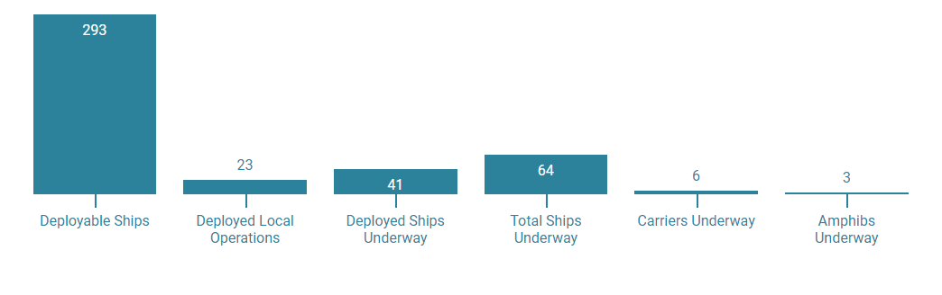
Modeling the Value of Naval Presence
The US Navy has a long-standing, global mission to “defend freedom, preserve economic prosperity, and keep the seas open and free” (US Navy, 2022)
This is no small task and requires the keen management of both time & space and resources & their allocation
Consider a simple metric; there are 134 million square miles of ocean in the world (Roger Williams University, 2022). This will only increase by mid-century when we anticipate the Arctic Ocean to be ice-free and fully trafficable in the summer months adding an additional 5 million square miles to patrol (Kramer, 2021)
The Chief of Naval Operations (CNO) must provide naval presence in these areas with a limited sized Fleet of surface ships
Status of US Navy Ships Underway as of 15 Dec 2022 Source US Navy, 2022

Slide 13
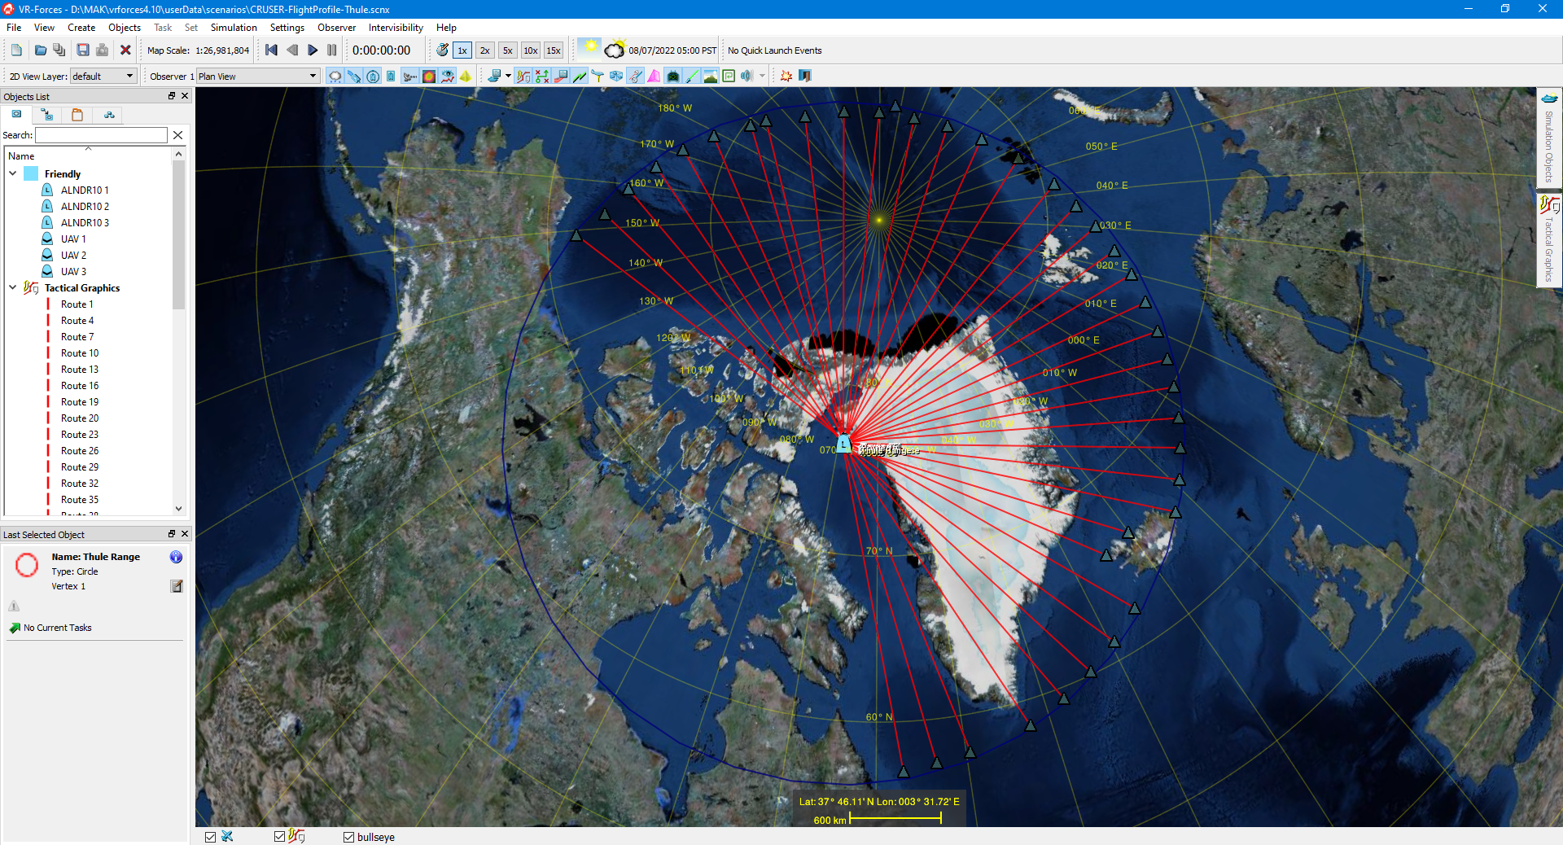
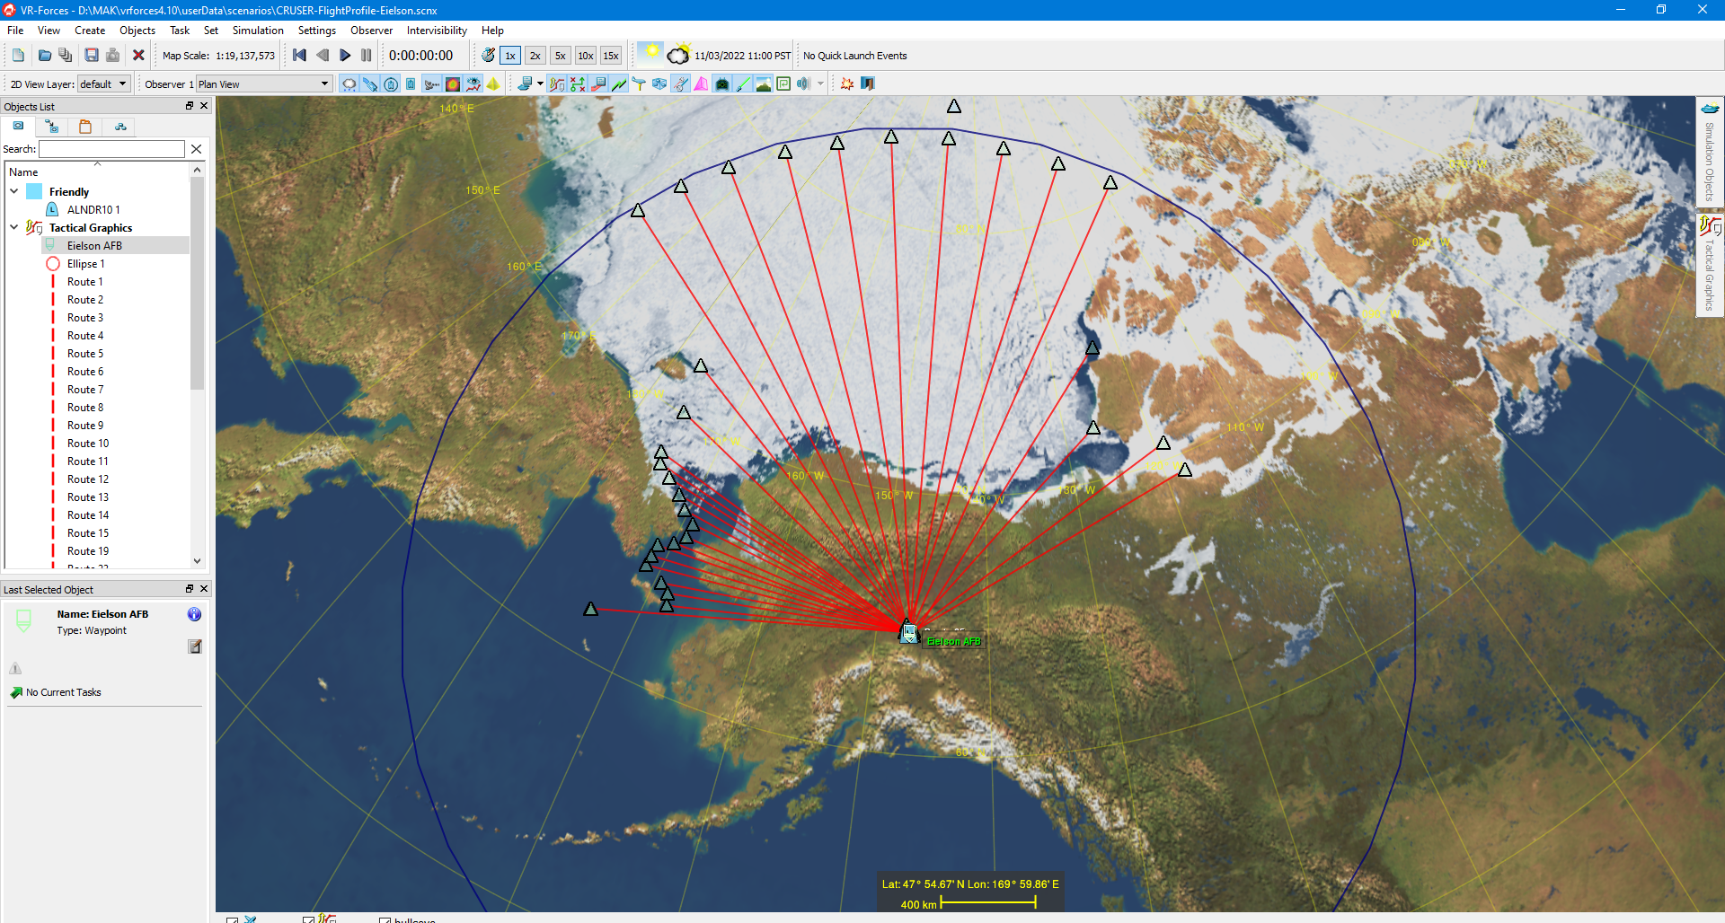
Interactive Synthetic Environment (ISE) to Evaluate Zero-Carbon UAS Launch Platforms in the Arctic
Simulation of Operations from Thule AB
115 possible routes
Find the best force mix of Airlander 10s and Scan Eagles to support naval surface presence
Simulation of Operations from Eielson AFB
77 possible routes
Find the best force mix of Airlander 10s and Scan Eagles to support naval surface presence

Slide 14
Integrated Naval Testing, Training, and Evaluation Environments
Filters Radar Specific Messages from the Federation and translates them into WDW or PDW messages for transmission to a Live Range
Fleet Training Use Case Assessment
Fleet Test & Evaluation Use Case Assessment
Lab Creation
Proof of Concept Event
Joint Simulation BUS and Architecture Management Integration Environment Assessment
RTI-S
All messages
NASMP to WDW/PDW Plugin
WDW/PDW to NASMP Plugin
Published messages
Published messages
WDW from WDW.xml
Subscribed messages
Subscribed messages
PDW (MIDAS 6000, SMW200A, FCP)
WDW
PDW
Threat System Emulator
Simulation modeling Blue Air (2 x F-35)
Simulation modeling Red SAM Radar Site

Slide 15
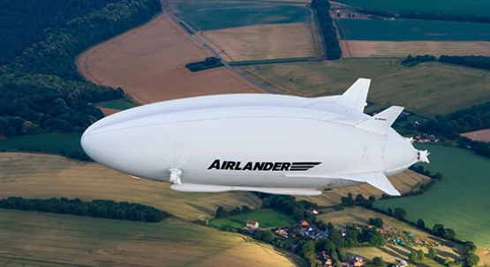
Airship Deployment for DoD Missions in a Contested Battlespace
For this work, we will be modeling the Airlander 10 and Airlander 50 in various combat simulations to evaluate their utility in the conduct logistics operations and intelligence, surveillance, and reconnaissance (ISR) missions
We will also be supporting Hybrid Air Vehicles (HAV) in developing Virtual Reality (VR) applications showing how logistics operations would be conducted in a contested battlespace

Slide 16
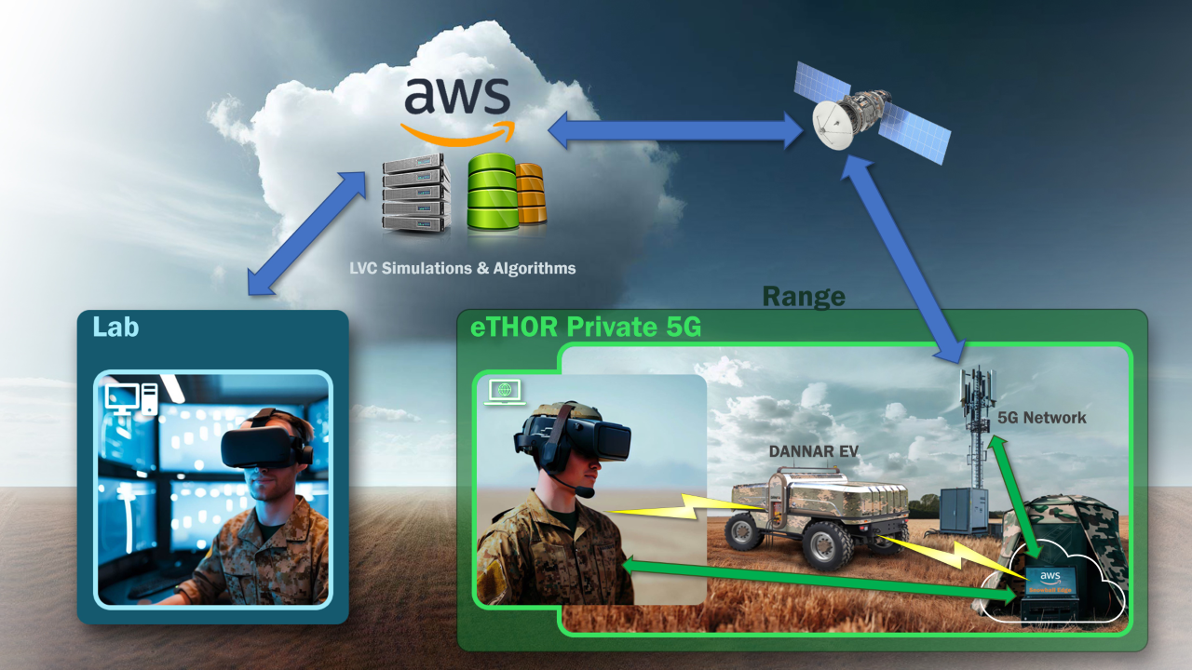
Tactical Cloud Architectures and 5G Communications for Distributed Live Virtual Constructive Training Environments
This research is intended to develop key performance parameters (KPPs) for network architectures in degraded environments
This work will be done in coordination with MV4504 Design and Implementation of LVC Environments
We will leverage the AWS CRADA
Funded via ONR Next Step

Slide 17
Questions

