Slide 1
Change Agent
Eric Heine
24 May 2023
erheine@nps.edu

Slide 2
Agenda
Technical Details
Adapting the Design
Development Concerns
Discussion

Slide 3
Technical Details
Unity WebGL Client
Server
NodeJS
In-Memory Database
Websockets for Communication
Notes:
Why did we pick Unity?
Previous experience taught us Unity is easier to draw/manipulate networks with
Allows us to make more interesting 2D/3D composite visuals
Why no database?
Games are meant to be temporary
Issues caused by server restart when client is still in a game
Why websockets?
Live communication between server and clients
Allows server signals to clients without constantly polling
Players can chat with each other during a game

Slide 4
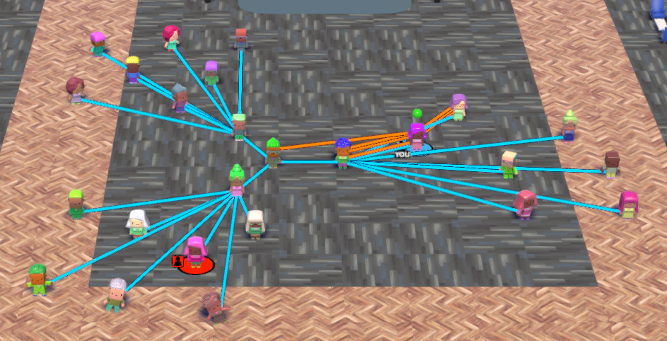
Adapting the Design: Building A Network
Notes:
Positions generated based on organization position

Slide 5
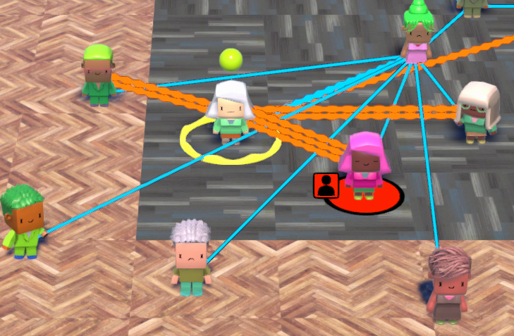
Adapting the Design: Building A Network
Notes:
Informal connections based on position

Slide 6
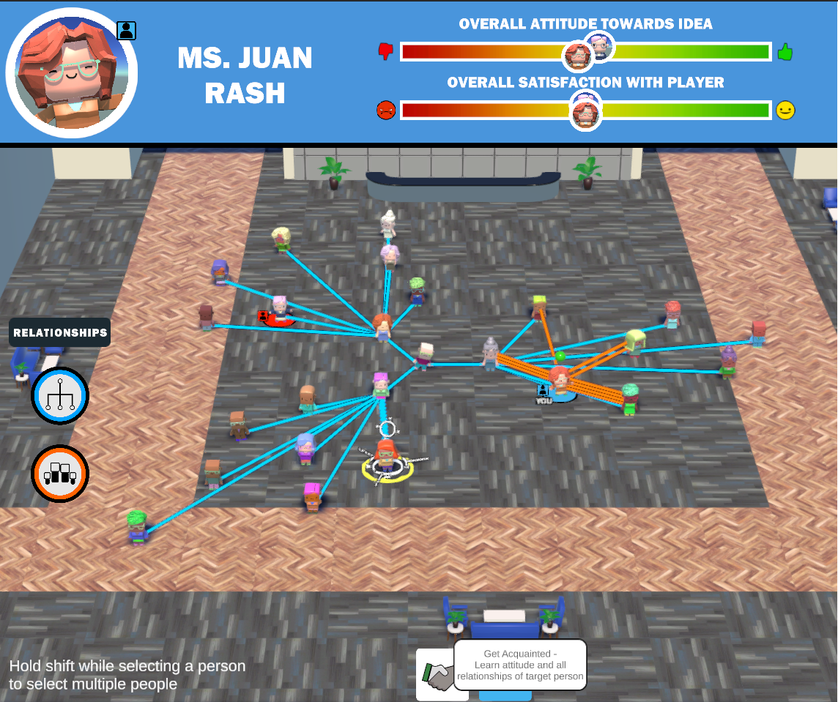
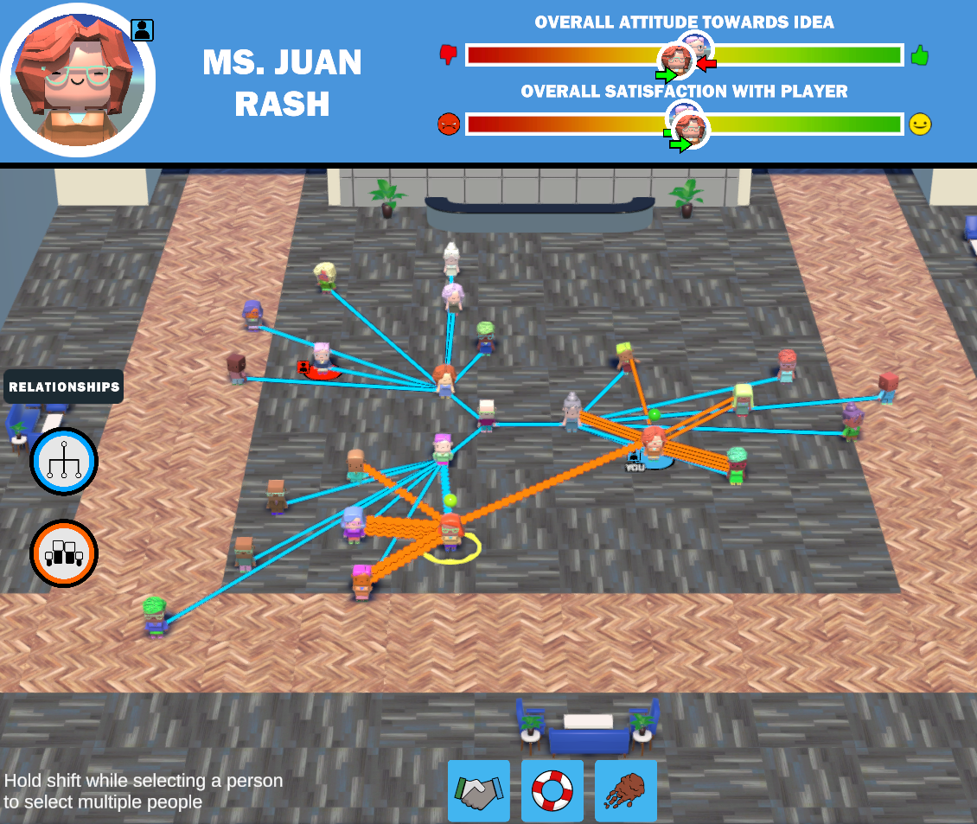
Adapting the Design: Generic Actions
Notes:
Network Discovery actions

Slide 7
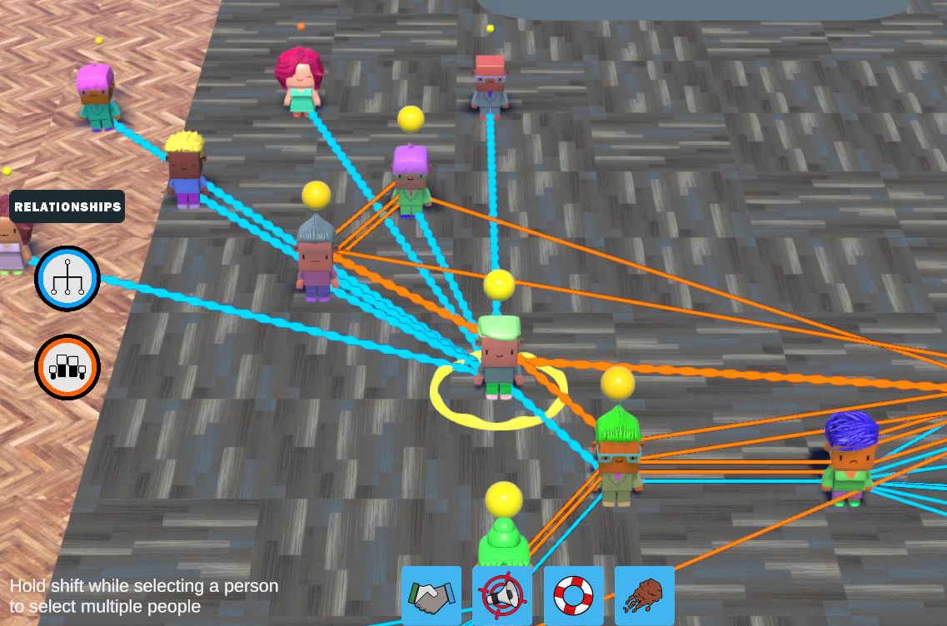
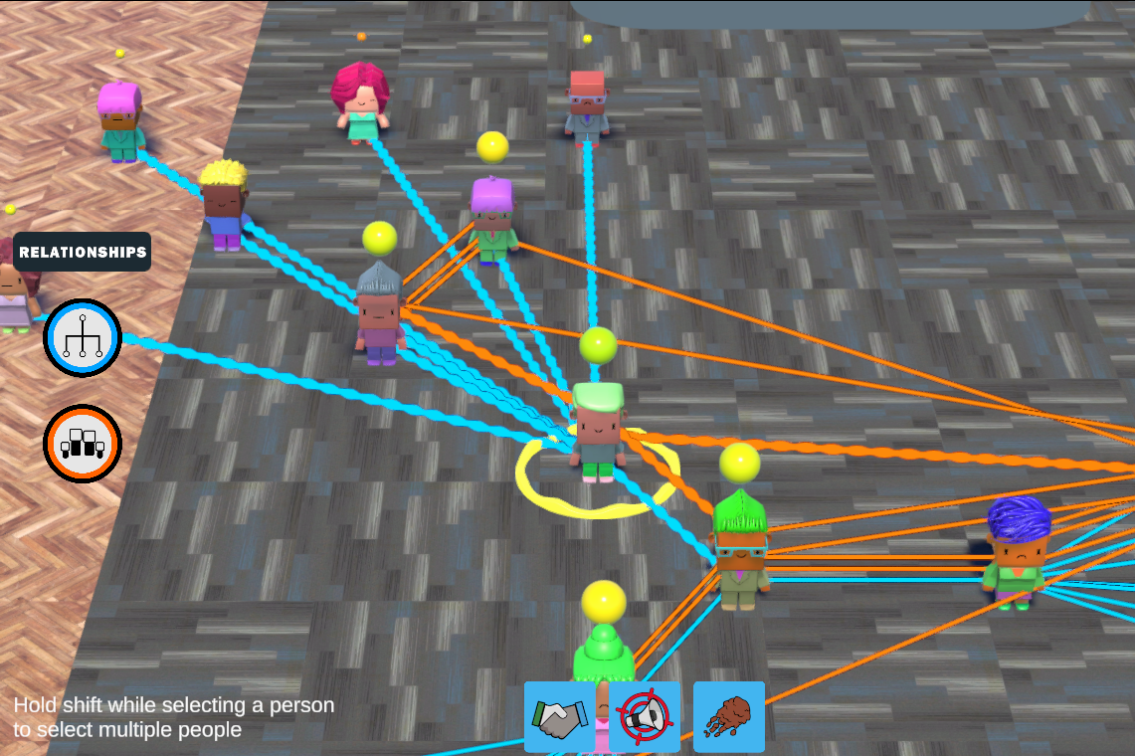
Adapting the Design: Generic Actions
Notes:
Attitude/Satisfaction Adjustment Actions

Slide 8
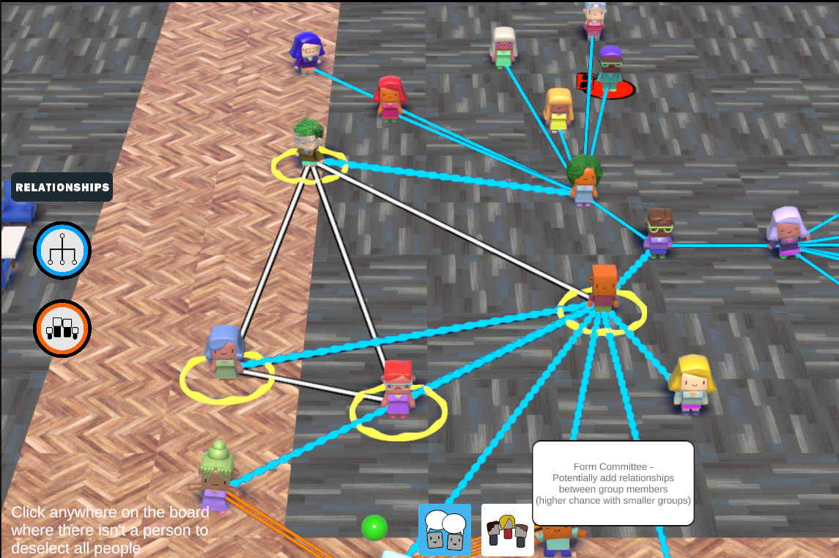
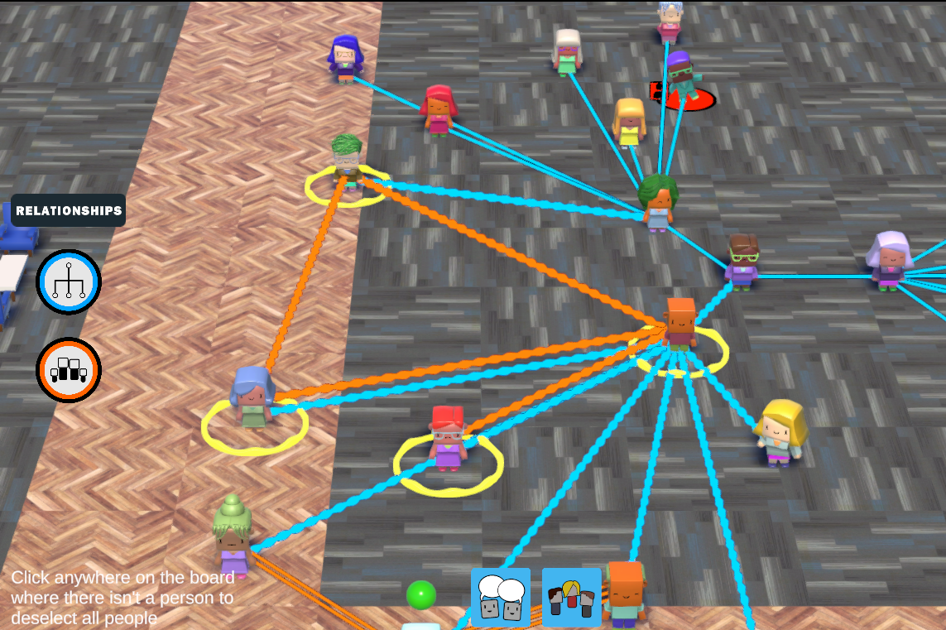
Adapting the Design: Generic Actions
Notes:
Network Modification Actions

Slide 9
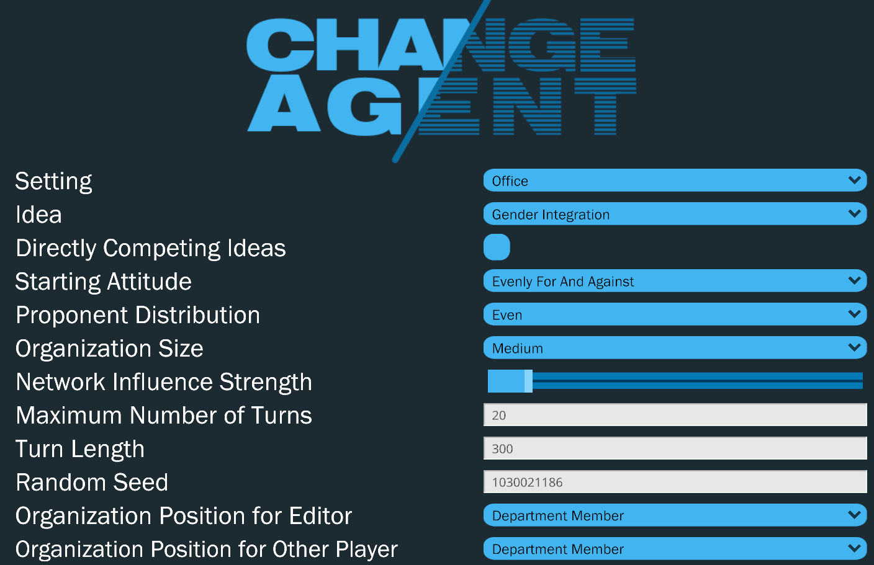
Adapting the Design: Customization

Slide 10
Development Concerns: Visual Style
Accessible
Flexible
Customizable

Slide 11
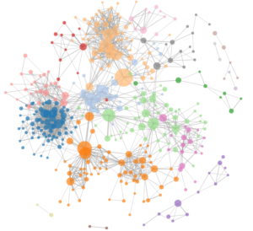
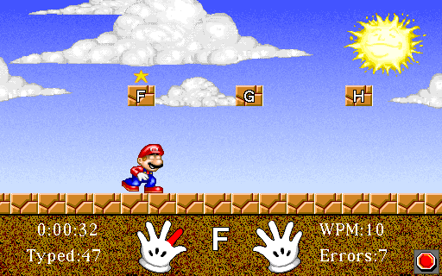
Development Concerns: Edutainment
Too Real
Too Gamey
Notes:
Talk about training “games”

Slide 12
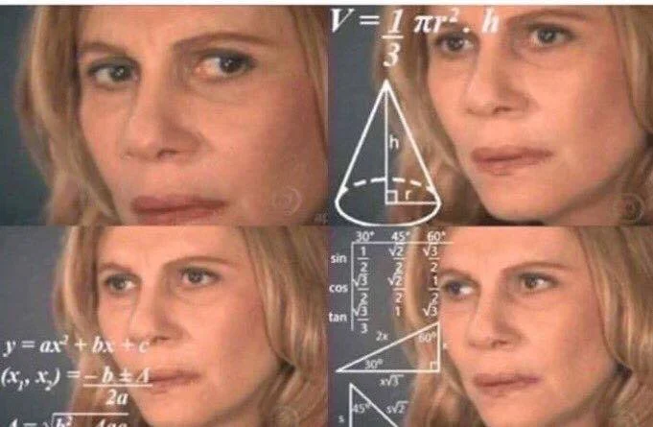
Development Concerns: Complexity
Notes:
Random Events
Network Influence Update

Slide 13
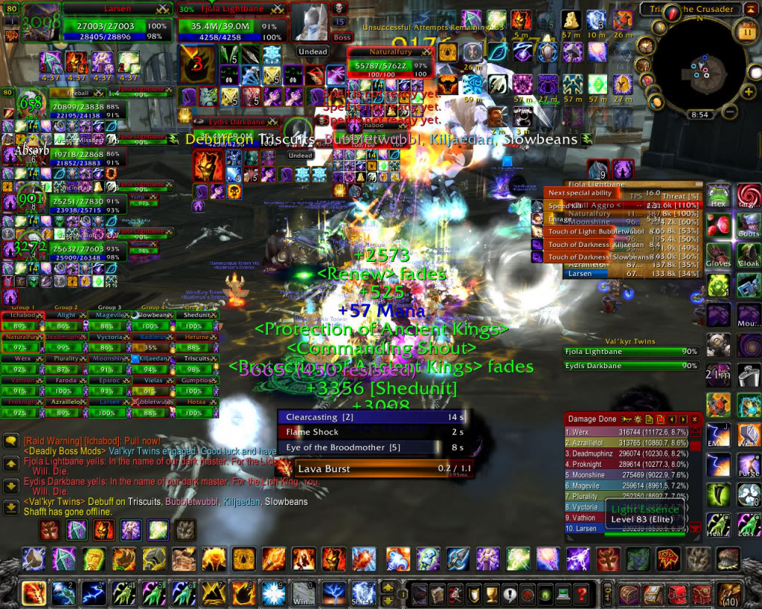
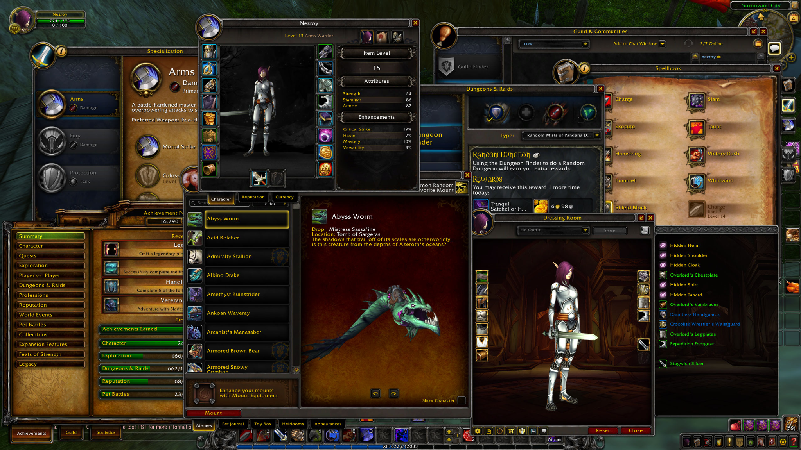
Development Concerns: Visualizations
Too Much Information
Buried Information

Slide 14
Development Concerns: Testing
Notes:
Bug caused by testing only one game at a time on the server vs. real use case of multiple games at once

Slide 15
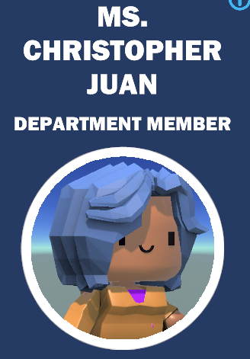
Development Concerns: Fun Time Sinks
Name Generation

Slide 16
Let’s Discuss
Change Agent

Slide 17
Backup Slides

Slide 18
Student Thesis Presentations
Intent
Show the range and scope of student thesis research
Highlight student contributions to the field of Modeling and Simulation
Give students a chance to present their work to a room full of M&S professionals and receive feedback.
Format/Outline
Title Slide
Problem Statement
Background
Approach
Results
Future Work
Time Limit
20 minutes each
15 minutes presentation
5 minutes questions

