Slide 1
Change Agent A New Game about Changing Minds and Behaviors
Concepts: Deborah Gibbons
Art: Ryan Lee
Program: Eric Heine

Slide 2
Change Agent
Change is hard
We need smart, strategic leadership to
Promote innovation
Diffuse new technologies
Propagate American values
Change Agent helps students balance formal mechanisms and informal social influences to make desired changes.

Slide 4
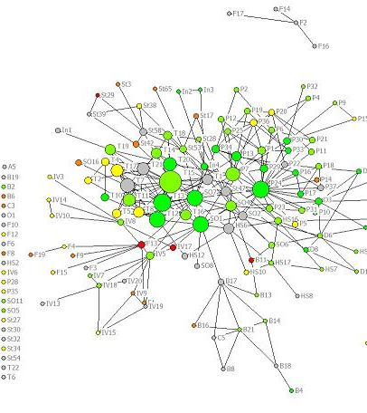
Key Concepts
Change agents must work with formal and informal social structures
Informal networks carry information and attitudes that formal networks don’t
Network structure affects diffusion of information and attitudes
Leadership interventions affect network structures
Strategic use of social networks can increase diffusion and adoption of ideas, practices, and innovations

Slide 5
Learning Points about Social Capital
Social capital increases when
you build relationships with others
your relationships place you in gatekeeping roles
your relationships give you access to a variety of different social groups
you connect with people who are connected to many others

Slide 6
Example Activity Before Playing Change Agent: Groups Strategize a Desired Change
Multi-session activity addressing:
Stakeholder analysis
participation in focus groups and committees
Educate them with facts and stories
Attention to stakeholders’ identities, values, and concerns
Framing persuasive messages in terms of their interests
Recruiting respected people to promote the desired change
Seeking collaborative solutions

Slide 7
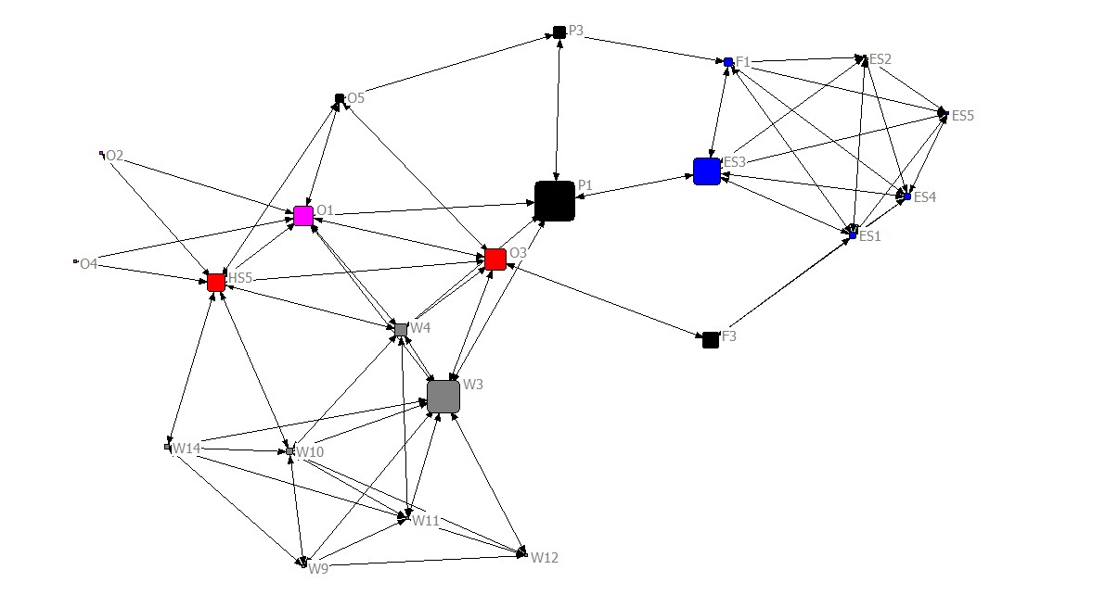
Example Discussion Before Playing Change Agent: Finding Influencers, Building Influence in a Network
Where are the gatekeepers?
Who has ties to influential people?
If you want to spread a new idea, which people will you talk with first? Why?
Which people might you introduce to each other to improve the communication capacity in this network? Why?
State organization, nodes sized by betweenness

Slide 8
Game Modes and Scoring
Gender integration scenario:
Each team starts with a separate organization, promotes gender mainstreaming in their organization
After several rounds, teams compare their performance with other teams
New technologies, disparate political perspectives, nations vying for influence with a local population:
Multiple teams promote their own ideas/technologies in the same social system
Performance of all players appears at each turn
Final scores provide direct comparison of performance
Scoring:
Percentage of people in the system who support each player’s objective
Percentage of people who are satisfied with each player

Slide 9
Playing Change Agent in a Class

Slide 10
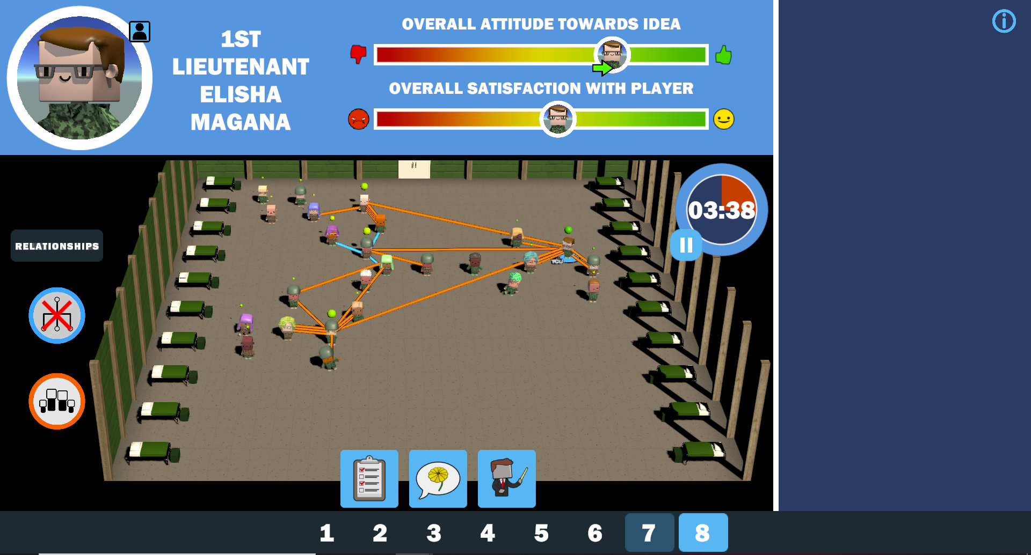
Introducing Change Agent
A Serious Game
about Leading Change

Slide 11
Practice Strategic Network Development
Greater social capital -> greater ability to influence the social system
Foster social ties connecting proponents with less enthusiastic people
Build your own relationships
Become a boundary spanner
Connect with influential people

Slide 12
Practice (Light) Use of Formal Mechanisms for Change
Use formal structures and processes to disseminate new ideas
Leaders can communicate with members via memos, videos, or presentations
Members may be required to attend training sessions
New ideas may be promoted through group chats, posters, newsletters, official websites, or other channels where members of the organization obtain information
Check attitudes toward the new idea
Organizational survey
Focus group discussion
Use available mechanisms strategically to build out the informal network
Proximity in focus groups or committees builds ties

Slide 13
Identify and Recruit Help from Informal Influencers
Talk to people in the organization about the new idea
Influencers who have many positive relationships
People who hold decision-making positions
Influencers who don’t like your idea
Ask people who favor the idea to share it with their friends
Especially important to introduce your idea to different parts of the organization
[Spread negative information about competing ideas]

Slide 14
Debrief Questions
(Highest performers): Please explain your strategy
How can we use the informal network to spread ideas?
How much should we rely on formal training and messaging?
How did you
improve the diffusion capacity of the network structure?
identify appropriate partners to spread the word?
align the informal network with formal mechanisms for spreading ideas?
What mistakes did your team make? How would you do better next time?
How can we apply the principles of Change Agent to the Department of Defense?

Slide 15
Current Status
We’ve tried it a few times in classes.
The game seems to be effective and engaging.
Let’s hear from Eric about how the program works.

