Slide 1
MOVES Curriculum Status
MOVES Open House
May 2023
C. Darken

Slide 2
Why a Modeling & Simulation Master’s?
Skilled application of M&S is a critical capability for a modern military organization
Training: to control cost and increase availability
Analysis: to support planning and decision-making of all kinds
Short-course training in M&S is possible and necessary, but...
Cutting-edge military M&S is a moving target!
Requirements always changing (training focus, adversary, mission, weapons)
Technology always changing
M&S Master’s education produces officers that can respond more rapidly to change

Slide 3
Special Properties of MOVES Master’s
Technical (hands-on labs, project, practica)
Does not require deep technical experience for admission
Teaches using examples that are military and M&S where possible

Slide 4
MOVES Master’s Student Requirements
All students must start Summer Quarter (beginning of July)
Students should have:
Good grades in previous studies
Math up to single-variable calculus, preferably recently
Technical bachelor’s degree recommended, but not required
Program runs for 24 months
Fixed course schedule (“matrix”)
Thesis is required

Slide 5
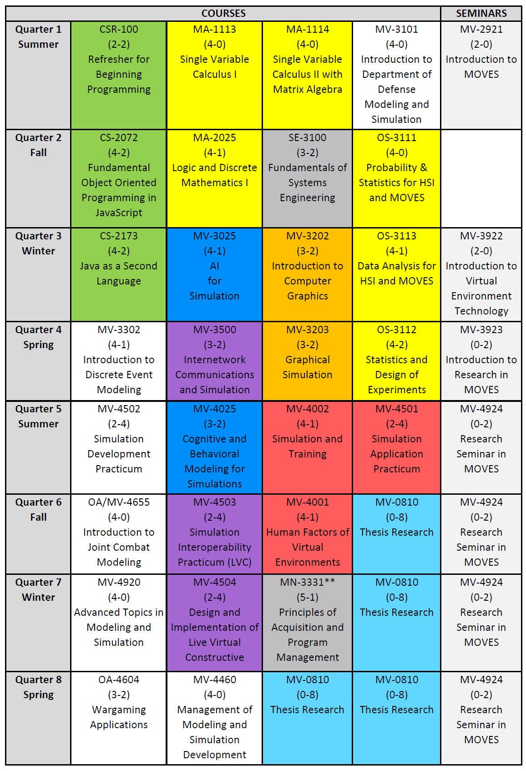
MOVES Curriculum Contents
A technical degree: broad, but with plenty of hands-on experience (labs, projects, practica, thesis research)
Four full courses each of eight quarters plus seminars
Math and statistics (6)
Programming (3)
Core M&S (7)
Computer graphics (2)
Artificial Intelligence (2)
Networking/interoperability (3)
Human factors (3)
Other (systems eng. and acquisition) (2)
Thesis research (4)

Slide 6
Curriculum Status
Face-to-face meeting happened during last Open House
Curriculum revision plan was approved by the sponsor (LtGen Heckl USMC) in September 22
Plan included nine items, most notably the creation of two new courses
MV4504 Design and Implementation of LVC Events has been approved by the Academic Council. First offering will be AY23-24.
MV4920 Advanced Topics in Modeling and Simulation is in work, but delayed due to Imre’s extension as Director. First offering also AY23-24
Smaller items are on track, some completed, some in-work
MV3500 is back! Had previously been suspended due to budget issues

Slide 7
Questions?

Slide 8
Reserve Slides

Slide 9
Plan by Knowledge Item (Part 1 of 2)
Environmental Models: Current capabilities and limitations of DoD environmental representations. Required Bloom’s Level: 5
Plan Will be covered in a syllabus to be created for a new section of MV4920 (to replace MV4657). The list of knowledge items to be covered by this section is in a separate document.
Terrain, Vegetation, Cultural, Weather: Level of fidelity, destructible terrain, underground, maritime, aviation, cover and concealment, mobility impacts, CBRNE representations. Required Bloom’s Level: 4
Plan: Will be covered in a syllabus to be created for a new section of MV4920 (to replace MV4657). The list of knowledge items to be covered by this section is in a separate document.
Physics Based: Capabilities and limitations of physics based vs. simplified models. Required Bloom’s Level: 5
Plan: Compare physical to simplified models in both CS2072 and MV3203. Will be covered in a syllabus to be created for a new section of MV4920 (to replace MV4657). The list of knowledge items to be covered by this section is in a separate document.
Software design: Software applications developed according to a software specification including model, view, controller GUIs (row 67, Required Bloom’s Level: 5
Plan: Add material on software requirement specifications to MV4460, including additional coverage of soft skills like informally analyzing a testing plan by asking questions about it
Conceptual Model: Creation and communication of a conceptual model from a software specification that can be 'validated' by non-software experts as an adequate representation of the concept. Required Bloom’s Level: 6
Plan: Add material to MV4502 on comparison of conceptual models. All courses with a model design or implementation project should require a conceptual model as one deliverable. (List of such courses? Can Brett share conceptual models from wargaming center project?)
Analysis of Alternatives: Evaluation of the strengths and weaknesses of existing software applications to meet a given software specification, include the ability to modify existing solutions. Required Bloom’s Level: 5
Plan: Coverage in MV4460 is believed to be adequate (includes developing a pitch for new software including an analysis of buying new versus existing solutions), but coverage will be changed to emphasize the specific terminology used in the KIs.

Slide 10
Plan by Knowledge Item (Part 2 of 2)
Developmental Testing: Best practices in development testing (unit testing, regression testing, etc.) Required Bloom’s Level: 5
Plan: Refresh relevant terminology in MV4502. Reinforce coverage in MV4460. Emphasize that unit tests are happening routinely in CS2072 and MV3202 automated homework grading.
Collective Training (including staff training via C4I): Special requirements of staff collective environments and simulations that stimulate C4I staff systems. Required Bloom’s Level: 6
Plan: Coverage inspired by AMSO course materials will be added to MV4503
Wargaming (Seminar, Simulation Supported): Manual wargames planning and execution, and simulation support for larger wargaming efforts. Required Bloom’s Level: 6
Plan: Simulation use as a wargaming adjudicator will be covered in a syllabus to be created for a new section of MV4920 (to replace MV4657). The list of knowledge items to be covered by this section is in a separate document. (Can USMC consider sponsoring a special project for MOVES students for OA4604?)
Distributed Simulation: Protocols and libraries for simulation (HLA, DIS, TENA) and voice data. Required Bloom’s Level: 6
Plan: (Consider additional interoperability course with sponsor deliverable to follow MV4503 to be taught when related research is funded)
Live-Virtual-Constructive Integration: Conceptual and technical interoperability across live, virtual, and constructive simulations. Capabilities and limitations engendered by connecting any two of the architectures to include augmented reality. Required Bloom’s Level: 5
Plan: (Consider additional interoperability course with sponsor deliverable to follow MV4503 to be taught when related research is funded)
Disruptive technologies and innovation: Identification of the realm of the possible, imminent disruptive technologies as opposed to those requiring significant technology development Required Bloom’s Level: 6
Plan: Add technology readiness level estimation to MV4460

Slide 11
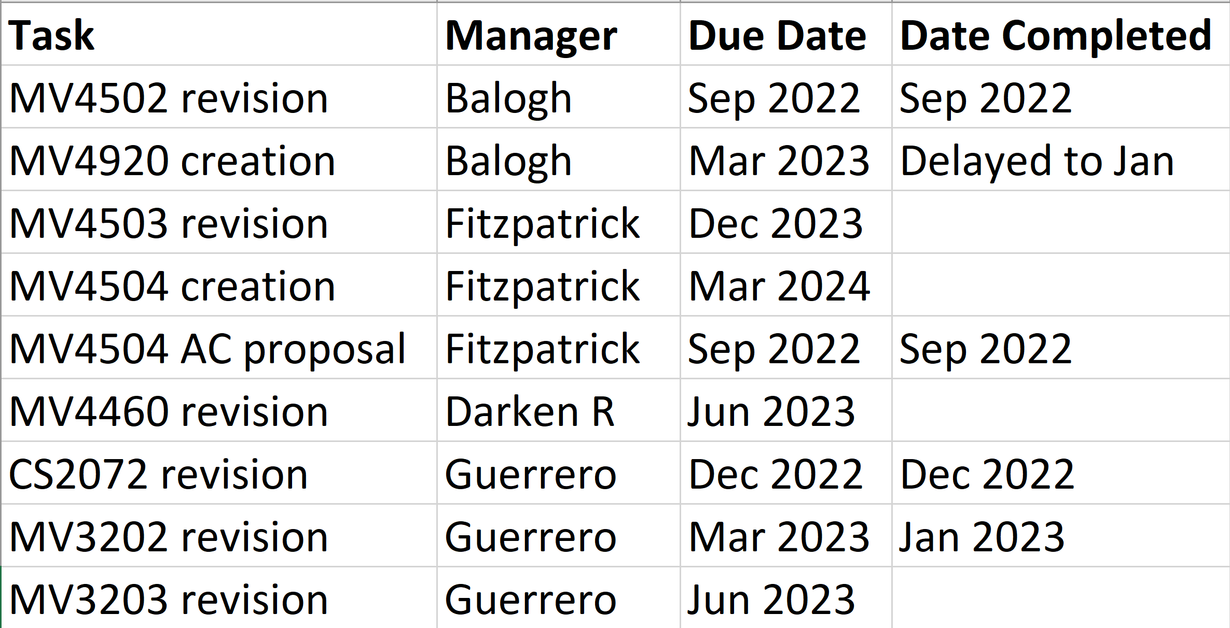
Plan Execution Status
On schedule, with one unavoidable delay

Slide 12
Extras: Modification Plan by Course Number

Slide 13
Plan Summary Breakdown by Course #
MV4920 Advance Topics In MOVES.
A new section of MV4920 (advanced topics) will be created to cover multiple knowledge items needing additional material (social, environmental, military process and system modeling as well as simulation use in adjudication in support of wargaming). The new MV4920 will replace MV4657 in the matrix. MOVES staff should survey current models to provide course material.
MV4XXX (New Interoperability Course).
A new interoperability course to follow MV4503 that provides a sponsor-specified deliverable. To be taught when corresponding research funds are available and incorporate cyber for simulationists so as to replace CS3600 in the matrix.
MV4460.
Add material on software requirement specifications, including additional coverage of soft skills like informally analyzing a testing plan by asking questions about it.
Emphasize the specific terminology in this KI when covering related material: Evaluation of the strengths and weaknesses of existing software applications to meet a given software specification, include the ability to modify existing solutions.
Add material on technology readiness level estimation
No Recommended ESR Updates

Slide 14
Plan Summary Breakdown by Course #
CS2072.
Compare physical to simplified models
Emphasize that unit tests are happening routinely in automated homework grading
MV3202.
Emphasize that unit tests are happening routinely in automated homework grading
MV3203.
Compare physical to simplified models.
MV4502.
Add material to on comparison of conceptual models
Refresh terminology relevant to best practices in development testing (unit testing, regression testing, etc.)
No Recommended ESR Updates

Slide 15
Plan Summary Breakdown by Course #
MV4503.
Add coverage of collective training (including staff training via C4I) based on AMSO course materials
Modify coverage to compensate for lack of MV3500
CS3052.
Investigate possibilities for augmentation by MOVES faculty to compensate for lack of MV3500
No Recommended ESR Updates

