Slide 1
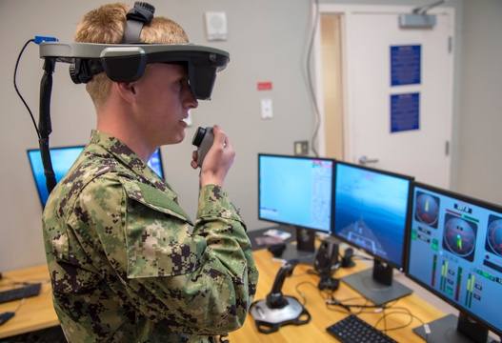
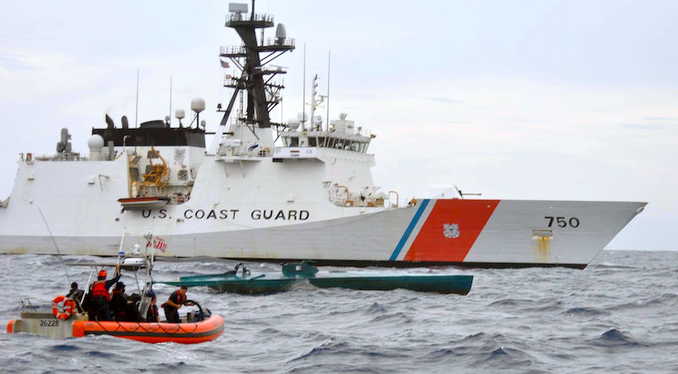
Utilizing Virtual and Augmented Reality to Augment Real World Operational Training to Improve Proficiency
25 May, 2022
Dr. Amela Sadagic and Dr. Douglas Van Bossuyt
asadagic@nps.edu, douglas.vanbossuyt@nps.edu

Slide 2
outline
Project basics
Tasks & Progress
Data Collection
Field Visits
Solution Space

Slide 3
Project basics

Slide 4
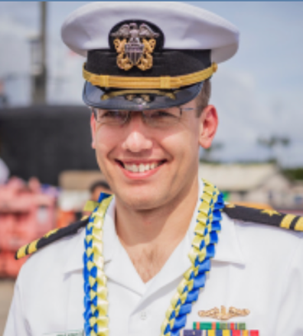
Project Team
Topic sponsor: Dr. James McGee, ONR
USCG POCs: Dr. Joseph III Direnzo and Rob Riley, USCG Research and Development Center
NPS research team:
Dr. Amela Sadagic
CS Deptartment & MOVES Institute
asadagic@nps.edu
https://faculty.nps.edu/asadagic
Dr. Douglas Van Bossuyt
SE Department
douglas.vanbossuyt@nps.edu
https://nps.edu/faculty-profiles/-/cv/douglas.vanbossuyt
Student: LT Steven Arnold
SE Department
steven.arnold@nps.edu

Slide 5
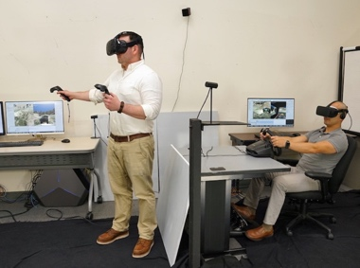
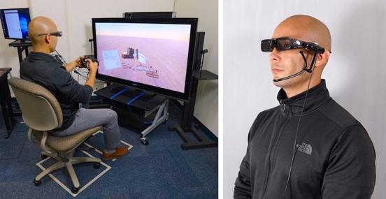
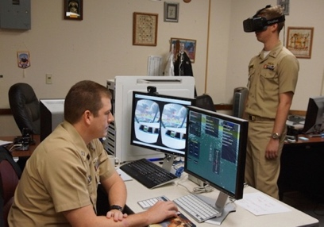
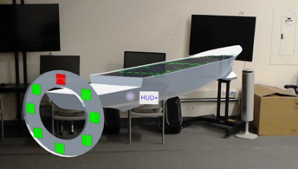
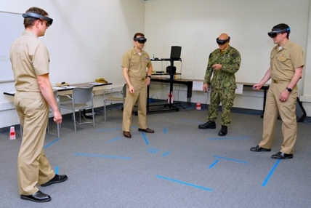
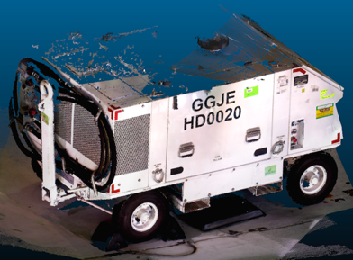
Research objective and research Questions
Research objective: Identify a range of contemporary VR/AR training solutions currently adopted and used in the Naval Domain and propose a mapping of those systems' capabilities to the USCG training needs.
Research questions:
Who are the service leaders developing and fully applying VR/AR tactical training alternatives in the Naval Domain?
What types of training approaches and practices with VR/AR training solutions provide the best results?
What is the available evidence and metrics that show training effectiveness of VR/AR solutions, and are there previous results of successful training transfer (if such information exists)?
What other novel USN technologies are available show promise of addressing USCG training gaps, and what USCG solutions could be used to support USN needs?

Slide 6
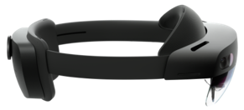
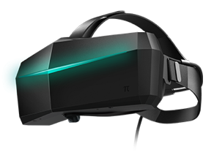
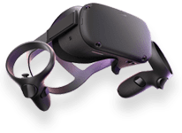
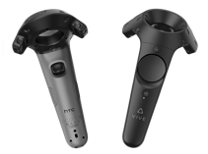
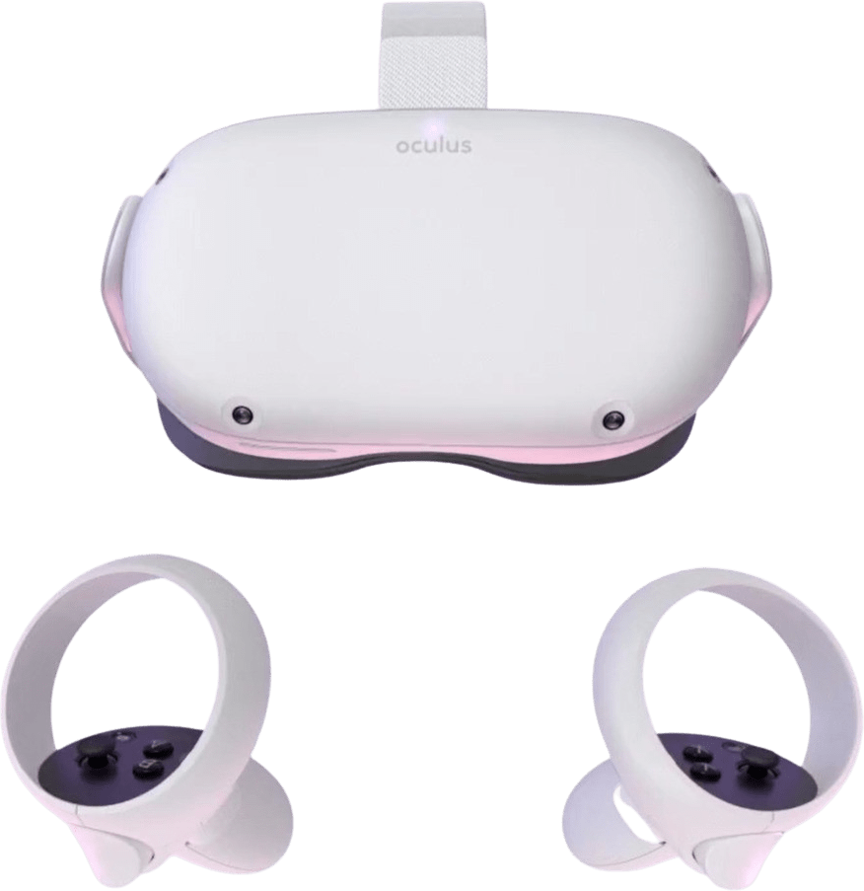
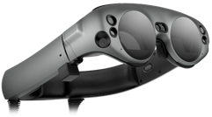
methodology
Research methodology
Study of literature in the domain of training (emphasis on VR/AR training solutions).
Visit local USCG facilities.
Collect comprehensive data set that reflect users’ needs, current trends and training results, projected and desired capabilities of training systems.
Conduct technology market research: Identify representative technological solutions and review their capabilities.
Collect a comprehensive data set about VR/AR training solutions used in the Naval Domain, including the results about their training effectiveness and transfer of training (if such information exists).
Design guidance that provides a basis for informed decision-making and selection of the optimal training systems for the USCG.
Identify USCG solutions that could be used to support USN needs.
Illustrate the best use cases and produce a set of recommendations on selecting training systems that match trainees' needs.
Identify gaps in technological solutions, studies of training effectiveness, and studies of training transfer.
Identify other candidate technologies and training approaches that hold a promise in addressing USCG training needs

Slide 7
Tasks & Progress

Slide 8
DATA collection
Data collection: Developed data collection instrument and started data collection
Internal data collection (NPS data and POCs):
Past research projects & student thesis
Discussions with USN/USMC students
Discussions with USCG students: identified 70 past and current USCG students
External data collection:
USN: (1) Online information, (2) Visit to training sites, (3) Interviews
USMC: (1) Collected ONR data sets, and data from LtCol Jesse Attig (MCAGCC, Twentynine Palms, CA), (2) Visits to training sites, (Interviews)
USCG: Visits to USCG stations in Monterey, CA and Alameda, CA
USCG: Mission sets and skill sets, report and catalogue on current training solutions, training gaps

Slide 9
Invaluable support from MOVES alumni: Thank you for your support!
LtCol Jesse Attig, MCAGCC, Twentynine Palms, CA
LtCol Francis Pascucci, MATSS Camp Pendleton OIC, 3d MAW Aviation Training System, CA
LCDR Daniel Cane, TACTRAGRUPAC N7, Point Loma, CA
Maj Michael Donaldson, Synthetic Training Integration and Management Branch Head, Range and Training Programs Division (RTPD), TECOM, Quantico, VA

Slide 10
USN/USCG training solution: data collection instrument
System name/Title
Acronym
Description
Organization responsible
Required hardware (type of computer, visual display, audio solution, haptic display)
Visual display solution [Headset/Smartphone/Tablet/Desktop/Large screen/CAVE]
Targeted task(s)
Individual or team use [Individual/Team/Both]
Targeted individual skills
Individual performance metrics
Targeted team skills
Team performance metrics
Year when first introduced
VR, AR/MR, simulator [VR/AR-MR/Sim]
Level of user proficiency required to use the system [Beginner/Intermediate/Expert]
Level of user proficiency targeted [Intermediate/Expert]
Scenario builder available [Yes/No]
Skills needed to create new scenario [Beginner/Intermediate/Expert]
Curriculum available [Yes/No]
Recommended use (hours per single session, sessions per user)
Maintenance details (needs for additional personnel, material resources)
Location(s) where installed
Record about the system use exists [Database/Excel/Hard copy/No record]
Current throughput (daily/weekly/yearly use)
Experiences about current use
Past throughput if different from current (daily/weekly/yearly use)
Experiences about past use (if different from current)
Training effectiveness measured [Yes/No]
Experiences of training effectiveness
Evidence about transfer of training [Yes/No]
Details about transfer of training evidence
Additional comments
Interview questions checked by IRB

Slide 11
Field Visits
April: Visit to USCG Station Monterey – participated in stern and side tow operations
May: Visit to several USN location in San and Camp Pendleton
June: Visit to Almeda, CA; additional visit to USCG Station Monterey
June or Aug: Potential visit to the East Coast

Slide 12
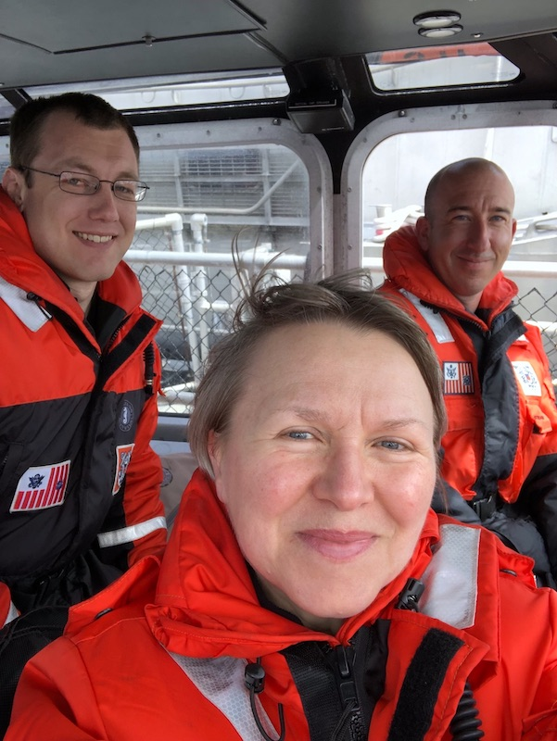
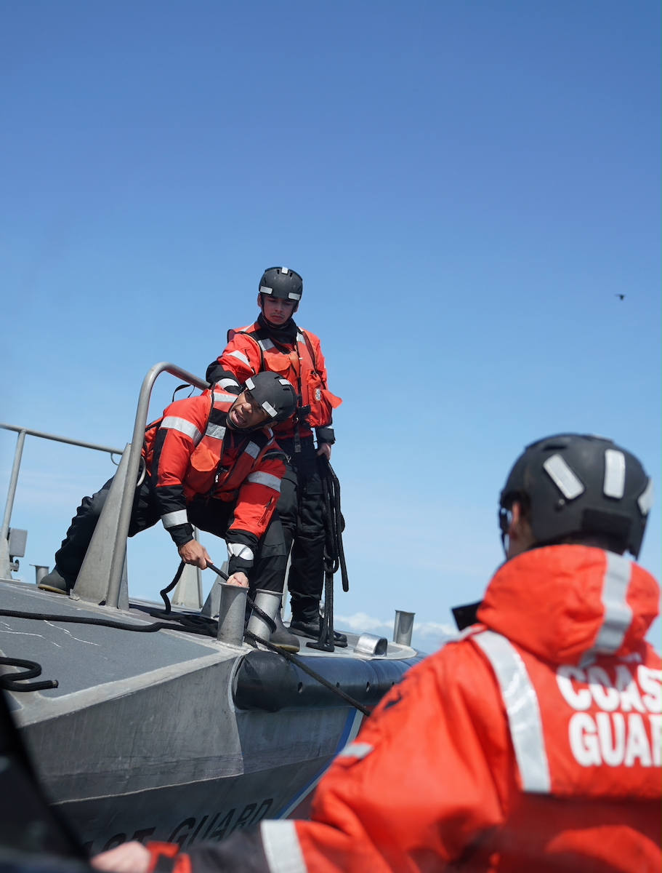
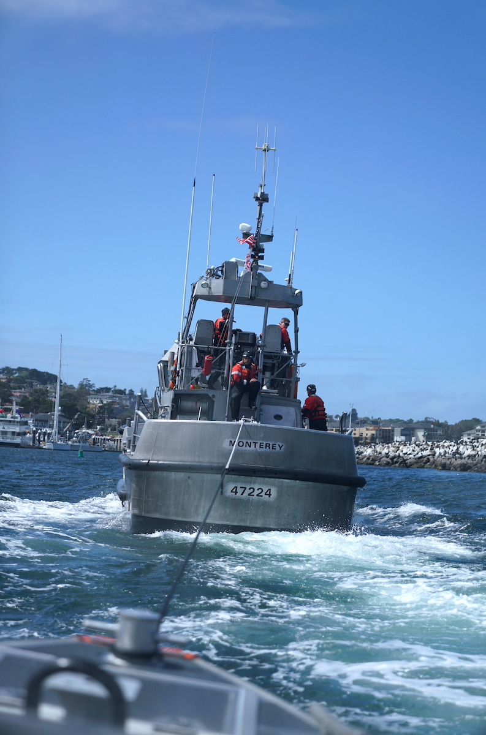
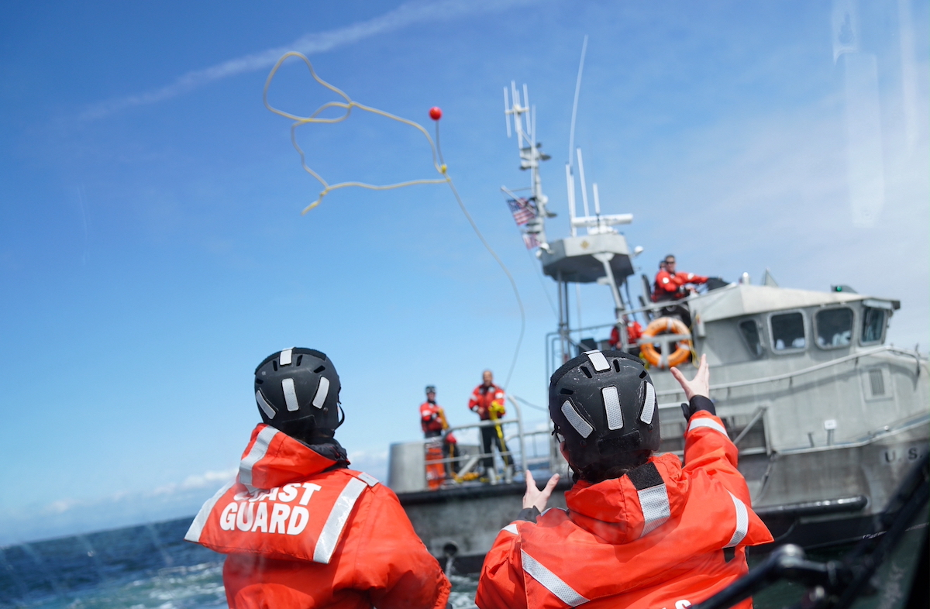
Visit to USCG Station Monterey
Stern and side tow techniques

Slide 13
Solution space

Slide 14
Starting point: USCG Missions and skill set
Maritime law enforcement (protection of America's maritime borders),
Maritime response (response to marine casualties and disastrous events),
Maritime prevention (conducting safety and security inspections, and analyzing port security risk assessments),
Marine transportation system management (safeguard the efficient and economical movement through the Nation’s ports and waterways),
Maritime security operations (execution of antiterrorism, response, and select recovery operations)
Defense operations (defense readiness and security operations).

Slide 15
Solution space: identify optimal mapping
Good mapping to USN and USMC operations and skill set:
USN examples: ship navigation, rules of the road, port security, recovery operations, casualty response, maintenance
USMC examples: Ground operations: room clearing, safety and security inspections, recovery operations, casualty response, maintenance
Some skills are specific to USCG only.

Slide 16
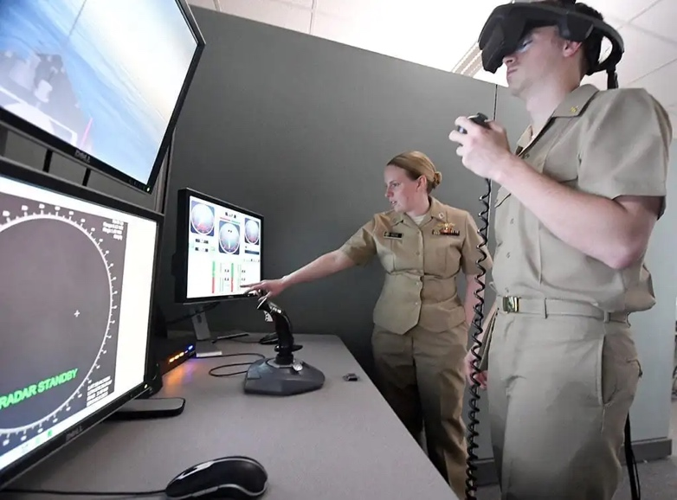
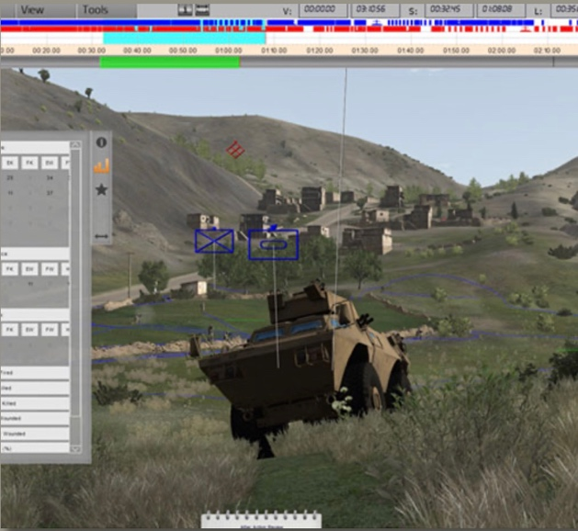
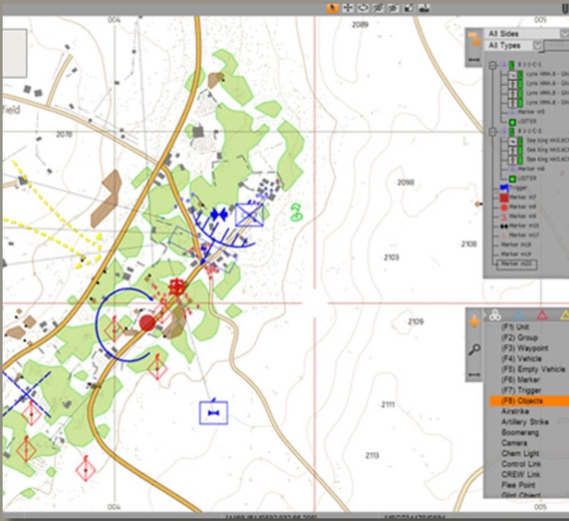
Solution space: TERRAIN AND Scenario development tools
Examine ability to create USCG-specific terrains and scenarios with current USN / USMC training solutions. Use the ‘mechanics’ of the current solutions with new scenarios
Examples:
Conning Officer Virtual Environment (COVE) shiphandling simulator
VBS for USMC operations
COVE
VBS

Slide 17
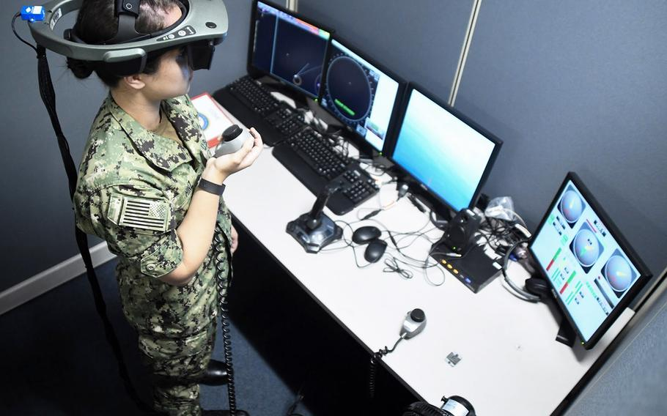
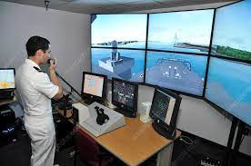
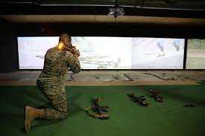
Solution space: Include simulators
Need to expand beyond VR/AR and include simulators as well
Use of passive haptics in training (use of real physical props to provide haptic feedback)
Examples: COVE, Indoor Simulated Marksmanship Trainer ISMT
COVE
COVE
ISMT

Slide 18
Solution space: include Usn/USMC programs and approaches
Examine applicability of relevant USN / USMC training programs and approaches.
Examples:
USN NETC Ready Relevant Learning (https://www.netc.navy.mil/RRL/),
Designed to “improve and modernize personnel management and training systems to more effectively recruit, develop, manage, reward, and retain the force of tomorrow.”
Modernized, on-demand, fleet-responsive learning
USMC DVTE: use deployable model of distributed learning

Slide 19
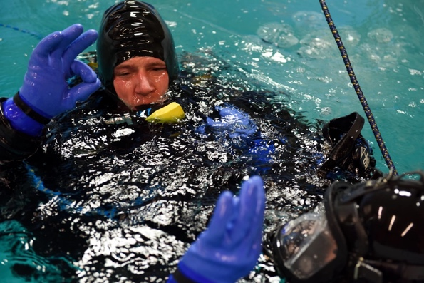
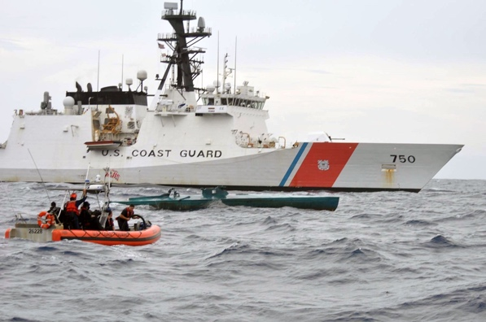
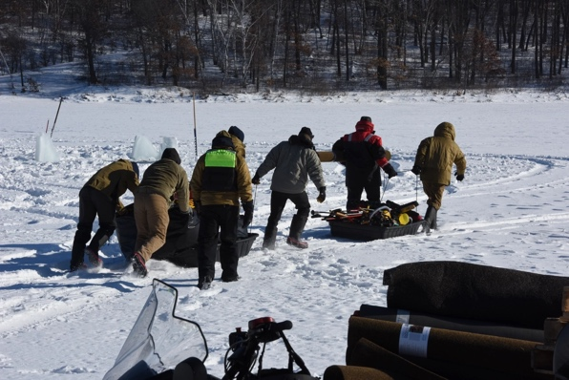
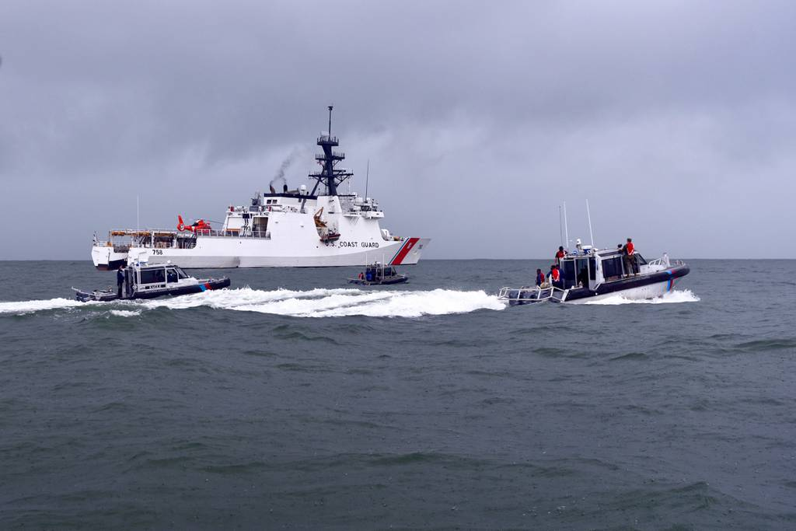
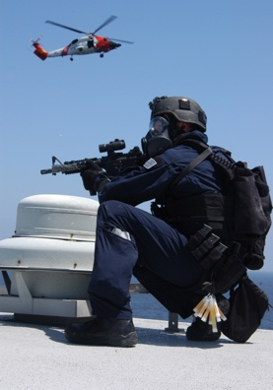
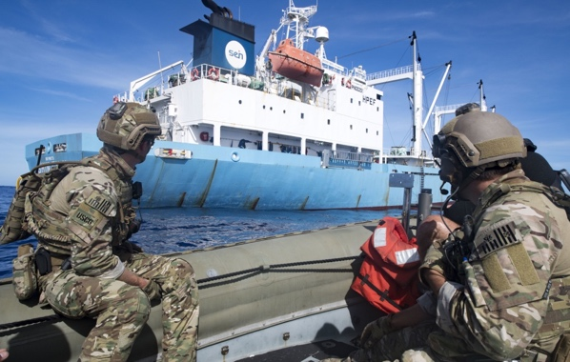
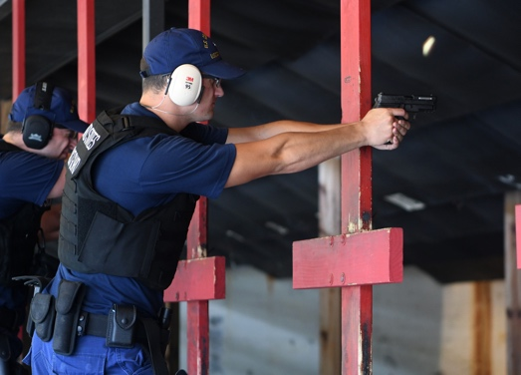
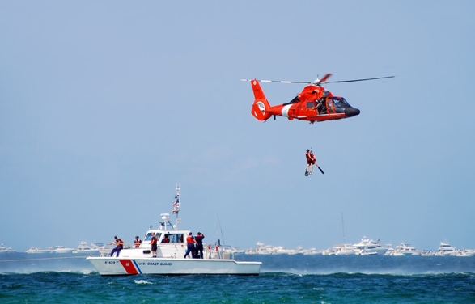
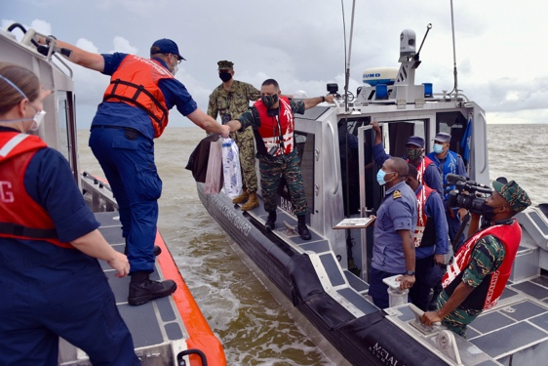
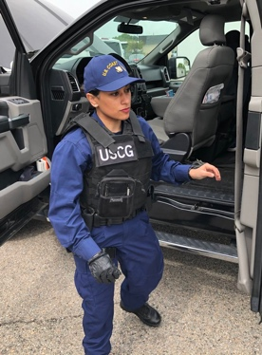
Solution space: generate Future program guidance
Generate guidance for a training program that is agile and has a greater potential to be adopted by a large (larger) number of trainees.
Examples: ‘gym bag training solutions’, part task trainers, train-the-trainer approach, mobile technology for on-the-job training

Slide 20
Q & A
Contacts:
asadagic@nps.edu, https://faculty.nps.edu/asadagic
douglas.vanbossuyt@nps.edu, https://nps.edu/faculty-profiles/-/cv/douglas.vanbossuyt

Slide 21
references
Azuma, R. T. (1997). A survey of augmented reality. Presence: teleoperators & virtual environments, 6(4), 355-385.
Bimber, O., & Raskar, R. (2005). Spatial Augmented Reality: Merging Real and Virtual Worlds. AK Peters, Ltd.
Carmigniani, J., & Furht, B. (2011). Augmented Reality: An Overview. Handbook of Augmented Reality, 3-46.
Fisher, S. S., McGreevy, M., Humphries, J., & Robinett, W. (1987, January). Virtual environment display system. In Proceedings of the 1986 workshop on Interactive 3D graphics (pp. 77-87).
Fisher, S. S. (1988). Virtual interface environment. Space Station Human Factors Research Review. Volume 4: Inhouse Advanced Development and Research.
Gibson, W. (2019). Neuromancer (1984). In Crime and Media (pp. 86-94). Routledge.
Milgram, P., Takemura, H., Utsumi, A., & Kishino, F. (1995, December). Augmented reality: A class of displays on the reality-virtuality continuum. In Telemanipulator and telepresence technologies (Vol. 2351, pp. 282-292). International Society for Optics and Photonics.
Sadagic, A., Welch, G., Basu, C., Darken, C., Kumar, R., Fuchs, H., ... & Lastra, A. (2009). New generation of instrumented ranges: Enabling automated performance analysis.

Slide 22
Past thesis focused on USN training needs (1 of 2)
LCDR Jason C. Lemma and LCDR Samuel Mendosa (Dec 2021): A Functionality and Cost Assessment of Mobile Learning Technology
MAJ William Mahan (Sep 2021): VISUAL SIGNAL TRAINING FOR DRIVERS AND THEIR GROUND GUIDES, http://hdl.handle.net/10945/68352
LCDR Rashaunda Holloway, LCDR Eugene Frye (Jun 2021): Virtualized Platforms to Conduct Remote Shipboard Training and Hands-on Readiness Assessments for Canes, http://hdl.handle.net/10945/67740
LT Roy Bliss: (Dec 2020): An Exploration of Training Alternatives, http://hdl.handle.net/10945/66588
Capt Daniel Jagears (Dec 2020): Replacing Powerpoint With Extended Reality for Marine Corps Planning, Concepts of Operations, and After Action Reports, http://hdl.handle.net/10945/66661
Maj Bert Knobeloch (Jun 2020): Military Mission Planning Using Augmented Reality Technology, https://calhoun.nps.edu/handle/10945/65384
LT Joseph Holliday (Sep 2020): Enhancing Effectiveness and Cost-Efficiency of Individualized Shiphandling Training Using Virtual Environments, http://hdl.handle.net/10945/66083
LT Kelvin Huntley (Dec 2019): Toward a Persistent Use of Augmented Reality Technology in Naval Domain, https://calhoun.nps.edu/handle/10945/64189
Capt Cody Tackett (Mar 2019): Development of a Virtual Reality Trainer for Tactical Vehicle Ground-guiding Procedures, https://calhoun.nps.edu/handle/10945/62303
LCDR Matthew Timmerman (Dec 2018): Enabling Collaboration and Visualization of Complex Operational Technology Computer Networks with AR Technology, https://calhoun.nps.edu/handle/10945/61287
LT John Jackson (Dec 2018): Damage Control Training Team Tool Suite, http://hdl.handle.net/10945/61396
Capt Jeremy Rogers, MAJ James, MAJ Sanders, Adam Vogel (Dec 2018): How Can the Center for Navy Security Forces Leverage Immersive Technologies to Enhance Its Current Training Delivery?, http://hdl.handle.net/10945/61260

Slide 23
Past thesis focused on USN training needs (2 of 2)
Maj Enrico Landas (Sep 2018): The Next Generation of Aviation Maintenance Training: Game-Based and Virtual Reality Augmented Learning, http://hdl.handle.net/10945/60424
CDR Christopher Angelopoulos (Jun 2018): Efficiency and Precision Experimentation for Augmented Reality Cued Maintenance Actions, http://hdl.handle.net/10945/58537
Sqn Ldr Faisal Rashid (Sep 2017): Use of VR technology and Passive Haptics for MANPADS Training System, https://calhoun.nps.edu/handle/10945/56170
Maj John Gibson (Jun 2017): Marine Light Attack Helicopter Close Air Support Trainer for Situational Awareness, https://calhoun.nps.edu/handle/10945/55601
Capt Kathleen Haggard (Jun 2017): Air support control officer individual position training simulation, http://hdl.handle.net/10945/55613
Capt Nicholas Arthur (Jun 2017): Proof-of-concept Part-task Trainer to Enhance Situation Awareness for Instrument Approach Procedures in Aviation Domain, https://calhoun.nps.edu/handle/10945/55508
Maj Jesse Attig (Jun 2016): Proof-of-concept Part-task Trainer for Close Air Support Procedures, http://calhoun.nps.edu/handle/10945/49487
LT Larry Greunke (Sep 2015): 'Charlie', Development of a Lightweight, Virtual Reality Trainer for the LSO Community, https://calhoun.nps.edu/handle/10945/47267
DS Dori Koren (Dep 2015): Virtual HUMINT: conducting human intelligence operations in the virtual environment, http://hdl.handle.net/10945/56397
LT Brendan Geoghegan (Mar 2015): Navigational Heads-Up Display: Will a Shipboard Augmented Electronic Navigation System Sink or Swim?, https://calhoun.nps.edu/handle/10945/45191
LCDR Jeffrey Korzatkowski (Mar 2015): Development of a virtual environment for catapult launch officers, http://hdl.handle.net/10945/45210
Maj James Reynolds, Maj Craig Smith (Sep 2013): Virtual environment training on mobile devices http://hdl.handle.net/10945/37700

Slide 24
Leveraging past research projects
Mobile Learning Technology: Assessment of Distribution Options and Recommendations (Dec 2020 - Dec 2021)
Evaluating the Effectiveness of Blended Learning Strategies in Navy Training (Dec 2020 - Dec 2021)
Military Mission Planning Using Augmented Reality Technology (Jul 2019 – Jun 2020)
Effectiveness of Training Systems that Employ Virtual Reality, Augmented Reality, and Touchscreen Displays (Oct 2018 - Oct 2019)
Toward a Persistent Use of Augmented Reality Technology in Naval Domain (Nov 2018 - Dec 2019)
Enabling Collaboration and Visualization of Complex Operational Technology Computer Networks with Augmented Reality Technology (Oct 2017 - Dec 2018)
Development of a Virtual Reality Trainer for Tactical Vehicle Ground-guiding Procedures (Sep 2017 - Mar 2019)
Use of VR technology and Passive Haptics for MANPADS Training System (May 2016 - Sep 2017)
Marine Light Attack Helicopter Close Air Support Trainer for Situational Awareness (Jul 2016 - Jun 2017)
Proof-of-concept Part-task Trainer to Enhance Situation Awareness for Instrument Approach Procedures in Aviation Domain (Jul 2016 - Jun 2017)
Proof-of-concept Part-task Trainer for Close Air Support Procedures (Sep 2015 - Jun 2016)
'Charlie', Development of a Lightweight, Virtual Reality Trainer for the LSO Community (Oct 2014 - Sep 2015)
Navigational Head's Up Display (NAVHUD): Will a Shipboard Augmented Electronic Navigation System Sink or Swim? (Feb 2014 - Mar 2015)
Development of a Web-based Periscope Simulator for Submarine Officers Training (Aug 2013 – Dec 2014)
Diffusion and Large-scale Adoption of Computer-supported Training Simulations in the Military Domain (Feb 2013 – Dec 2013)
Behavioral Analysis and Synthesis for Intelligent Training - BASE-IT (FY08 - FY11)

