Slide 1


Consortium for Additive Manufacturing Research and Education - CAMRE
A. Sadagic, D. Van Bossuyt
asadagic@nps.edu, douglas.vanbossuyt@nps.edu
25 May 2022

Slide 2
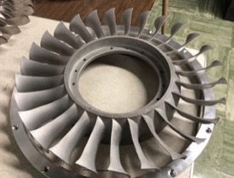
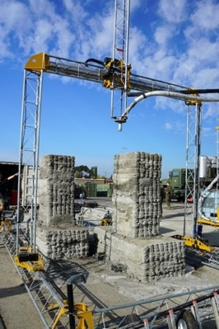
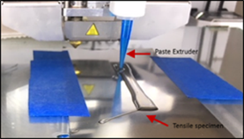
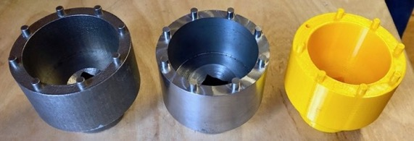
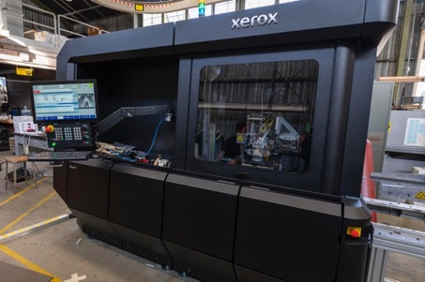
Agenda
NPS Center for AM
CAMRE Introduction
CAMRE Approaches
Connection with DON
Examples of Past Work
  Work with Domain Users
  Additive Manufacturing from a Systems Engineering Perspective

Slide 3
NPS Center for Additive Manufacturing
Center officially approved: May 30, 2019
Mission: Interdisciplinary research in additive manufacturing (AM) with emphasis on the Naval needs
Members: 38 faculty
Academic units: Computer Science Dept., Defense Analysis Dep., Energy Academic Group, Information Science Dept., Dept. of Mechanical & Aerospace Engineering, Operations Research, Physics Dept., System Engineering Dept., Space Systems Academic Group
Current laboratories:
  Center for Materials Research facilities
  Applied Physics laboratories
  MOVES Additive Manufacturing Lab
  Space Systems Academic Group Lab
  System Engineering Lab
  RoboDojo Lab
Co-directors: Dr. A. Sadagic and Dr. E. Gunduz
Web site: https://nps.edu/web/cam

Slide 4
CAMRE Introduction
Congressional plus-up: $15 million for Consortium for Additive Manufacturing Research and Education
Research, Development, Test and Evaluation, Navy, Line 184
  “The funds will be used to establish a consortium for additive manufacturing research and education at the Naval Post Graduate Research School (NPS) that will accelerate widespread adoption of additive manufacturing across the Department of Defense. The Consortium will drive the adoption of 3D rapid prototyping method in support of the Tri-Service Maritime Strategy.” (March 22, 2022)

Slide 5
CAMRE Approaches
Multi-year, interdisciplinary, umbrella research and education initiative
Goals:
  Coordinate a diverse portfolio of interdisciplinary research projects that advance basic and applied research domains in concert with education and training.
  Address both technical issues and human/personnel issues, i.e., support a full human-technology integration.
Focus on research domains directly connected to AM: (1) Materials and technology development and testing, (2) parts fabrication and certification, (3) diffusion of innovation, and large scale technology adoption, (4) innovation by service members, (5) personnel education and training, (6) portals for AM learning and collaboration, (7) metadata provenance and cybersecurity, (8) secure model databases for 3D printing afloat/ashore, (9) return on investment, (10) methods and techniques of operations research for AM.
AM treated as a part of the ecosystem with other technologies: Sensors, robotics, advanced manufacturing, artificial intelligence, machine learning, data science, data mining, cybersecurity, virtual and augmented reality.
DoD domains: Operations, logistics, acquisition, maintenance, and warfighting resilience.

Slide 6
Research Topics: Current & Future
Materials development and testing
Development of new AM technologies
Parts fabrication and applications
Determination of mechanical properties and postprocessing steps of 3D printed parts
In-situ quality control
Use of AI/ML to make 3D printing more efficient
Use of Virtual Reality and Augmented Reality for AM prototyping, testing and training
Use of supporting commercial off the shelf technologies (example: 3D scanning)
Personnel education and training
Large scale adoption of AM technology
Innovation in AM domain by service members
Return on investment
Effects of AM on logistics and acquisition
Operational aspects of AM
Secure model databases
Cybersecurity in AM domain
Portals for AM collaboration

Slide 7
Education (Segments at NPS)
Current:
  Curricula augmented with AM-themed lecture materials and courses
  Student thesis
  Brown Bag lecture series
  Lab research demonstrations, panel discussions
Future:
  Develop AM certificate (4 courses)
  Reach every single NPS student and, at a minimum, ensure they have basic understanding and appreciation of AM technologies, including strategic value of AM in Naval domain.
    They will take a role of change agents: they will actively support, endorse, and provide incentives for adoption of technology in their units, including the adoption of AM

Slide 8
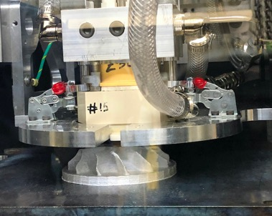
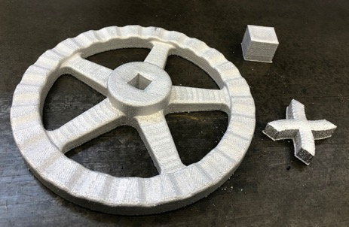
Consortium Members
Academia
Industry
DoD domain: commands & active-duty units
Gov. laboratories

Slide 9
Work with Domain Users

Slide 10
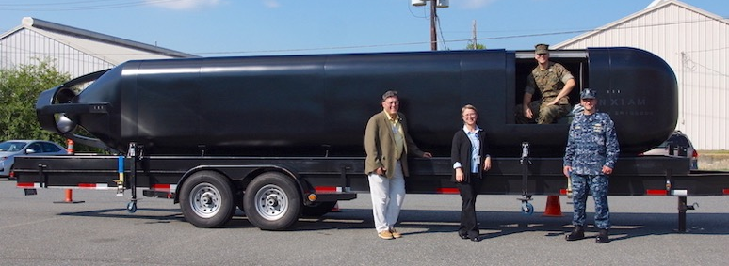
Collaboration with DON
NPS CAM is a core member of Navy Additive Manufacturing Executive Committee – NAM EXCOMM, a DON forum of AM users coordinated by N4. The group meets bi-weekly to plan and coordinate DON initiatives in AM domain.
  Core members: OPNAV N4, ASSTSECNAV RDA, NAVSEA, NAVAIR, NAVFAC, NAVSUP, NAVWAR, NSWC, NAWCAD, NIWC PACIFIC, NFEXWC PHE, ONR, NPS, and others.
  Extended group includes active duty units and other directorates.
Repeated visits, data collection and studies conducted by Dr. Amela Sadagic and her students with AM innovation cells.
Visited: USS America, USS Boxer, USCGC Hawksbill, USCG Station Monterey, CA
Upcoming deployment of ElemX metal printer onboard Navy ship →Twin printer experiment

Slide 11
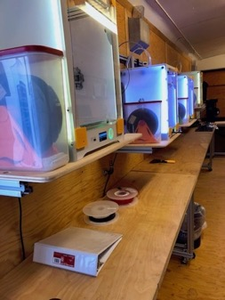
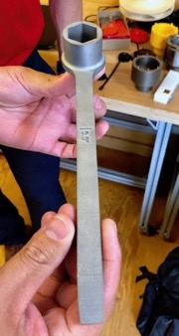
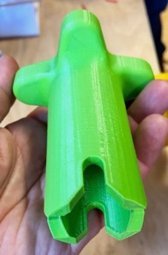
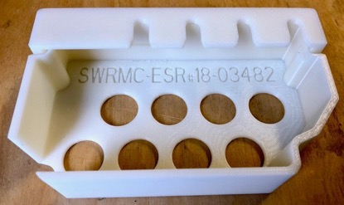
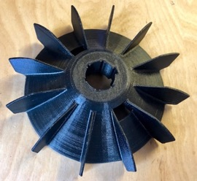
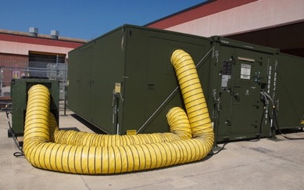
Past Visits and Data Collection in Naval AM Labs
Mid Atlantic Regional Maintenance Center (MARMC), Norfolk, VA
SW Regional Maintenance Center (SWRMAC), San Diego, CA
NAVFAC, Port Hueneme, CA
Naval Expeditionary Construction Force (NECF),Port Hueneme, CA
FRCMA Det Patuxent River, MD
NAVAIR, Patuxent River, MD
USMC Systems Command, Quantico, VA
FabLab, MCAGCC, Twentynine Palms, CA
Marine Corps Air Station (MCAS), Cherry Point, NC
X-FAB, Camp Lejeune, NC
Camp Pendleton, CA
Ships: USS Makin Island, USS America, USS Boxer, USCGC Hawksbill

Slide 12
Additive Manufacturing from a Systems Engineering Perspective

Slide 13
Motivation
For several years, the Navy and Marine Corps have been employing Additive Manufacturing (AM) capabilities to rapidly deliver warfighting equipment in operational environments.
The use of AM will increase the level of warfighter readiness and self-sustainment, allowing them to be more adaptive and reactive to the wartime environment.
Research must be done to determine how to integrate future AM capabilities for expeditionary forces, while maximizing return on investment and minimizing duplicated efforts.

Slide 14
AMPAT Demonstration
Additive Manufacturing for Expeditionary Forces
–
What Printers for What Parts Where

Slide 15
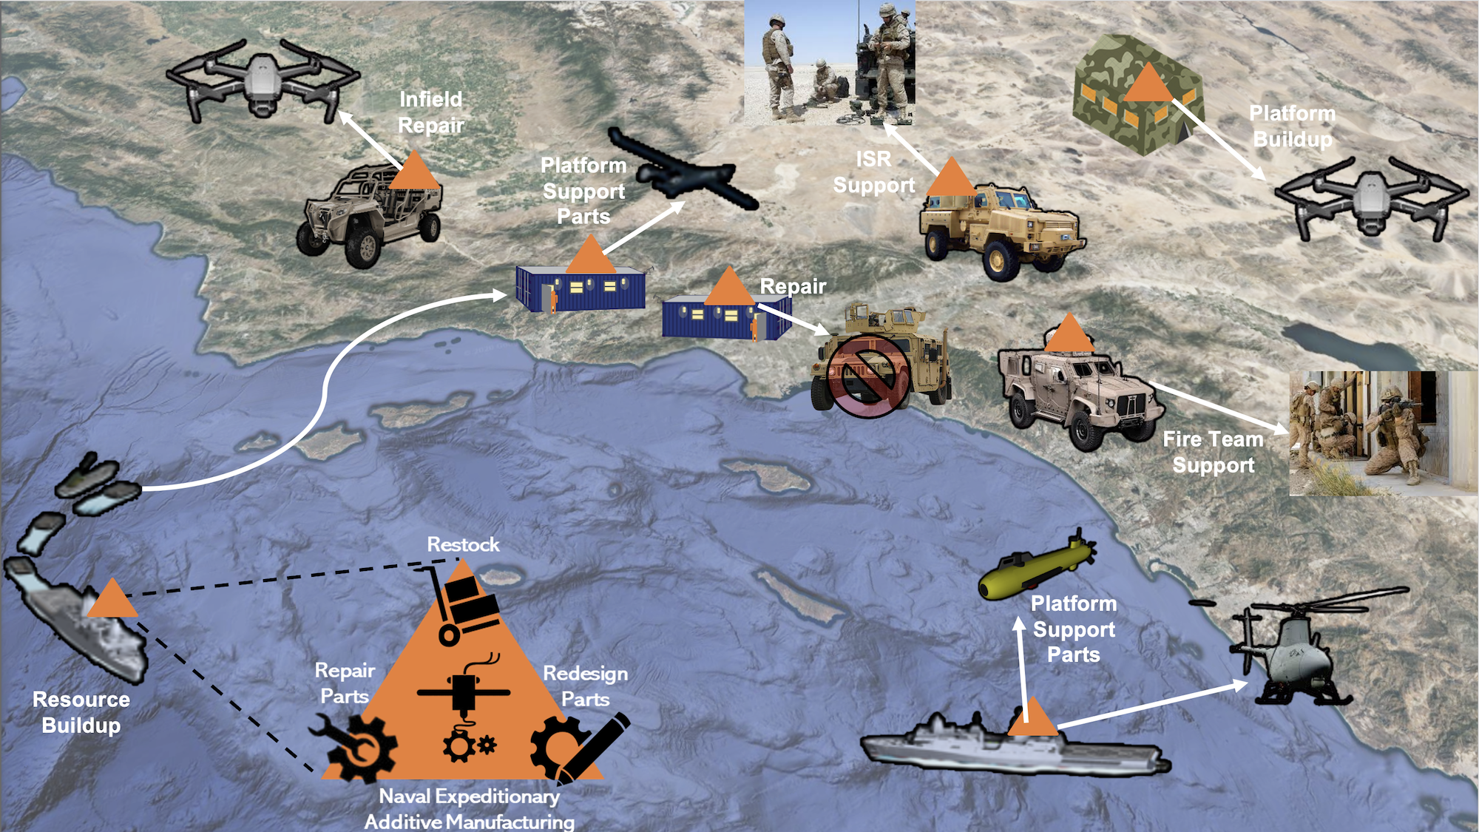

Slide 16
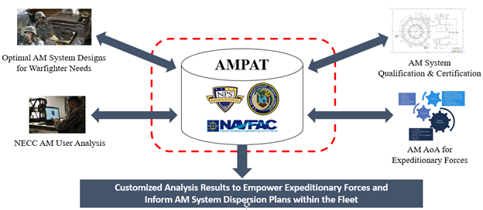
Use of Additive Manufacturing Process and Analysis Tool (AMPAT) in the DoD

Slide 17
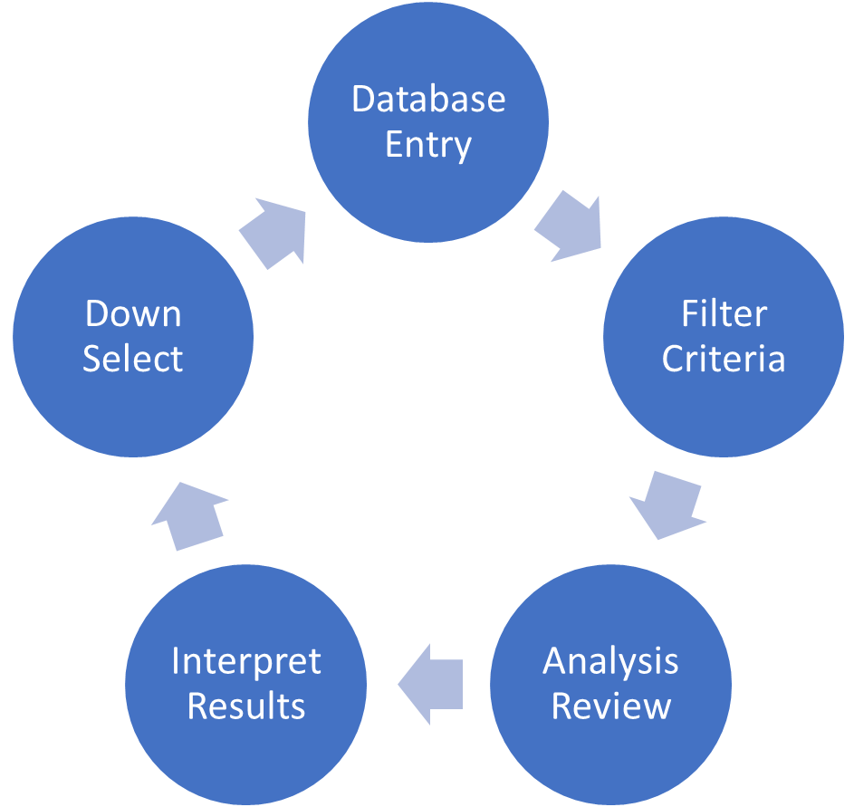
Additive Manufacturing Process Analysis Tool (AMPAT) Overview
The Additive Manufacturing Process Analysis Tool (AMPAT) deliverable consists of two main portions.
  Excel-based tool that performs the analysis
  User guide for directions on how to use the tool
    Tool Overview
    Written Directions
    Visual Tutorial
AMPAT Methodology
  User populated and modifiable database
    Allows the user to add AM systems and detailed attributes
  Iterative analysis process

Slide 18
AMPAT Demonstration
Scenario/Code Demonstration

Slide 19
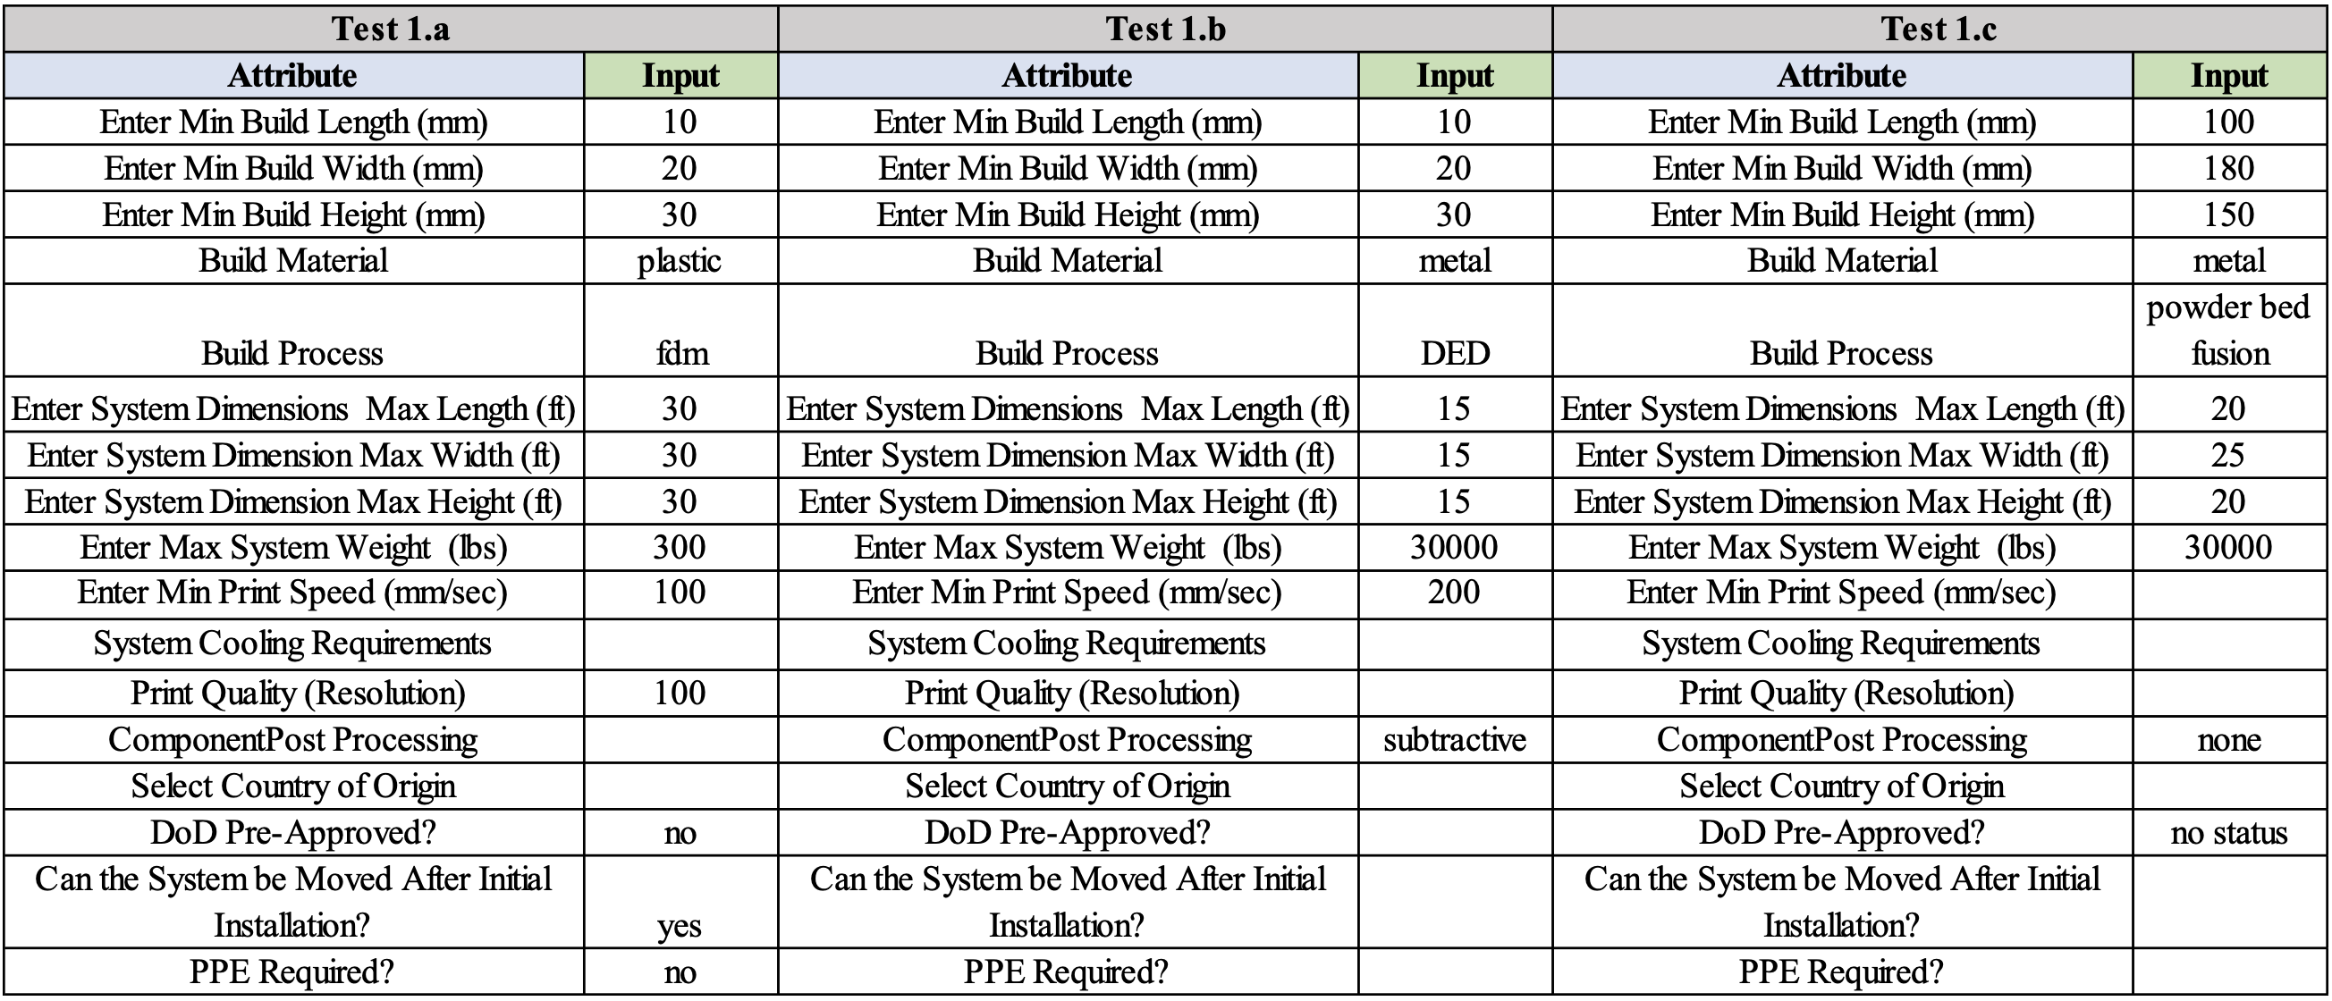
V&V Test Case Overview – Test Case 1
Test Case 1 – Filtering Options
  Tests the tool’s ability to appropriately filter the AM systems based on user input
  Tests the clarity of user guide directions on inputting filter criteria

Slide 20
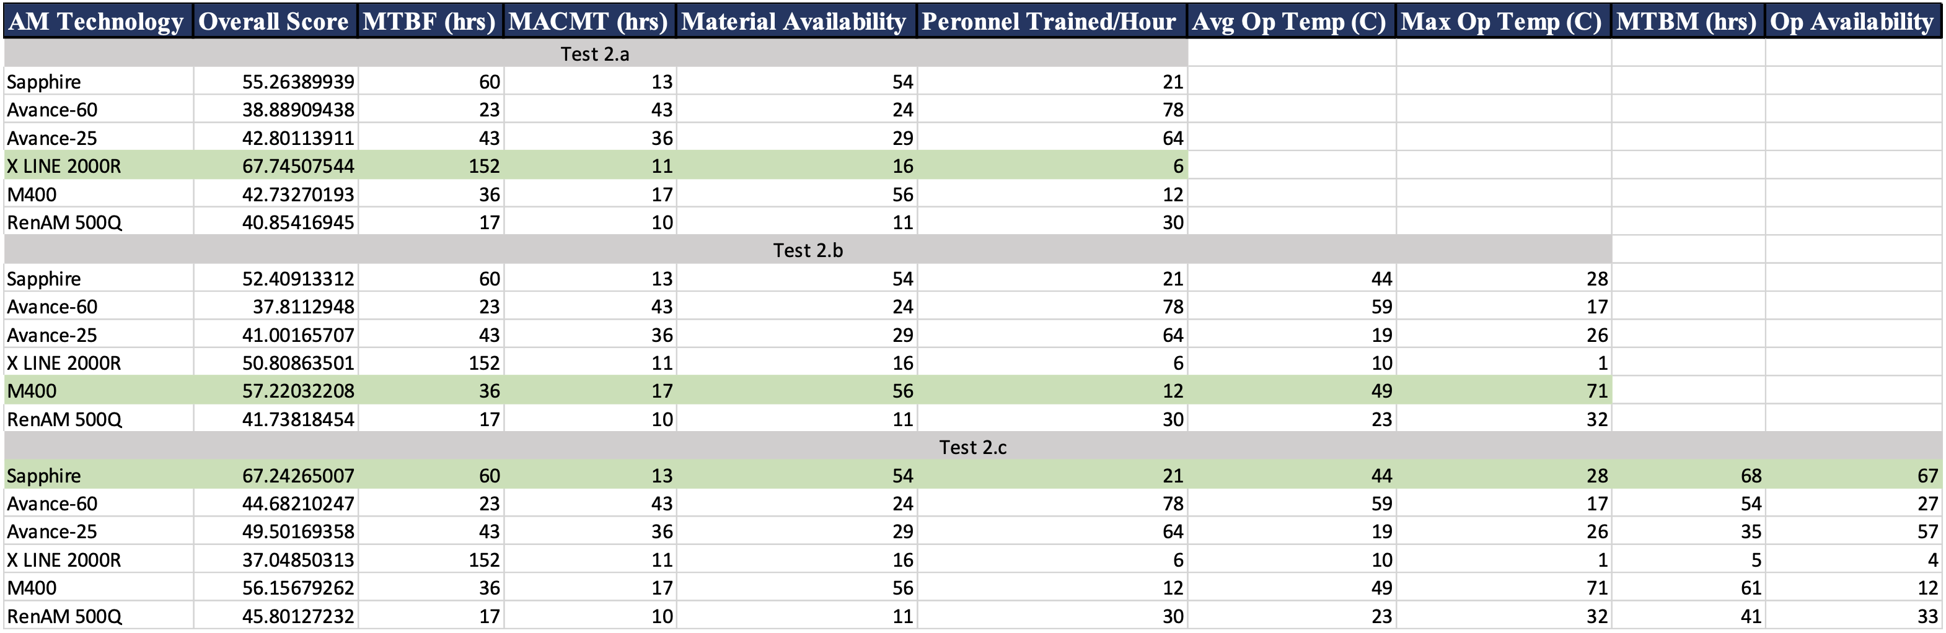
V&V Test Case Overview – Test Case 2
Test 2 Results
  Show how weighting additional attributes changes the overall outcome of the scoring

Slide 21
Conclusions
AMPAT can be used to conduct customized, iterative analysis with user-defined inputs that are tailored to a specific expeditionary environment and use cases.
  Results of AMPAT analysis can be used to determine the best strategy to preposition AM technologies throughout the Fleet.
In order to better integrate AM capabilities into the greater Navy mission, the NECC should collaborate and strategize with the various organizations that work with AM technologies and contribute to the development of DOD AM policy.
  There is a need for an all-encompassing strategy document that establishes criteria necessary to approve AM systems for DOD use.
  AMPAT analysis results can be used to evaluate different AM technologies and determine suitability for DOD missions and operational scenarios.
  AMPAT analysis results can be used to justify DOD approval decisions.
AMPAT Analysis Directly Supports the Needs of the Greater Naval Mission.

Slide 22
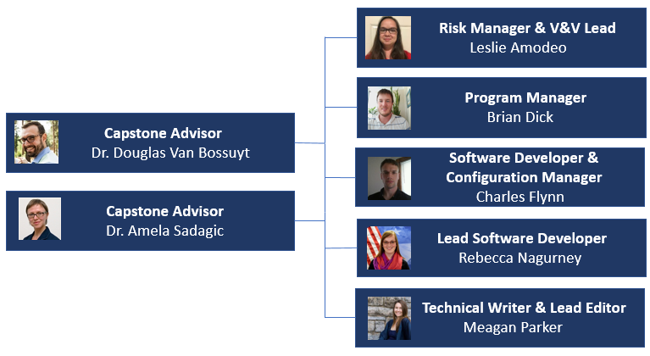
NEAM Team
NEAM Team | Job Title | Location
Leslie Amodeo | Flight Test Engineer | Cape Canaveral, Fl
Brian Dick | Project Manager for Autonomous Vehicles | San Diego, CA
Charles Flynn | Electromagnetic Compliance Engineer | Newport, RI
Rebecca Nagurney | Satellite Ground System Architecture Lead | Huntsville, AL
Meagan Parker | Program Manager for Threat M&S Projects | Dahlgren, VA
*
†
NEAM Advisors | Job Title | Location
Dr. Douglas Van Bossuyt | NPS Assistant Professor in the Systems Engineering Department | Monterey, CA
Dr. Amela Sadagic | NPS Research Associate Professor in the Computer Science Department | Monterey, CA
‡
* Naval Postgraduate School Outstanding Academic Achievement Award for Department of Defense Student
† Nomination for Graduation with Distinction
‡ Meyer Award for Outstanding Student in Systems Engineering (Distance Learning)
22

Slide 23
AMAR Demonstration
Additive Manufacturing for Surface Ships
–
What Printers on What Ships

Slide 24
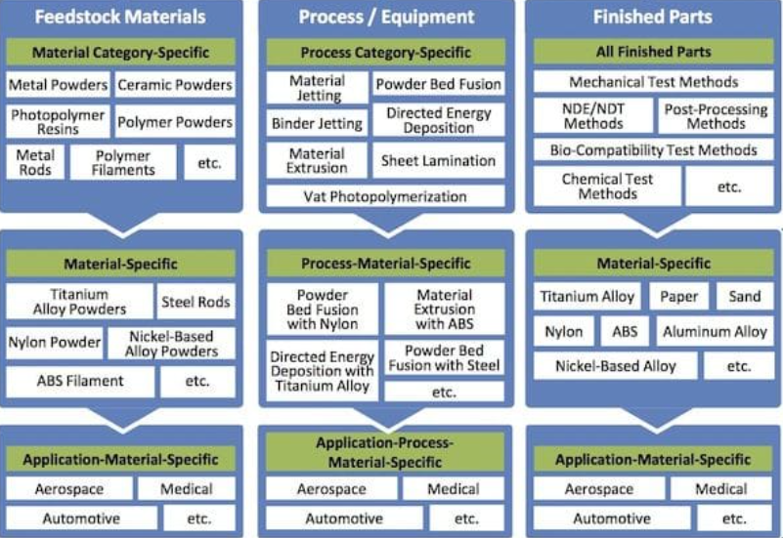
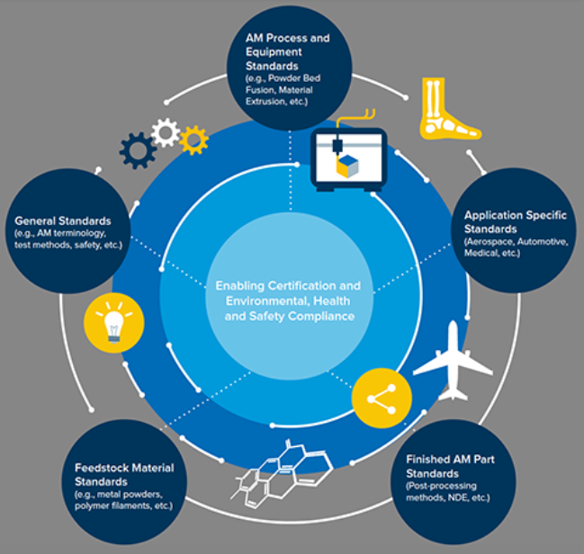
AM Trade Study
Conduct Research:
  Survey AM Technology, Machinery, Capability, Materials, and Costs
  Identify AM printers suitable and provide the most benefit for at sea use on selected naval vessel types
Create a database for:
  AM printers with associated attributes
  Naval Vessels
Create a process of evaluation for part, AM technology, and material attributes

Slide 25
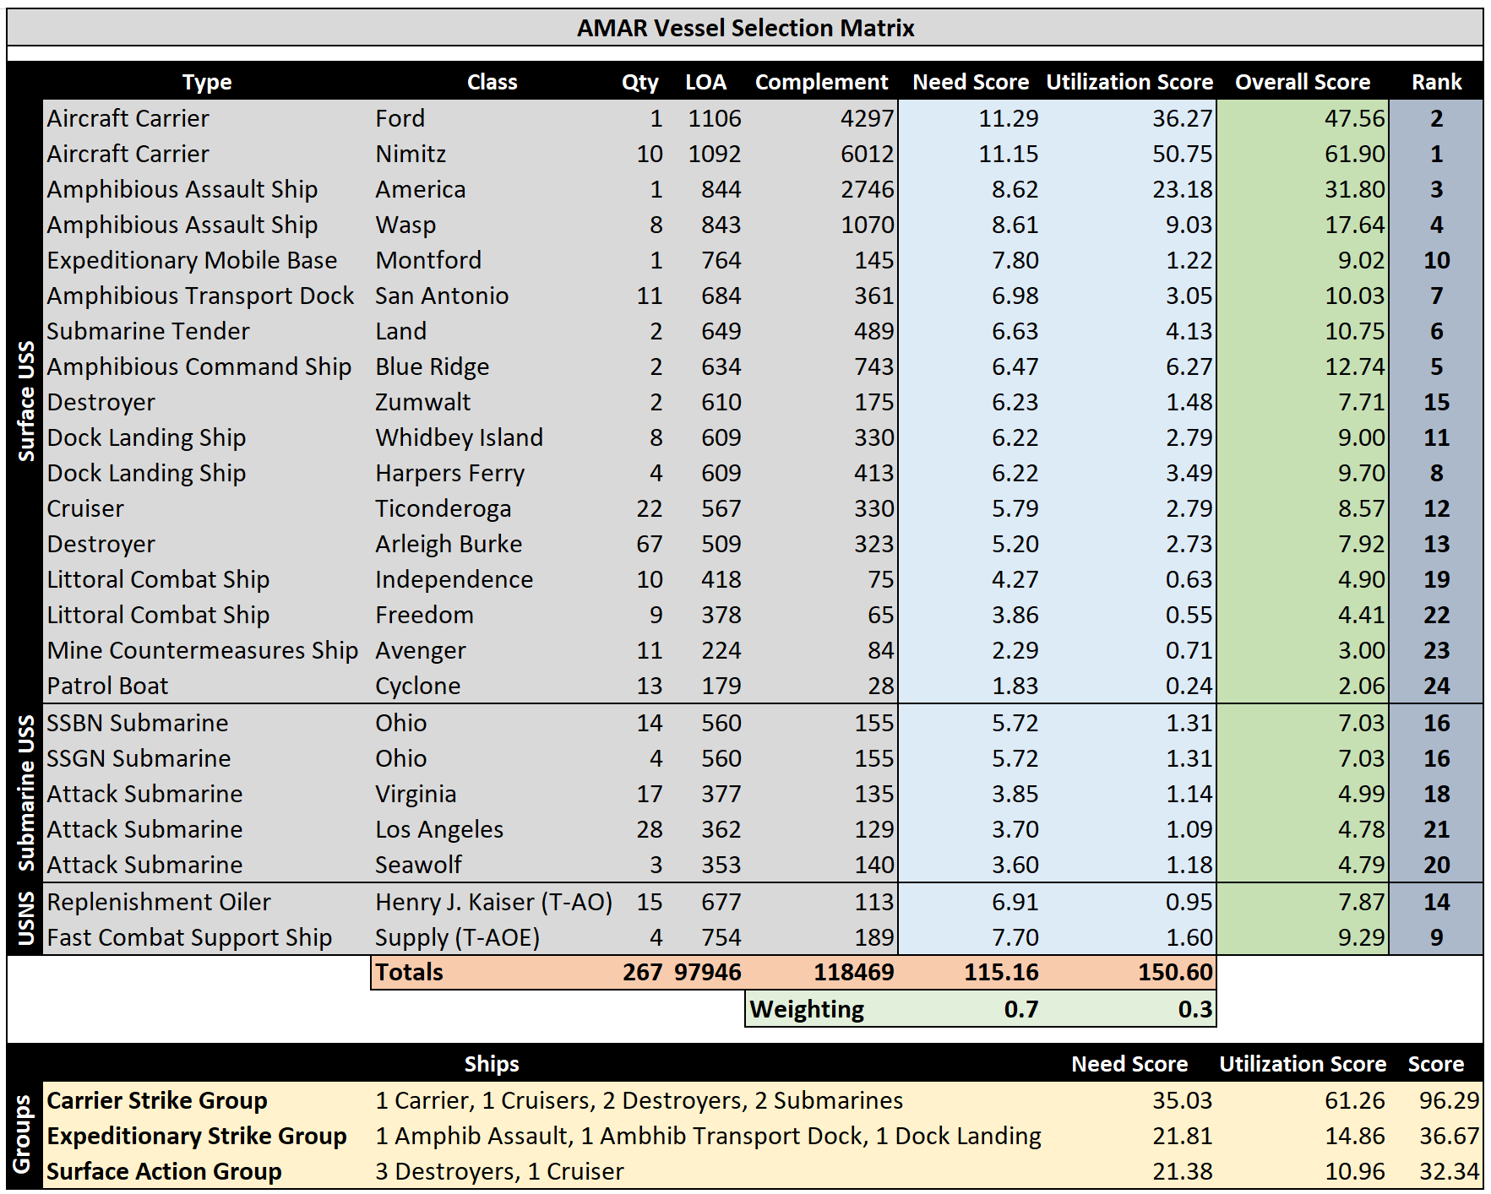
Navy Vessel Scoring
Assumptions:
  Deployment strategy is independent of application or recipients:
  Could be ships, schools, laboratories, prisons, etc.
  High-priority recipients must be differentiated from low-priority recipients
Determining priority for new technology:
  Technology provider needs a goal / vision for the distribution
  Based on recipient’s need and utilization capability
Technology Need:
  The amount of potential value that could realized from the introduction of a system
  Includes value for users, neighbors, and community
Technology Utilization:
  The value the user can realize from a system
  Includes adoption, user readiness, system availability, environment
Scoring:
  For surface vessels, need is correlated to LOA and utilization is correlated to complement.
  Total score is summation of need score and utilization score (both weighted).

Slide 26
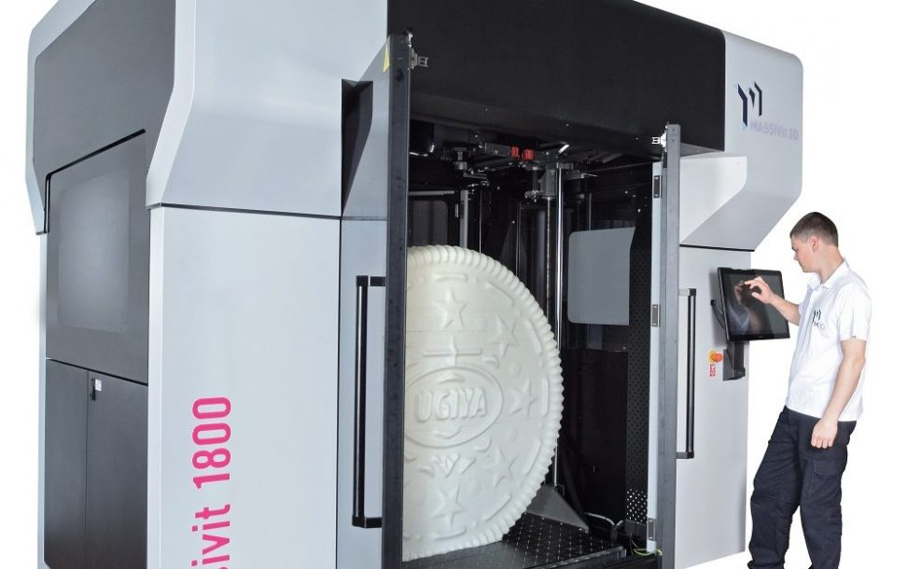
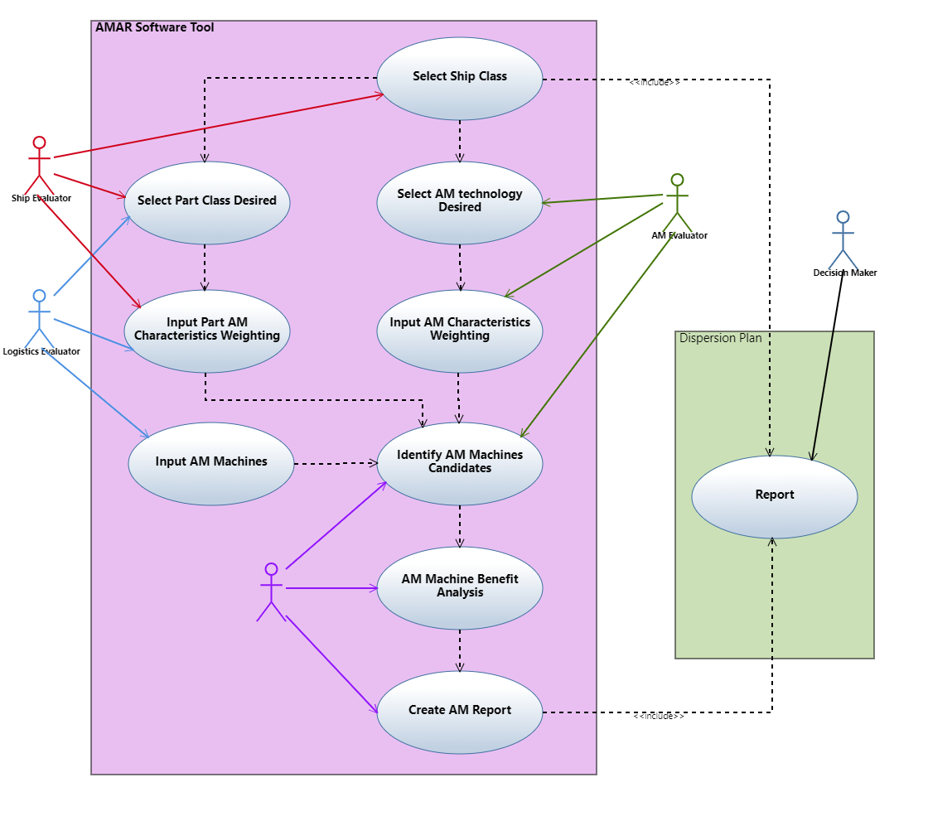
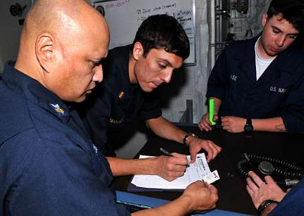



AMAR Software Tool
https://www.3dprintingmedia.network/wp-content/uploads/2016/06/Massivit-1800-with-operator-and-model-print-e1499365923926-1170x610.jpg
http://www.public.navy.mil/surfor/ddg89/Photos/101130-N-8721D-028.jpg
https://www.kencogroup.com/fullpanel/uploads/files/kenco-wholesale-logistic-people-safety-00004.jpg
https://img-aws.ehowcdn.com/340x221p/photos.demandstudios.com/getty/article/201/235/1616701.jpg

Slide 27








AMAR Team
Additive Manufacturing Acquisition Research (AMAR)
Team
  Nathan Banks
  Daniel Ferreira
  Jerry McCauley
  Joseph Trinh
  Ken Zust
  Nathan Banks
Daniel Ferreira
  Jerry McCauley
  Joseph Trinh
Ken Zust
Outstanding Capstone Report (DL)
Nathan Banks received Meyer Award for Outstanding DL Student in Systems
Dr. Van Bossuyt
  Dr. Sadagic

Slide 28
Conclusions
Impacts of Additive Manufacturing on Navy’s surface fleet
  Reduce dependence on traditional supply chain and local inventory requirements
  Reduce maintenance downtime
  Increase fleet operational availability to improve force readiness

Slide 29
Big Picture – Systems Engineering and Additive Manufacturing
We have worked on understanding what printers can be used where to produce what parts
This helps with developing plans for additive technology deployment to the fleet and to expeditionary forces
New printers are available all the time with new capabilities which means the Navy’s deployment strategy must remain nimble and be constantly re-evaluated

Slide 30
Questions?
Contacts:
asadagic@nps.edu
douglas.vanbossuyt@nps.edu

