Slide 1
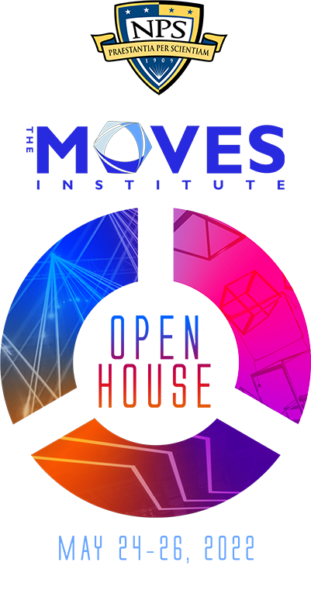
Naval Modeling and Simulation Office Projects
Curtis Blais
24 May 2022
clblais@nps.edu 831-656-3215

Slide 2
Agenda
Statement of the Challenge
Background
Approach
Results
Future Work
Discussion

Slide 3
Challenge (1)
Navy and Marine Corps Modeling and Simulation (M&S) communities need to meet requirements for:
Service-level modeling and simulation improvements and capability enhancement
Education and workforce development
Cross-community/organization coordination and execution
To meet these requirements, NMSO must be supported by organizations with educational, technical, and operational reach across academic, industry, and military domains to leverage existing and emerging technologies

Slide 4
Challenge (2)
Students completing master's degrees as part of the NPS MOVES curriculum at the Naval Postgraduate School (NPS) are required to complete a thesis
Students currently lack both a demand signal from the Navy and Marine Corps and resources that could be applied to those research needs
As a result, student research alignment with Navy and Marine Corps M&S research requirements is serendipitous at best

Slide 5
Background
The NPS MOVES Institute is an educational and research resource for the Naval Modeling and Simulation Enterprise
Long but uneven relationship with the Navy M&S Office over the years
Significant source of M&S education for Marine Corps officers
Not used as effectively for M&S education to Navy officers
The relationships need closer coordination to improve relevance and mutual benefit

Slide 6
Approach (1)
Received funding from Navy Digital Integration Support Cell (DISC)/NMSO in February FY22 for:
Naval M&S Education and Research
Opportunity for expanded coordination to meet specific Naval M&S Enterprise requirements
Multi-level, multi-disciplinary, multi-organizational engagement
NPS MOVES Student Thesis Research
Opportunity for more directed, problem-oriented student research

Slide 7
Approach (2)
MOVES is in the unique position to support M&S education and research across the full spectrum of organizations engaging in current and future modeling and simulation capabilities
Key relationships with academia, industry, and DoD
Actively produces M&S professionals serving US military and international organizations
Enhance M&S curriculum to respond to direct Naval M&S workforce and operational warfighting requirements
Provide greater focus on specific Naval M&S research needs

Slide 8
Approach (3)
Continue to expand technical activities in investigation and development of Live-Virtual-Constructive (LVC) simulation architectures
Promote adoption of systems engineering principles and processes, including standards such as the Distributed Simulation Engineering and Execution Process
Directly support Naval M&S needs, while also serving to enable greater integration of Naval M&S with other DoD activities and the international M&S community

Slide 9
Results (1): Education and Research
Several initiatives are underway:
Curriculum refinement (e.g., relating to most recent review)
Formulation of “stackable” certificates in M&S
Focused alignment of M&S to currently proposed NPS Academic Program Areas:
Naval Engineering
Cyber and Information Systems
Combat Systems
Maritime Battlespace Environments
Data Science and Decisions
Global Security and Strategic Competition
Space Technology and Operations
Defense Systems Management
Modeling and Simulation

Slide 10
Results (2): Student Thesis Research
Students and Faculty have had opportunity to attend important M&S Enterprise events or pursue research opportunities; for example:
Supporting thesis research, faculty member and student attended Live, Virtual, Constructive (LVC) Training Environment Working Group (Project Tripoli)
Student traveled for experiment conduct supporting thesis
Student traveled to 29 Palms to investigate requirements for small unit planning software for thesis proposal
Resulted in separate funding (!) from ONR for an NPS/NRL team to perform the software development and testing
Student traveling for Command PE research on dynamic Red Force behaviors

Slide 11
Future Work
Availability of funding is creating and supporting numerous opportunities for faculty and students
Curriculum revision and evolution will be ongoing as NPS continues its transformation toward greater alignment and engagement with operational Navy warfighting needs
MCMSO has proposed activities that could involve NPS MOVES:
USMC M&S Cross-Community & Interservice Collaboration Action Team
Cyber Data Exchange Model DEM Cross Domain Solution (CDS)
NPS MOVES Student Thesis Research

Slide 12
Discussion
Naval Modeling and Simulation Office Projects

