Slide 1
Towards Tactically Savvy AI
MOVES Open House
May 2022
C. Darken
cjdarken@nps.edu

Slide 2
Where we were last year...
Impressive results in industry on computer games that resemble constructive sims (e.g. StarCraft)
98th percentile human-level performance on specific scenarios
Interesting, but less impressive results from defense community
Credible human-level performance on specific scenarios
May hold up to repeated human exposure (but I fear they will not)
Small proofs of principle in MOVES
Demonstrated that optimal behavior may be found by deep reinforcement learning in specific small scenarios (max 5 units) in a simple model

Slide 3
Outline
Current applied work
Obstacles and current and future work to address them

Slide 4
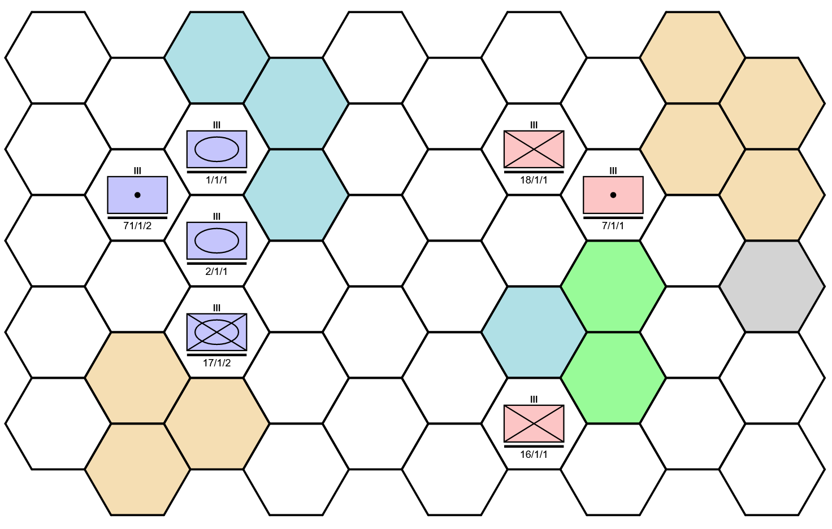
Atlatl
Very simple, easily customizable wargame
Intended for research and educational use
Model is Python and runs quickly
Optional visualization/human in the loop is via browser
Red and blue alternate turns
Each turn, each unit either moves or fires
Fire effects use the deterministic salvo model for resolution
Units are fully specified by several data tables: detection and engagement ranges, offensive and defensive firepower vs each other platform, mobility, defensive advantage from terrain

Slide 5
Outline
Current applied work
Obstacles
Current foundational and future work

Slide 6
Current Applied Work

Slide 7
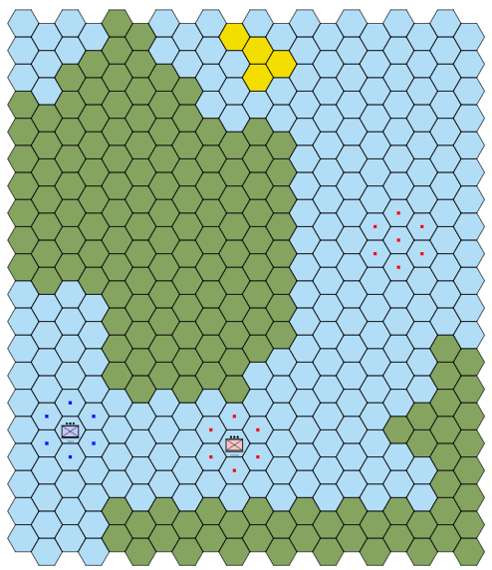
FONOPs Decision Support
Simple FONOPS (one blue ship vs one or two harassing red ships)
Scenario from LT John Allen’s thesis work shown at right
Codebase supported by ERDC ITL
Sponsor is NSWC PHD

Slide 8
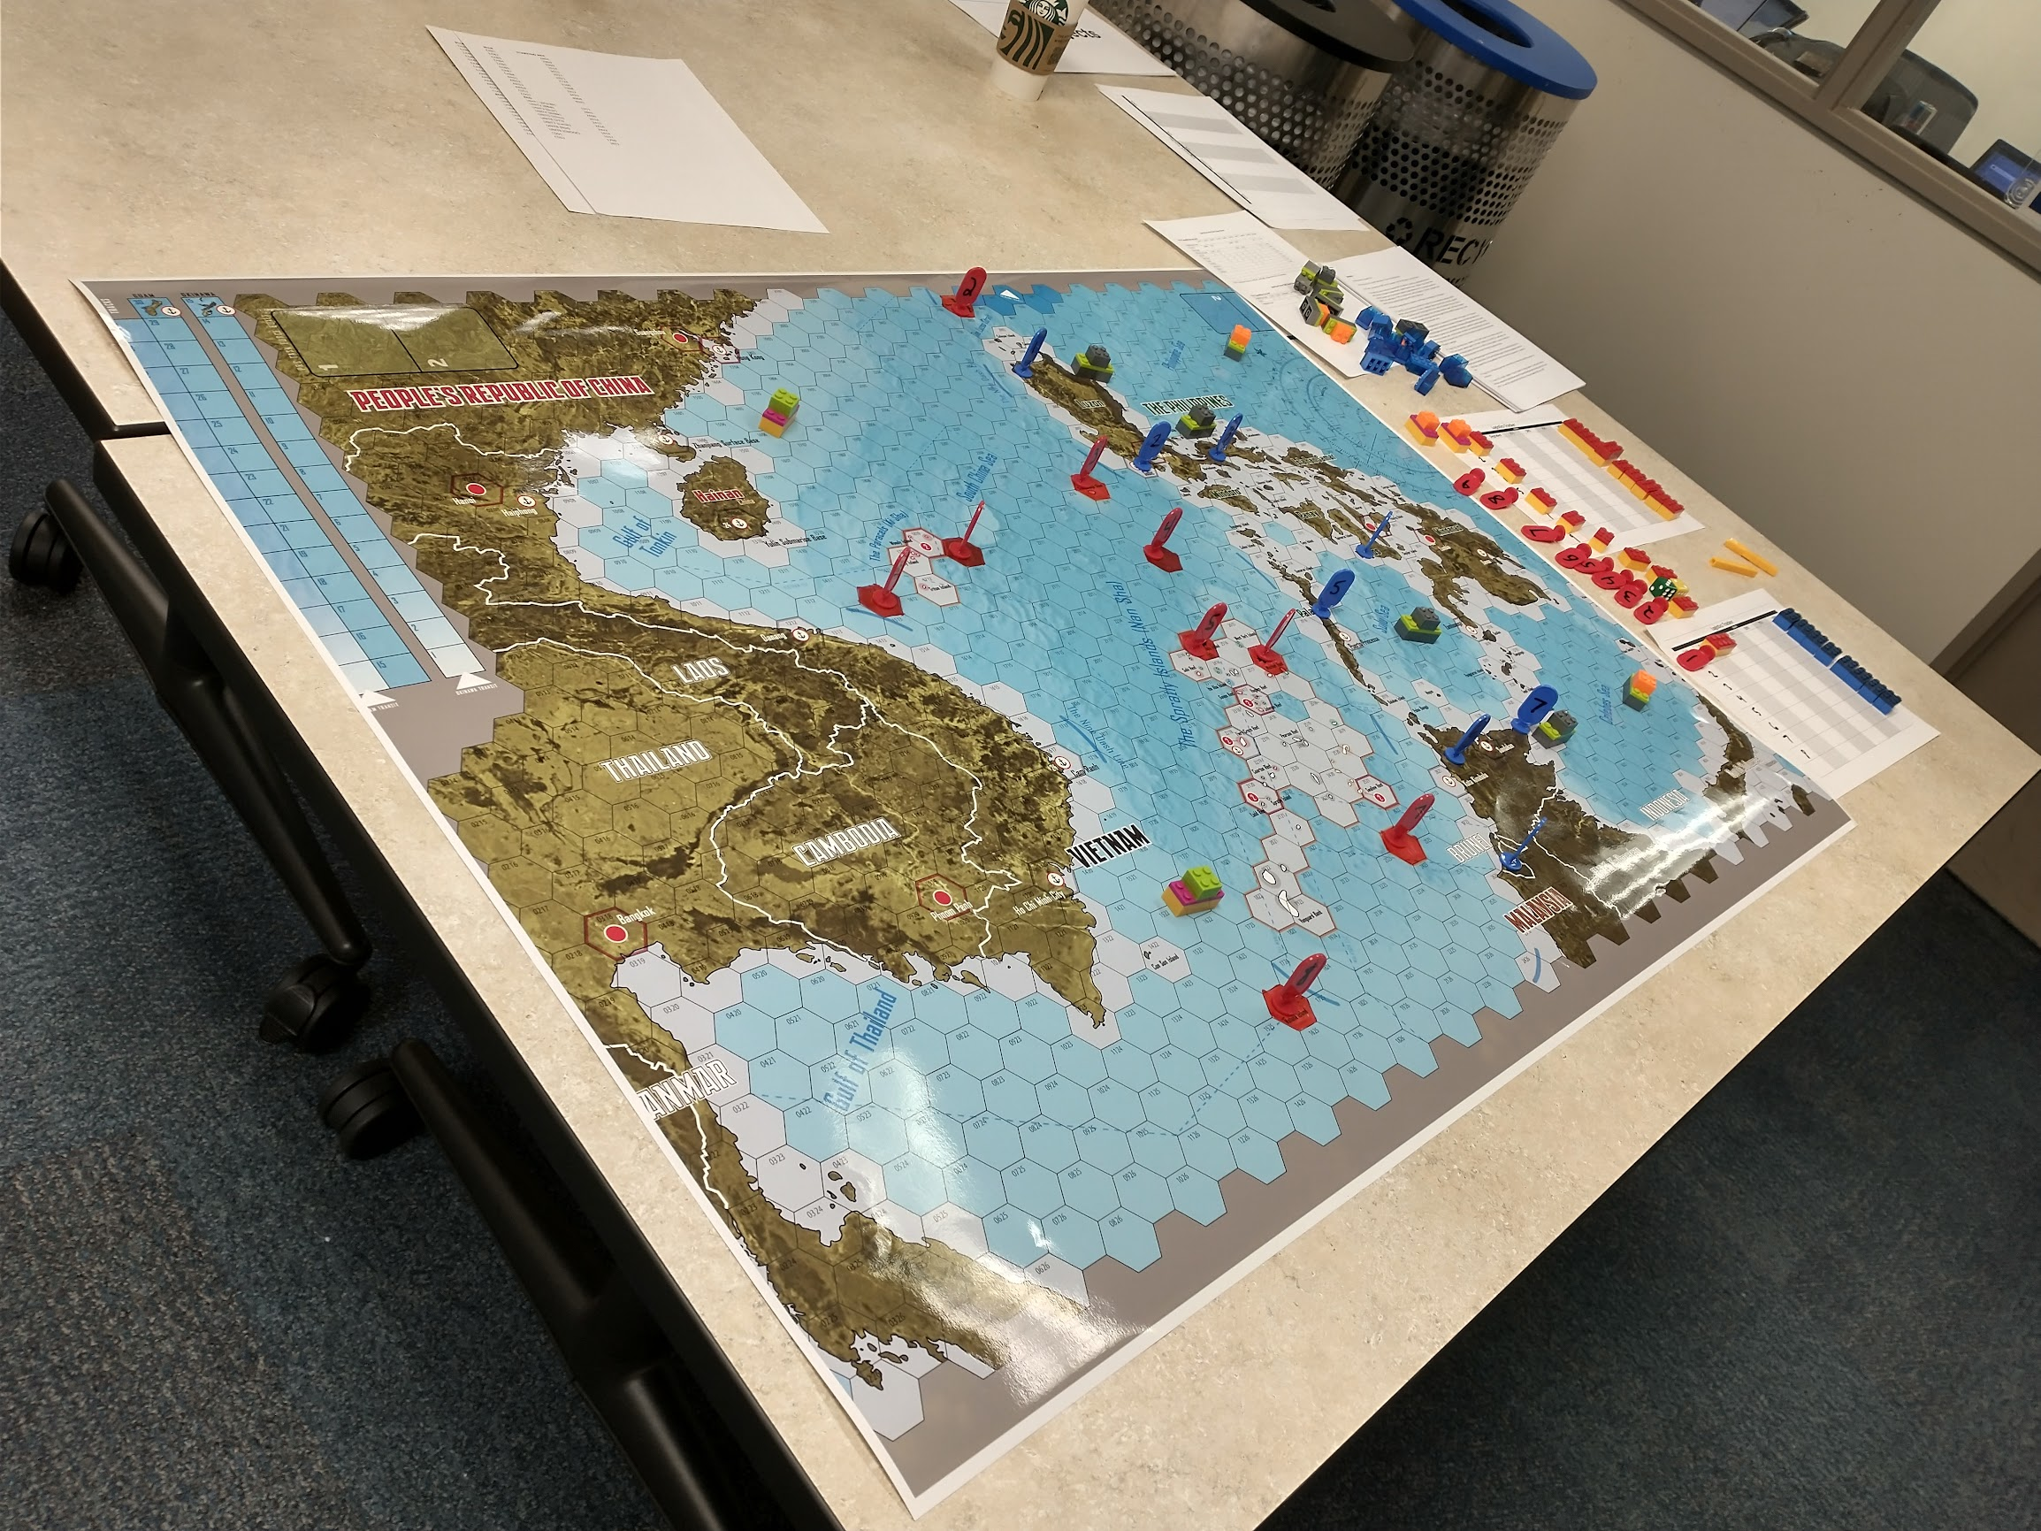
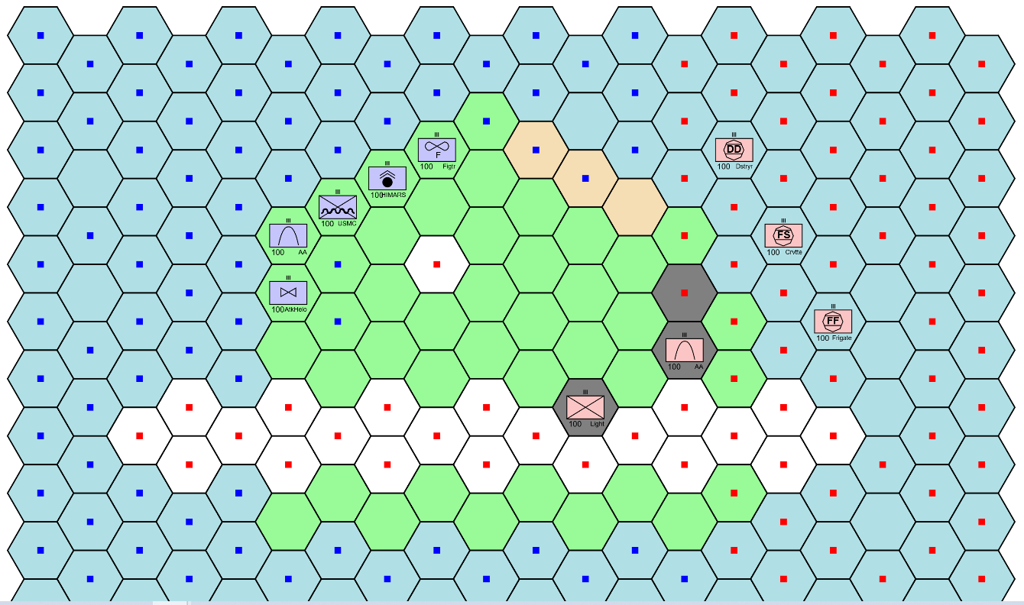
Hi-Speed Wargaming
Unclass EABO scenario provided by sponsor MARFORPAC G-35 for Jeff Appleget’s wargaming course
One large team runs a large scale tabletop wargame
MOVES Tiger Team (Pugh, Reynolds, Pugh) resolves fine scale island battles
Atlatl with 15 new TT-defined unit types
Existing scoring-based AI (non-ML)
Wargame should be open for viewing first week of June
Island
Battle

Slide 9
Main Obstacles
Lack of rigorous mechanics and MoEs
“Tactically savvy” ML-based AI not even being attempted
Effective search is problematic

Slide 10
Lack of Rigorous Mechanics and MoEs
AI methods select actions to maximize a measure of utility, so...
The mechanics of the simulation need to be rigorous, i.e. well defined and thus consistent
A measure of overall utility needs to be precisely defined, i.e. a summative MoE needs to be constructed, possibly from traditional limited MoEs. E.g. utility is the number of enemy forces destroyed minus the number of friendly forces lost minus supplies expended
Most DoD computer simulations have rigorous mechanics, but often lack a summative MoE
Wargames moderated by a human referee often lack both rigorous mechanics and a summative MoE
This is at least partially a cultural issue; resources and strenuous efforts will be required

Slide 11
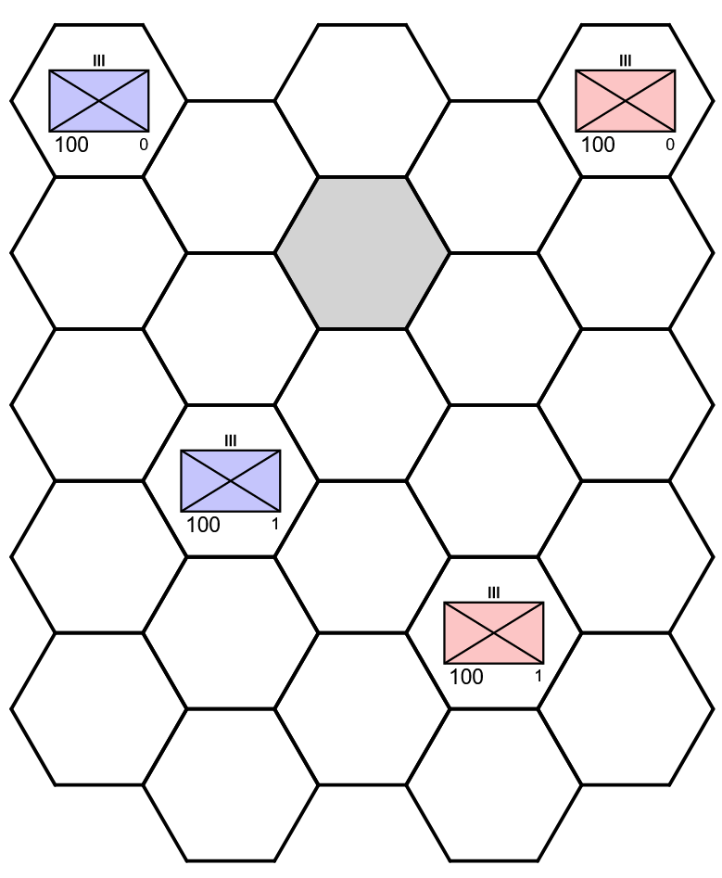
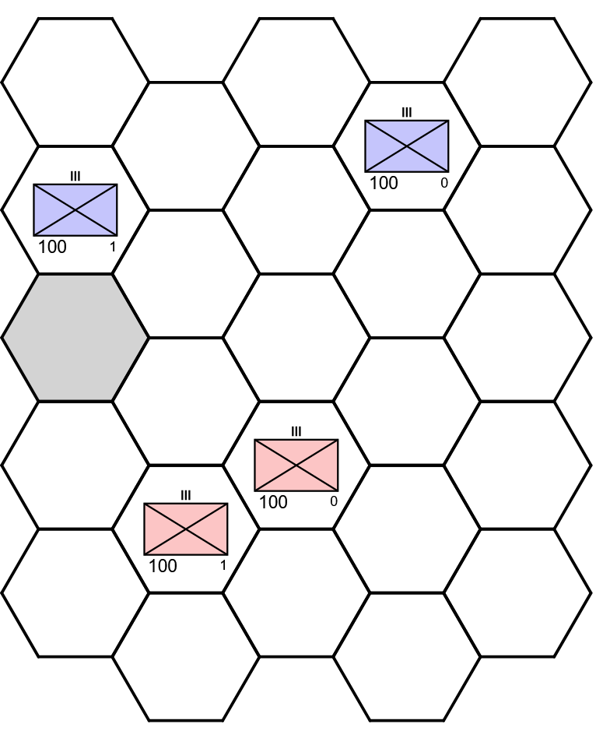
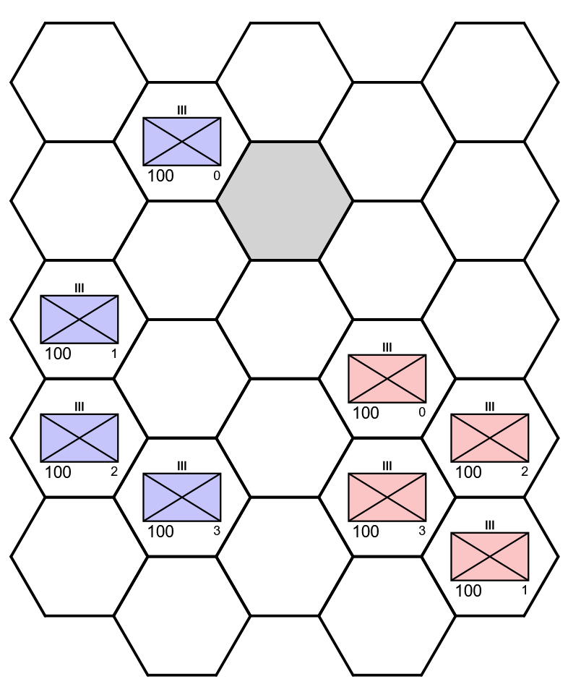
Tactical Savvy Not Attempted
Current ML-based tactical AI efforts across the defense community produce AIs that perform well for a single scenario (terrain, OOB, objective)
Application to another scenario requires (at minimum) retraining the AI, if not some amount of human engineering work as well
An AI with true tactical savvy should make competent decisions for a wide range of scenarios
One way to begin addressing this is to train and test AIs using scenario generators that automatically produce a wide range of scenarios
Output from a simple generator produced for Atlatl is shown at right

Slide 12
Inefficient Search
The spaces that an AI must search are enormous
Reinforcement learning uses random search, which may...
Attempt exact same option multiple times
Spend most of its time exploring similar options
Fail to explore “short term pain for long term gain” COAs
 | State Space | Branching Factor
chess | 10^44 | 35
Go | 10^170 | 250
small wargame | 10^44 | 10^7
medium wargame | 10^124 | 10^64
Notes: Wargame estimates are lower bounds based mostly on movement and neglecting unit status. Small wargame is 9 units on a 10x10 map (single leader training exercise scale). Medium wargame is roughly the size of MCWL’s 9-Dash Line scenario (50 units per side, 15x15 map)

Slide 13
Demo: Larger Scale, Sub-Optimal Behavior

Slide 14
Hierarchical Reinforcement Learning
Higher Echelon AI
AI is split into parts
Lower echelon: control a subset of the units, have focused missions
Higher echelon: specifies goals for lower echelon AIs, which in turn determine how they will be rewarded
Divide and conquer approach: one large decision problem has been reduced to multiple smaller ones
LTC Patrick Rood’s thesis
Goals
Lower Echelon AI 1
Lower Echelon AI 2
Rewards
Actions
Simulation

Slide 15
Way Forward
Applied
Reinforcement learning to enhance non-ML AI (constrained AI)
Examine loading player actions onto a neural network to bootstrap ML (“imitation learning”)
Vignettes from full scale games (e.g. Assassin’s Mace)
Fully solving games played on a small mobility graph
Foundational
Study optimal maneuver in the simplest possible settings, e.g. identical units on a map that is featureless except for a small number of key terrain hexes
Game solvers (engineered evaluation, AlphaZero) applied to small wargames

Slide 16
Questions?

Slide 17
State Space Size
Compare to
tic tac toe : 3 (log base 10) solved
checkers : 18 solved
Othello : 28
chess : 44
Stratego : 115
Go : 170
Wargame state space size: (k X w X h)^n, where k is number of health levels and n is the total number of units (sum of red plus blue)
If w=h=10 and k=3, that’s 300^n = 10^(2n), or in log base 10, 2n
n=18 => 44
n=50 => 124
Compare to atoms in universe, etc. : 80

Slide 18
Average Branching Factor
Board games
tic tac toe : 4 solved
checkers : 2.8 solved
Othello : 10
chess : 35
Stratego : 22
Go : 250
Wargame branching factor: k is the total number of units per side
Assuming no terrain prohibitions, the number of possible new positions for each unit are the “hex humbers” corresponding to the maximum move length
1:7, 2:19, 3:37, 4:61, 5:91, 6:127, 7:169, 8:217, 9:271, 10:331, 11:397
Corresponding branching factors are:
1:7^k, 2:19^k, 3:37^k, ...
A small command training scenario could have k=9. If each moves one hex, branching factor is 7^9>40,000,000
Assassin’s Mace 9-Dash Line scenario has k=53 for opponent and k=64 for US allies. Slow movement is 2 hexes (fast ships and air move further). So branching factor is about 19^50~10^64

