Slide 1
Combat Aviation Brigade
Architecture Integration Lab (CABAIL) Overview
Briefing to MOVES Institute Open House
Mr. Al Abejon
Director, CABAIL
Program Executive Office for Aviation
24 May 2022

Slide 2
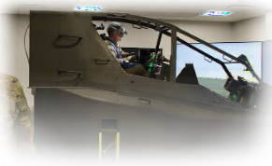


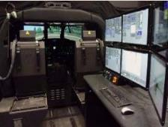

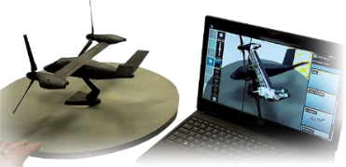
CABAIL Objectives
Holistically develop capabilities of the Combat Aviation Brigade (CAB) as a lethal force
Provide a risk-reduced environment to examine / explore technologies and capabilities for the CAB
Introduce Aviation Warfighter influence early in the design and implementation of technical solutions
Streamline incorporation of systems and capabilities of PEOs/PMs with Aviation equities into the CAB
Expedite increased capabilities to the Aviation Force
Influence FVL capabilities and shape Tactics, Techniques, and Procedures (TTP)

Slide 3
Operational Challenges
Shift from COIN* to LSCO** Environment
Extended operational depth – 400-700 miles / 800+ miles Cross-FLOT; not 100-150 miles
Dynamic Balance between Reach and Stand-Off Ranges
Interoperability of Large Army Formations with Joint and Coalition Forces
Multi-faceted Battlespace
Varying Contested Environments, Anti-Access/Area Denial
Cyber Threat Complexities
Influence of Space Operations
Force Modernization
Implementing change at the “speed of relevance”
Maintaining capability throughout change
Concurrent Warfighter adaptability
Critical Information Exchange
Every battlefield system/platform generates, processes, and/or receives information
Requires dynamic, resilient network of networks
*Counterinsurgency (COIN) **Large Scale Combat Operations (LSCO)

Slide 4
Churns of Change Factors
Rapid Pace of Technology Change
Quantum leaps in technology occurring in months not 2-3 years or decades
Requirements based on technology during the time of establishment
Ripple delay effect throughout acquisition process
The Evolving Threat
No longer “third-world” country focused
Peer, near-peer, and overmatch threats
Allies today could be adversaries tomorrow; adversaries today could be allies tomorrow
Dynamic Operational Environment
Joint, Interagency, Intergovernmental, Multi-national (JIIM)
Range of Military Operations (ROMO) -- “Full Combat” to “Peace and Stability” to “Homeland Security/Domestic Operations”
Rapid force projection, sensor/counter-sensor, weapons capabilities, artificial intelligence (AI), agility and flexibility, and rapidly adaptable communications systems

Slide 5

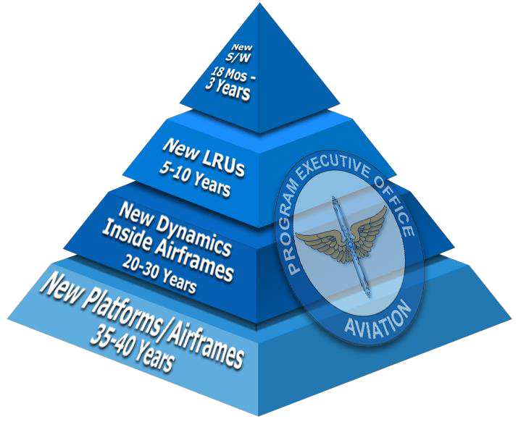


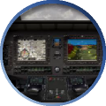



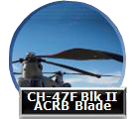

































Army Aviation Development Battle Rhythm Pyramid
Industry Alignment is Critical to the Materiel Development Mission
Greatest Opportunities for Agility Occur in the Software and LRU / Component Domains
UH-60M MFDs
Improved Data Modem
CH-47F Blk II
ACRB
Multi-core
Processor
CH-47 Blade
ITEP
T700
FARA
FLRAA
UH-60L/M/V AH-64D/E
Enduring Fleet Targeted Modernization Applicable to Future Vertical Lift
Capabilities must be developed and fielded at the “speed of relevance”
5

Slide 6















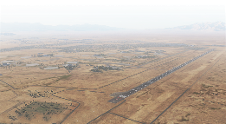
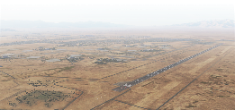







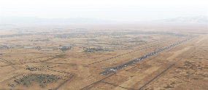



Air-Ground Integration Enterprise (from a PEO Aviation Perspective)
Areas of Integration
Operational
Technical
Programmatic
Systems
Production
Sustainment
PEO GCS
Ground Platforms
PEO CS&CSS
Logistics
Army Futures Command
Systems Integration Alignments
PEO C3T
Networks & Communications
PEO Aviation
Air Platforms
Joint MATDEVs
USAF / USN / USMC / USCG
COEs
Army Branches
SOCOM
ARSOAC / AFSOC /
TAPO /160th SOAR
PEO Missiles
and Space
Airspace Coordination
PEO EIS
Information Management
MEDCOM
Soldier Sustainment
PEO IEW&S
EW and Sensors
PEO Soldier
Soldier Interface

Slide 7




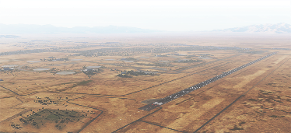


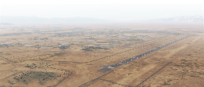









Expanded Air-Ground Integration Enterprise (from a PEO Aviation Perspective)
Areas of Integration
Operational
Technical
Programmatic
Systems
Production
Sustainment
PM MBCT
PM SBCT
JPO JLTV
PM E2S2
CFTs
PM AMPV
PM MPF
PM FP
PM AFV
PM TS
STE
AMDC
F&C
PEO GCS
Ground Platforms
PEO CS&CSS
Logistics
NGCV
Soldier Lethality
PM FLRAA
FVL
PM CH
PM FARA
PM I2S
LRPF
PM AH
APNT
PM UAS
PM UH
PM MC
PM TN
Network
Army Futures Command
Systems Integration Alignments
PM MASPO
PM AMSA
PM FW
PM ITE
PM TR
PEO C3T
Networks &
Communications
CCDC
PEO Aviation
Air Platforms
Aviation
Fires
Mission
Command
MARSYSCOM
AFMC
Maneuver
PEO C4
PEO FW
NAVAIR
Cyber
PEO RW
Intel
COEs
Army
Branches
SOCOM
ARSOAC / AFSOC /
TAPO / 160th SOAR
Joint MATDEVs
USAF / USN /
USMC / USCG
Sustainment
PM Lower Tier
PM IPPS-A
PdM Ground
Soldier
PdM Air Warrior
PM
IAMD
PM DCO
PM
DCATS
USAMMDA
PM
JAMS
PM
C-RAM
PM
ASE
PM ES
TATRC
PM SSV
PM
Sensors
PM
AESIP
PM
IVAS
PD
REF
PEO Missile
& Space
Airspace Coordination
PEO EIS
Information
Management
MEDCOM
Soldier
Sustainment
PEO Soldier
Soldier
Interface
PEO IEW&S
EW and
Sensors

Slide 8


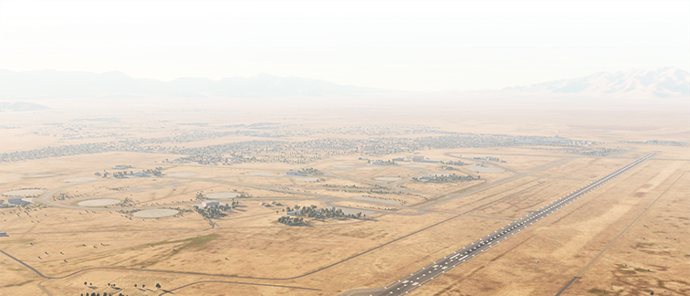







Joint Air-Ground Integration/Large Scale Combat Operations (LSCO)
Coordinated Convergence of Effects at the Tactical Edge
“Move, Shoot, Communicate”… If you can’t communicate, you don’t know where to move, what or when to shoot.
Timely mission information exchange to converge decisive effects at critical points on the battlefield requires a dynamic network of networks
To COCOM
Enemy Situation/Operational Mission Status/A-G COP/Log Info
Ground SITREP/A-G COP/Air-Threat Aircraft Status
Link 16 LEOS
BLOS Voice
Link 16
LEOS
Voice/COP/C2
Ground SITREP/A-G COP/
Air Threat/Aircraft Status
Mission
Status & C2
BLOS Voice
AEHF
Mission Status/Info
Air COP/DACAS
Air COP/DACAS
Air COP
DACAS
Mission Status & C2
WB SATCOM Equipped C2 Aircraft
Ground SITREP/A-G COP/
Air-Threat/Aircraft Status
Air COP
DACAS
JTAC
Extended Expeditionary Operational Ranges
Internal Aerial Network
Gnd SITREP
A-G COP
BLOS Voice
Military
Objective
Main Base
Mission Status & C2
Long Range
Precision Fires C2
LEGEND
Log SITREP
Aircraft Status
Ground Network
Forward Edge Network
WB SATCOM/BFT 2 & 3
AEHF
Link 16, SATURN
Contested
Environment
LOS (TSM, SINCGARS
w/CRYPTO MOD,
VHF/UHF)
TSM
FARP
Forward Element Cmd Post
Forward Area
MUOS Voice

Slide 9

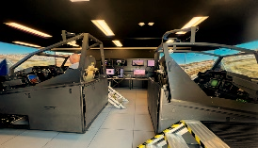
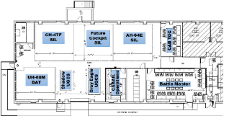








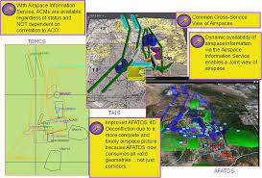

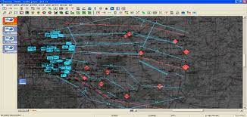
CABAIL Composition, Configuration, and Use
Components Interoperable:
High-fidelity Aircraft Replications and Virtual Simulators
Ground Control Stations
Constructive Simulation
Mission Management Center (Battle Master)
Implementation
Integrate existing & prototype Air-Ground systems
Man with actual Aircrews and Staff Personnel
Employ capabilities employed in Multi-Mission Scenarios
Compare Quantitative & Qualitative Data – ‘To Be’ capability measurements against ‘As Is’ Baseline
Measure ‘Before/After’ CAB Operational Values
AH-64E SIL
AH-64E MODLAB
Bldg. 5678 Redstone Arsenal, AL
TOC Mission
Command Systems
UH-60M D-SIL
JBC-P
MOSA Open ITB
WinTAK
Enabling Voice &
Data Networks
FM/SINCGARS/VHF/UHF Voice Radios
Tactical Scalable MANET (TSM)
Blue Force Tracking (BFT) 1 / 2
SATCOM DAMA
HQ1 / 2 (migration to SATURN)
Link-16
High Frequency (HF)
Abn Wide Band SATCOM
Common Data Link (CDL) / BE-303/4
Mobile User Objective System (MUOS)
APCO P-25 (phase 1/phase 2)
WiFi
Dissimilar Networks Routing
CH-47F SIL
CAB TOC
TAIS
Gray Eagle
GCS Emulator
Shadow GCS
Emulator
AMPS
(AFATDS)
Constructive Simulation of CAB Aircraft / Assets
Battle Master
(JADOCS)
(In Work)

Slide 10




















CABAIL Employment and Feedback Loops
Development of Aviation as a “Force”
Multi-faceted Risk-Reduction Process
Expedite Capabilities to the Force
Inform/Shape FVL Capabilities
Warfighter
Participation
Input
Input
Strategy
Input /
Feedback
Virtual Aircraft SILs / Constructive Simulation / Live Networks
Input /
Feedback
Policy
Implementation Plans
Rapid Technical Insertion
TRL6-TRL 9
Hardware
Software
Data Exchange
Combat Aviation Brigade Architecture Integration Lab (CABAIL)
Focused Operational Validation
Hardware
Software
Data
Exchange
Reference Architecture
Reference Architecture
Operational Adaptation and Explorations
Input /
Feedback
Modular Open Systems Approach (MOSA) Architecture
MOSA Transformation Office (TO)
Field Early to User
Inform/
Shape
FVL
Input /
Feedback
Common/Standard
Interfaces
Hardware
Software
ICDs
Data Formats
Input / Feedback
Relevant / Usable Capability
Influence FVL
Capability
CFTs, PEOs/PMs (Aviation, C3T,
I&EWS, Soldier, SOCOM, M&S,GCS, CS&CSS, EIS, USAMDA)

Slide 11
Current-Projected CABAIL Army/Joint Networks Connectivity
Promote & Support Operational Joint Force Concepts Development
Redstone Arsenal, AL
Army Aviation as a “Force”
Legend
S3I/JSIL Bldg 6263
Established
S3I/SAIL Bldg 6263
AH-64E SIL
AH-64E MODLAB
Planned/In Work
S3I/APEX Bldg 5400
Established
CH-47F SIL
Aviation “Eco”SIL
Gray Eagle
UGCS
RTC/DTTC Bldg 4500
Planned/In-work
NCM3 CH-47F
CABAIL
RC-12 EMARSS
CJSIL-Hub (APG, MD)
UH-60M D-SIL
Network Comms
Coordination Ctr
CAB TOC
GVSC SIL (Warren, MI)
NCM3 UH-60M
Battle Master
FVL CFT SIL
APARI SIL (Ft. Belvoir, VA)
UH-60L CAP-T
Shadow UGCS
FARA Vendor
Virtual Prototype
FIRES SIL (Ft. Sill, OK)
USAARL Aircrew Stress SIL (Ft. Rucker, AL)
Aviation Capabilities Connectivity
Naval Postgrad School FVL SIL (Monterey, CA)
Risk Reduction for Project Convergence (PC)
Edge 22 LBRR
PC 22 LBRRs 1, 2, & 3 / COMMEXs A & B
PC 23 COMMEXs
AFRL (Rome, NY; Wright-Patterson AFB, IL)
NAVAIR SIL (Patuxent River, MD)

Slide 12

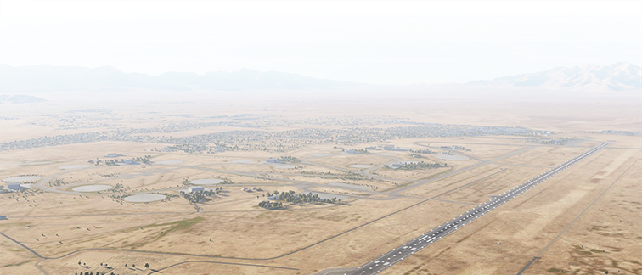




















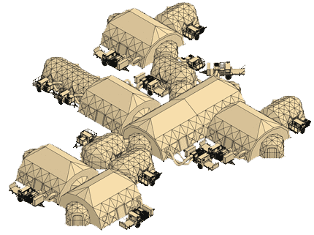
ALE Long Range Missions, Data, and Comms
ALE Vehicles with Configurable Multiple Mission Equipment Packages Launched from Manned / Unmanned Aircraft
Stand-off LSCO Multi-Domain Effects at Extended Ranges
AirMCOTM/ CRE C-12
WB SATCOM
Satellite
Launch Platforms Missions
BFT2/3
Satellite
CH-47F
Extended Range Comms Relay (ERCR)
LLAM
LLAM
Comms
Counter
UH-60L/V/M
Relay ERCR
Drone
Surveillance / Recon / BDA
ERCR
EW Sensor
AH-64E
Electronic Warfare (EW) Sensors
C-12
Force Decoy
Long-Range Loitering Aerial Munition (LLAM)
Base Sanctuary
ERCR
X
X
X
X
MQ-1C
Supply/Resupply
LLAM
Surveillance / Recon / BDA
FTUAS
Counter Drone
Ground Network
(ITN-TSM/Link 16)
FLRAA
Force Decoy
Enroute
MDTFF
Air Network
(ITN-TSM/Link 16)
FARA
Autonomous Support of Comms, Force Protection, SA/SU, and Sustainment at Extended Distances
Forward Element
ALE Control Data Link (CDL)
Supply/Resupply
Forward Base
BFT2 / 3
WB SATCOM
Compete, Penetrate, Disintegrate, Exploit, and Dominate at Operational Ranges

Slide 13






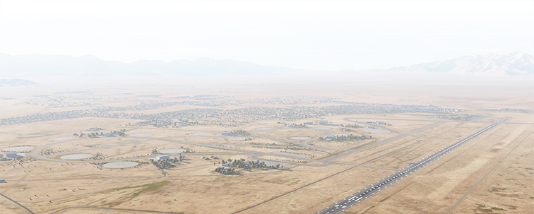









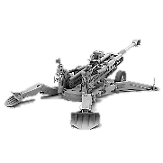

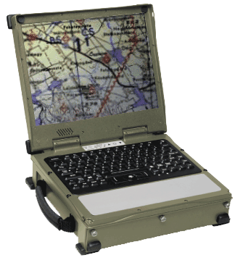
Dynamic Airspace Synchronization
Shared Real-time/Near Real-time Joint Airspace Situational Awareness
Near Real-time Aircraft Tracking Below 3000 ft. AGL
Non-radar SA for ATC
Commercial/Coalition SA
Dynamic Airspace Management/De-confliction
Airspace Control Measures to Cockpit (Air Corridors, GTLs, ROZs, SAFIREs, NOFLY)
Fratricide Reduction
WB SATCOM
SEAD/DEAD Operations
BFT2/3
Comprehensive Joint Airspace/Aircraft COP
Link 16
Airspace Coordination Altitude
CAS Operations
A-G COP
Force Decoy
Ground Network
(ITN-TSM/Link 16)
TAIS
AMPS
Air Network
(ITN-TSM/Link 16)
ROZ
BFT2 / 3
IMPACT
WB SATCOM
Counter Drone
ACM Changes
Link 16
Air Corridors
Command Post
Internal Aerial Network
Ground Network
ROZ
MAIN BASE
Air Corridors
Supply/Resupply
AFATDS
Gun Target Lines
Forward Edge Troops
13

Slide 14





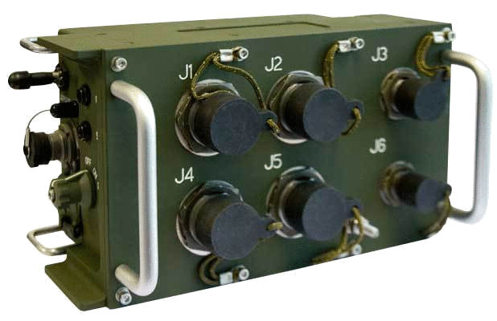















Joint All-Domain ASE Collaboration
Air Threat Survivability - COP Synergy - SEAD/DEAD
AIS Tablet
w/ATAK
(Non-Digital Aircraft)
Aircraft On-board ASE and Radios
BFT2 Avn
(BLOS)
To BFT NOC
GMR 1000
(Non-Digital Aircraft)
APR-39
Radar
Warning Receiver
Link 16
(LOS)
Link 16
AVR-2B
Laser
Warning Receiver
or
STT /
KOR24-A
PRC-161
Common
Missile
Warning System
AMCS
(Digital Aircraft)
PRC-158 or
PRC-162
TSM
(LOS)
Common
Infrared Counter-Measures (CIRCM)
(AT I RCM - CH-47F)
Multi-Function/ Purpose Display
(Digital Aircraft)
ASE Alerts
Aerial Tier
TSM
Ground Network
(TSM)
Air Network
(TSM)
Threat Radar
Threat Alert Data
DCGS-A
TAIS
Ground Tier
TSM
Link 16
BE-303 CDL
BFT2
G2/G3

Slide 15
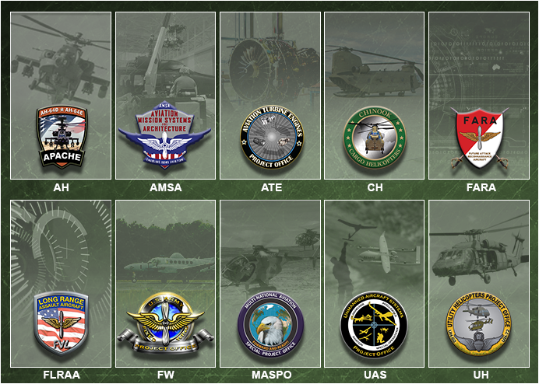
Closing Comments and Questions

Slide 16
BACK-UP
CHARTS

Slide 17



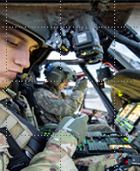
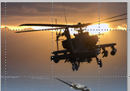
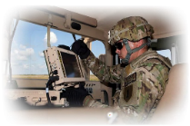

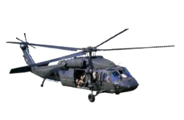


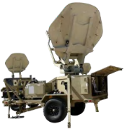


Army Aviation Focus Areas
Air Reconnaissance and Security
Tactical Transport/Re-supply of Ground Forces
High Combat OPTEMPO Equipment Readiness
Joint Lethality Options
Threat Weapon Systems Protection
Congested/Complex Airspace Operations
SEAD/DEAD
Safe DVE/Urban Operations
Counter Recon Against Aerial Threats
MEDEVAC Responsiveness
AGI Networked Interoperability/Range
Aircraft Network Setup & Initialization
Extremely High Interest
Very High Interest

Slide 18

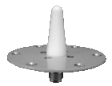



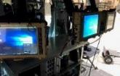





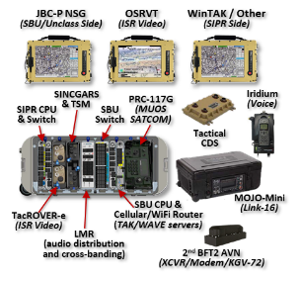



Airborne Mission Command On-the-Move (AirMCOTM)
Inflight Joint Mission Command at Extended Operational Ranges
Carry-On/Carry-Off (COCO)
Command & Control (C2)
Integrates POR Products w/COTS Items
Greater Comprehensive SA/SU
UNCLASS, CUI & SECRET Capabilities
Encrypted/Unencrypted ISR Video
Joint Links for Integrated Air-Ground Ops
Multiple LOS/BLOS Communications
Aligned with Army’s Integrated Tactical Network (ITN)
Supports C2 Missions throughout ROMO in the JIIM environment
2nd
BFT2
TSM
Link 16
UH-60L C2
Antenna A-Kit
Adds
Wi-Fi
FUTURE
2 x PEO Soldier
AIS Tablets
(w/ATAK)
MUOS
WB SATCOM
Airborne COCO C2 System
Wi-Fi
PRC-148C TSM Radios (Voice / Data)
TacROVER-e (Encrypted ISR Video)
PRC-158 (2 x channel) SINCGARS, UHF/VHF/FM, HQ1/2, SATCOM IW & DAMA, TSM, ANW2C, P-25 (replaces PRC-117G)
KOR-24A/STT (2 x channel) Link 16, SINCGARS, VHF/UHF/FM, HQ1/2, SATCOM, IW & DAMA, ANW2C, P-25
Small Server and 24-port Switch (NIPR/SIPR)
Cradle Point (WiFi & Cellular)
Tactical CDS (Cross-Domain Solution/Switch)
Iridium Phone
MFoCS Displays for JBC-P, WinTAK & ISR Video
Separate BFT2 AVN/JBC-P System for On-board Commander
Fills current AirMCOTM void
Adaptable to other platforms for airborne C2 in Multi-DomainOperations
Current Configuration
Focus Areas: Joint Lethality Options/Tactical Transport/Re-supply at Ground Troops/Network Setup and Initialization

Slide 19

Current Infrastructure/Capabilities
NCM3 CH-47F
Voice & Data Networks
FM/SINCGARS & VHF/UHF
Voice Radios
Tactical Scalable MANET (TSM)
Blue Force Tracking (BFT) 1 / 2
HQ1 / 2 Link-16
Abn Wide Band SATCOM
Common Data Link (CDL)
WiFi
NCM3 UH-60M
CH-47F
SIL
UH-60L
CAP-T
SIL
AH-64E
SIL
RC-12
EMARSS
CAB TOC
UH-60M
SIL(-) w/
OpenITB
Shadow
UGCS
Gray Eagle
UGCS
CABAIL
Operations
AH-64E
MODLAB
Battle Master
Legend
RTC / DTTC
w/2-way CDS
(Bldg 4500)
Established
In Work
CABAIL
(Bldg 5678)
CJSIL
(APG)
Unclassified
Classified
S3I / SAIL
w/2-way CDS
(Bldg 6263)
GVSC SIL
(TACOM)
Planned
In Work
Labs Network Connectivity

Slide 20
Projected Infrastructure/Capabilities 2025 and Beyond
Voice & Data Networks
FM/SINCGARS and VHF/UHF Voice Radios
Tactical Scalable MANET (TSM) Warfighter Resilient Enabled Network (WREN)
Blue Force Tracking (BFT) 1 / 2
SATCOM DAMA
HQ1 / 2 (migration to SATURN)
Link-16
TTNT
MADL
High Frequency (HF)
Abn Wide Band SATCOM
Common Data Link (CDL)/BE 303
Mobile User Objective System (MUOS)
APCO P-25 (phase 1/phase 2)
WiFi
“Eco”
SIL
UH-60M
DSIL(-) w/
OpenITB
NCM3 CH-47F
CABAIL
NCM3 UH-60M
CH-47F
SIL
UH-60V
SIL
AH-64E
SIL
RC-12
EMARSS
UH-60L
CAP-T
SIL
CAB TOC
UH-60M
SIL
Shadow
UGCS
Gray Eagle
UGCS
UH-60M
SIL
CABAIL
Operations
Battle Master
FARA
Vendor
Virtual
Prototype
FVL CFT
SIL
AH-64E
MODLAB
Joint SILs
(AFRL, NAVAIR)
RTC / DTTC
w/BLCSE
(Bldg 4500)
Legend
CJSIL w/BLCSE
(APG)
Established
CABAIL
(Bldg 5678)
Completion
prior to 2025
S3I / SAIL
w/BLCSE
(Bldg 6263)
Fires SIL w/BLCSE
(FSOK)
Unclassified
Classified
Planned
GVSC SIL
(TACOM)
System Integration Labs Network Connectivity

