Slide 1
The Research and Analysis Center TRAC - Monterey
Overview Brief
NPS - MOVES Open House

Slide 2




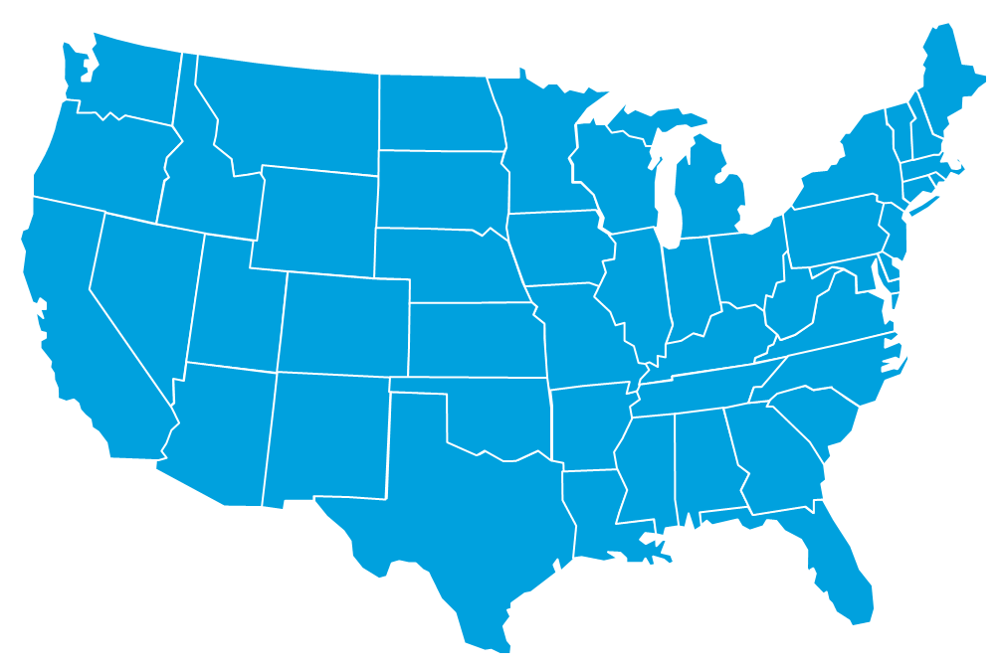

TRAC Organization
AFC
LTG Richardson, Acting CG, AFC
TRAC
Ms. Blechinger, SES, Director
COL Jensen, Deputy Director
Monterey
White Sands
Ft Leavenworth
Ft Lee
LTC Wade
Analytic Research Data Science
Dr. Lambert, SES
LTC McClure
Soldier to Bde OPS
Modeling and Wargaming
Ms. Wagner (Acting)
COL Roach
Div/Corps & Higher
Modeling and Wargaming
LTC Schmidt (Acting)
Sustainment Modeling
Analytic Expertise
Division / Corps & Higher Operations
Individual Soldier to Brigade Operations
Maneuver Sustainment
Analytic Research
Data Science
Modeling and Wargaming
Methods, Models, and Tools
HQ & Ft Leavenworth
Monterey
Ft Lee
White Sands

Slide 3

TRAC Mission
TRAC mission is to produce relevant, objective, and credible operations analysis to inform decisions.
TRAC Mission Essential Tasks
Conduct the studies that inform key decisions made by AFC, Army, and Joint leaders.
Conduct force effectiveness modeling and analysis of the Army Future Force to meet the needs of the National Defense Strategy.
Develop and maintain the scenarios to underpin Army concepts & requirements.
Develop, configuration manage and apply verified and validated models and simulations (M&S).
Research, develop and share new analytic methods and modeling.

Slide 4

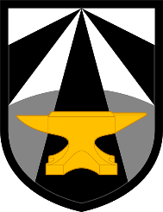

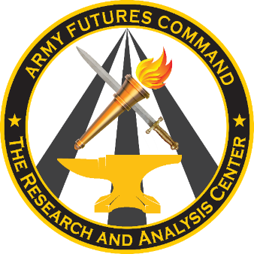


TRAC-MTRY and NPS Partnership
DoD and AFC Research Needs
Military / Government Students
World-Class Faculty
TRAC-MTRY
Naval Postgraduate School
Student and Faculty Research
TRAC-MTRY works with AFC, Army, and DoD sponsors to identify problems that require graduate-level research and performs that research with students and faculty at NPS and other schools.

Slide 5








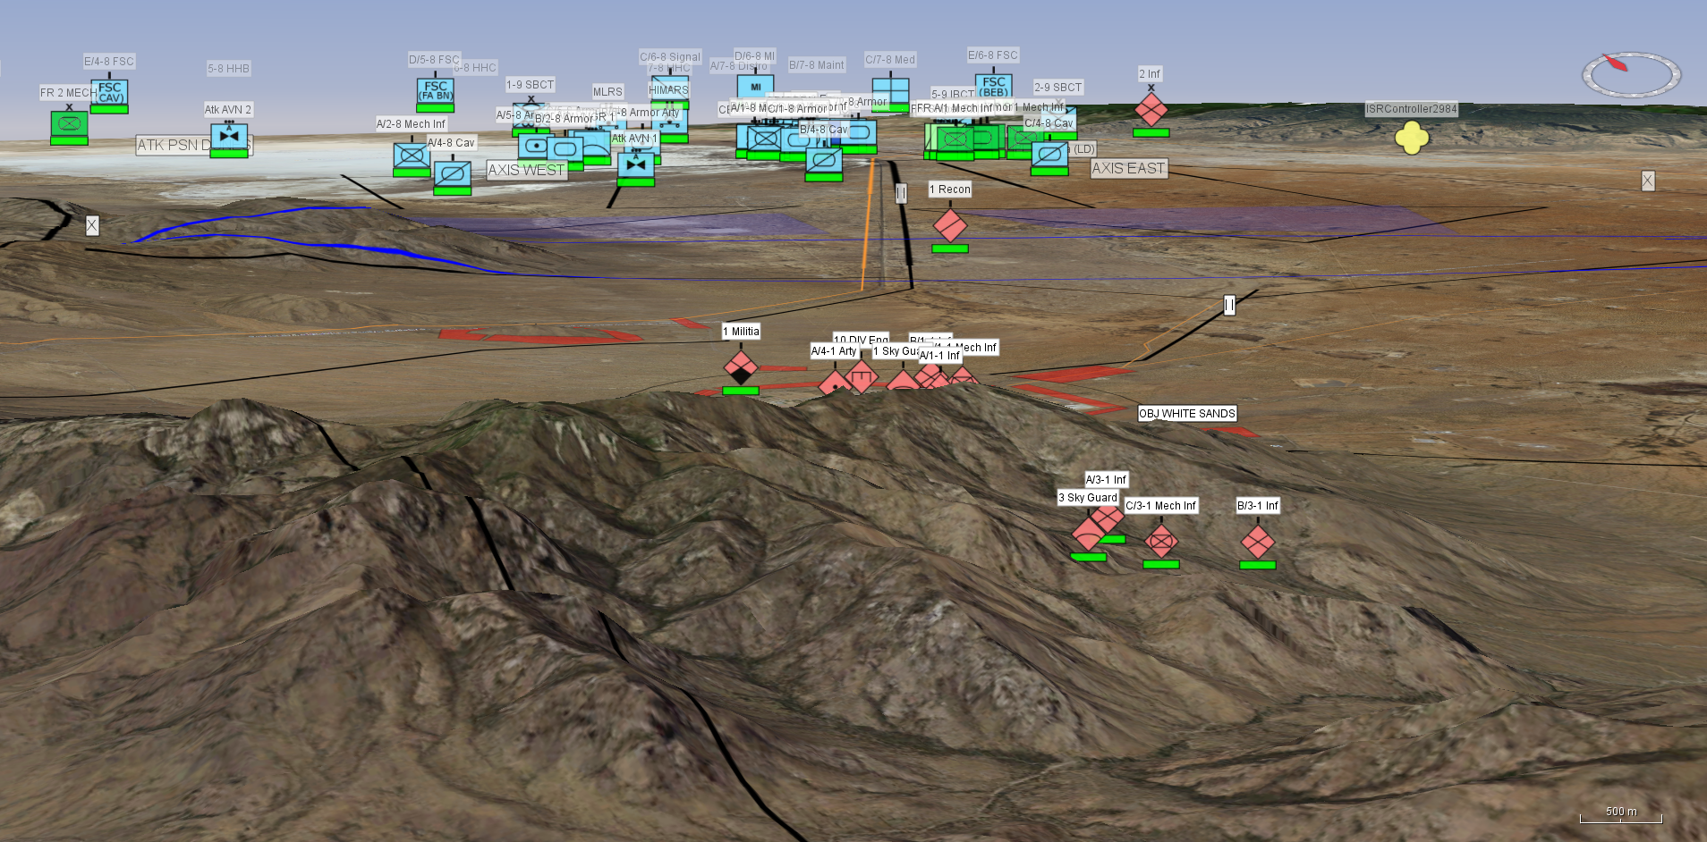
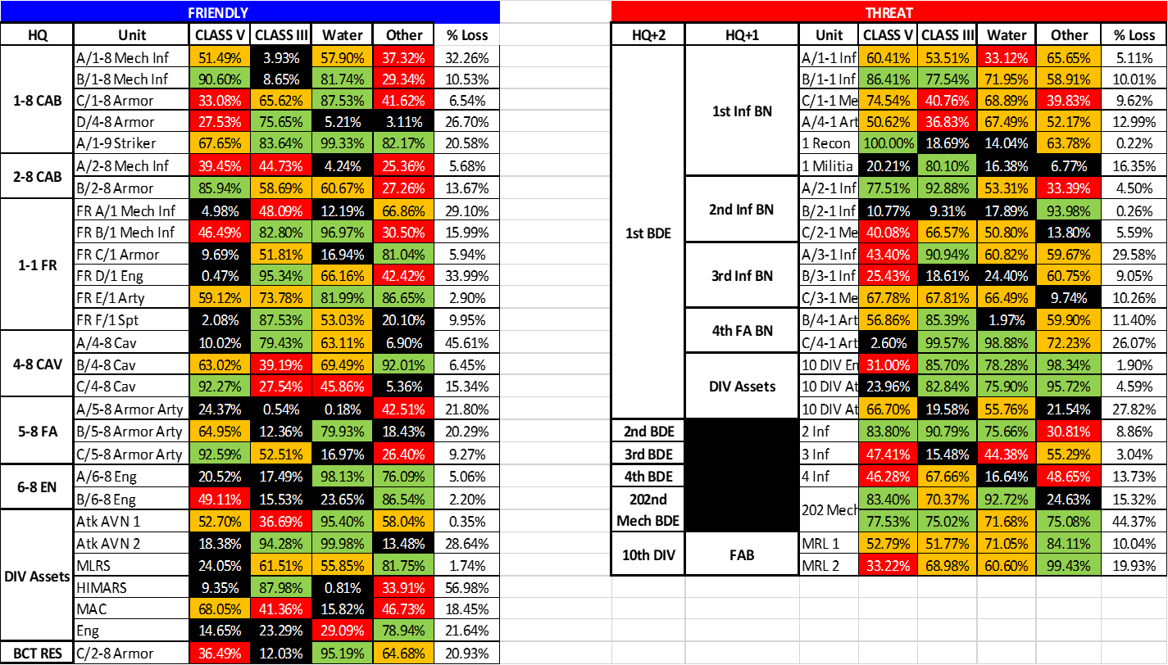
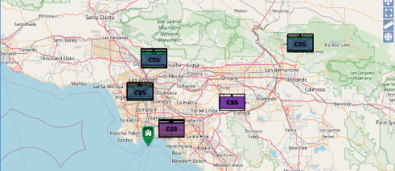
TRAC M&S Capabilities
Analytic Tools: Purpose-Built In-House
The Advanced Warfighting Simulation (AWARS):
  Developed by TRAC.
  Multi-sided; units regard other units as friends, foes, or neutrals.
  Maneuver and engagement decisions based upon perception.
  Operations analysis from Brigade to Corps in a Joint context.
Combined Arms Analysis Tool for the 21st Century (COMBATXXI):
  Developed by TRAC in partnership with the Marine Corps.
  Multi-sided; represents individual combatants as friends, foes, or neutrals.
  Sophisticated behaviors to exploit information provided by the network.
  Operations analysis from Soldier up to Brigade.
Versatile Assessment Simulation Tool (VAST):
  State-of-the-art wargaming tool developed by TRAC.
The Logistics Battle Command (LBC) Model
  A supply consumption and distribution simulator.
Numerous other tools and efforts:
  Artificial Intelligence / Machine Learning / Text Analytics.
  High Performance Computing (HPC).
  Trades tools (system attributes and portfolio).
VAST
Physics based models
High resolution terrain.
Perception based decisions
Continuous R&D
LBC
TRAC M&S enables identifying and understanding the tactical / operational “so what” of new capabilities, concepts and/or force structures.

Slide 6
Current Projects
Development of an Intelligent Agent to Control Entities in a Combat Simulation:
  Use reinforcement learning techniques to enable an AI agent to find the optimal strategy for a selected scenario within a combat simulation.
Project Convergence Real Time Data Analysis:
  Develop data processing, checking, storage, visualization, and analysis tools for streaming data from the Project Convergence exercises.
Combat Simulation Models Transition to the Cloud:
  Develop a process to run TRAC’s combat simulations using off-premises resources.
Virtual Reality to aid the training of DoD Geospatial intelligence Analysts:
  Develop a virtual reality and computer-based training aid to help DoD geospatial intelligence analysis with combat vehicle identification.
Database Recommendation / Search Engine:
  Develop a search and/or recommendation engine for a database of Army analysis documents, information documents, and exercise directives.
Computer Network Data Insider Threat Detection:
  Develop anomaly detection methods for use on large datasets of computer network traffic logs.
Natural Language Processing (NLP) for Exercise Comments
  Develop tools to augment and/or automate the analysis of exercise observers who make written observations.
Defense Language Institute (DLI) Linguist Retention:
  Develop models and visualizations of the attrition trends on DoD linguists and/or develop models and visualizations of a linguist's retention of his/her language skills.
Army Modernization Analysis:
  Develop models and visualizations of programmatic, operational effectiveness, and scheduling data to support materiel acquisition decisions.
Assistant Secretary of the Army for Acquisition, Logistics, and Technology - (ASA)ALT - Data Collection Plan:
  Develop a data collection and analysis plan for (ASA)ALT to understand program delivery schedule and risk, and to help ASA(ALT) leadership answer questions from Army Senior Leaders.
Latent Variable Assessment Through Structural Equation Modeling:
  Develop a more robust meta-model for combat simulations using Structure Equation Modeling.

Slide 7






TRAC M&S Cloud Experimentation
What is the cost-benefit of different cloud-structures to support combat model and simulation experimentation and other use cases?
TRAC On-Premises Infrastructure
Locally managed resources configured specifically to support TRAC.
Able to prioritize resources to meet high-priority study needs.
Server down-time effects all study teams.
Must be upkept and maintained by TRAC personnel and funds.
Future Cloud Infrastructure
Scalable server network with much greater compute capability.
On-demand or reserved resources managed by external organization which has higher availability.
Potentially lower long-term costs.
TRAC Local Compute Farms
Azure - Modernization Application and Data Environment (MADE), cARMY.
AWS - Army MI Cloud Computing Service Provider (AC2SP).
High Performance Computers (HPCs) – DoD owned multi-core supercomputers.
Local computer / server farm – 180 physical cores
Developer, integrator, and postprocessing terminals.
Job management system, servers, and data repositories.

Slide 8
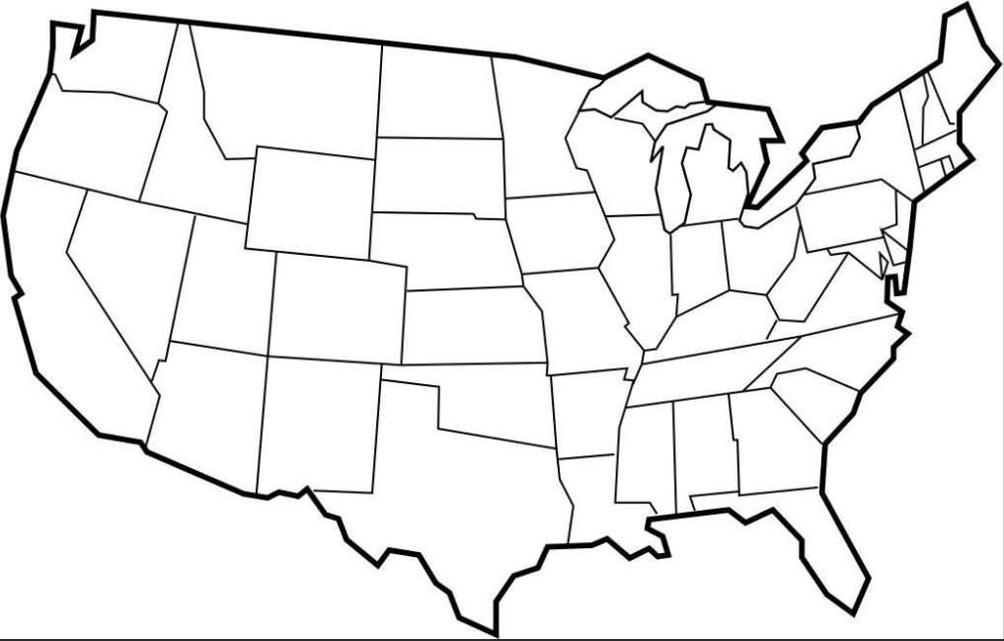
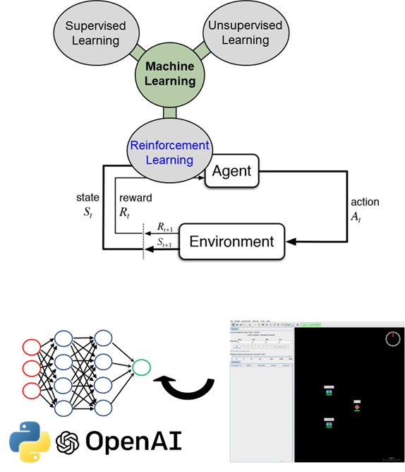
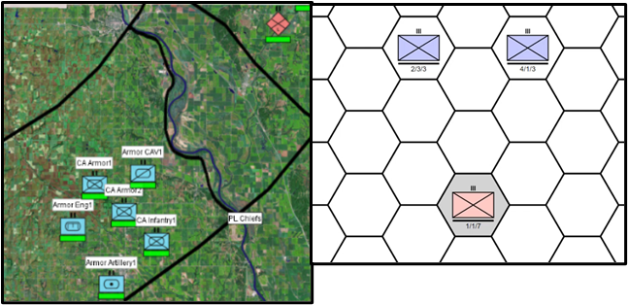
Artificial Intelligence for
Combat Simulations
Sponsors/Stakeholders
Potential Techniques & Methods
Army Futures Command
Futures and Concepts Center
USMC – Operations Analysis
Directorate
Naval Surface Warfare Center
– Port Hueneme Division
Army Artificial Intelligence Center
TRAC
Artificial Intelligence.
Reinforcement Learning.
Potential Thesis
Research Questions
Hierarchical Reinforcement Learning - Can a feudal multi-agent hierarchy (FMH) be effectively leveraged to expand existing work?
Information Systems Integration - Can mission command systems information from Army Combat Training Centers (CTCs) be integrated to inform state space?
Policy Gradient Reinforcement Learning - What are the advantages of using additional algorithms such as Proximal Policy Optimization (PPO), Advantage Actor-Critic Method (A2C) or Deep Q-Networks (DQNs)?
Combat Model Integration - Can previous associated work (trained reinforcement learning agents) be integrated in other DoD combat models (such as COMBATXXI or OneSAF)?
Multi-Agent Reinforcement Learning - What are the advantages of using Multi-Agent Reinforcement Learning techniques/algorithms?
Scenario Expansion - Can the scope/complexity of current scenarios be increased though additional types of units?
Scenario Expansion - Can the scope/complexity of current scenarios be increased though additional types of terrain?
Previous Efforts/Methodology
Proof of
Principle
Background
Project originated with sponsorship from Naval Surface Warfare Center – Port Hueneme Division.
Seeks to apply similar reinforcement learning techniques to integrate with military simulations as previous high profile efforts with Go and Starcraft.
Currently in year three of a joint effort, with faculty support from the MOVES Institute (Dr. Chris Darken).
Integration with VAST

Slide 9

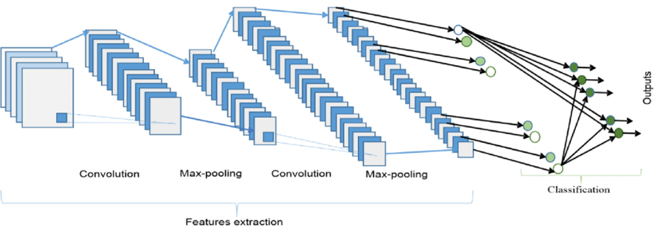
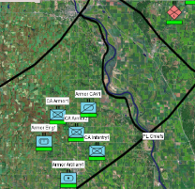
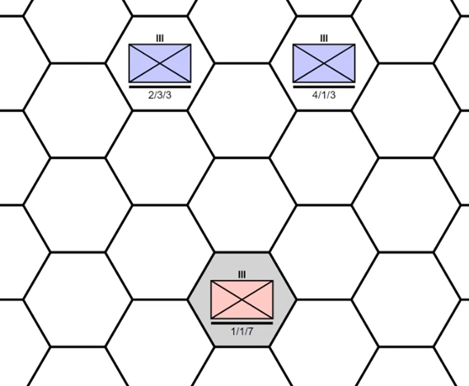
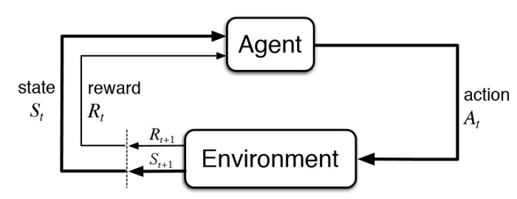
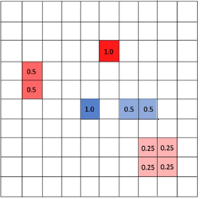
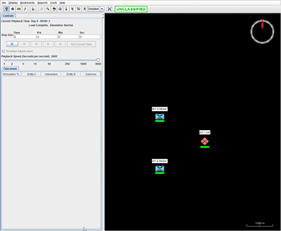

Learning Curriculum Methodology
1
Use Case Setup
2
3
Agent Training
Curriculum
OpenAI: stable baselines toolkit.
Select fundamental concept of war, key task, or technical challenge we want to see.
Train the Agent.
Choose reinforcement learning design.
Choose neural network design and hyperparameters.
Progress to Date:
2019:
-Agents sense, move, attack, and learn (Objective).
2020:
- Synchronize attacks and allocate the minimum combat power to achieve objective (Mass and Economy of Force).
- Integrate with VAST wargaming system.
2021:
- Agents to seize key terrain (Objective).
Objective
Offensive
Mass
Economy of Force
Maneuver
Unity of Command
Security
Surprise
Simplicity
Develop scenario in M&S and translate scenario to OpenAI framework.
5
Transfer to Combat Sim
4
Tune Agent
Current Efforts:
Expand Scope:
- Train agents to control a variety of unit types to include indirect fires.
Expand Scale:
- Expand scale of the scenario using hierarchical reinforcement learning where one agent controls the objectives and boundaries for lower-level agents.
Wargame View
State View
Transfer agent to M&S to ensure similar behavior on the new platform.
Tune the Agent / Training.
Observe agent’s actions.
Adjust reward signal or hyperparameters to encourage certain actions over others.
Allow agent to learn via trial-and-error
As the agent gains experiences, it adjusts its decisions to maximize its reward.

Slide 10
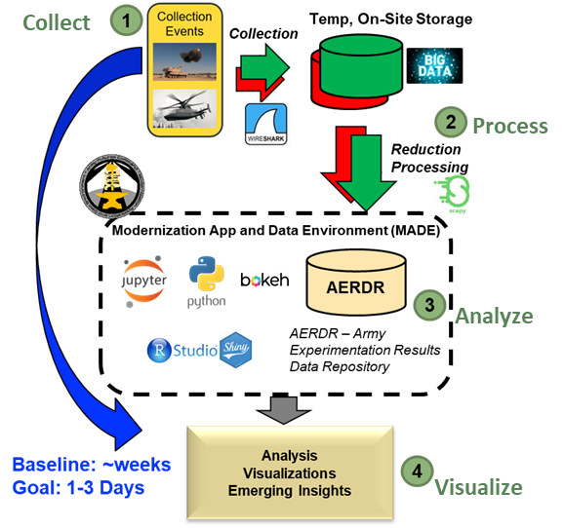
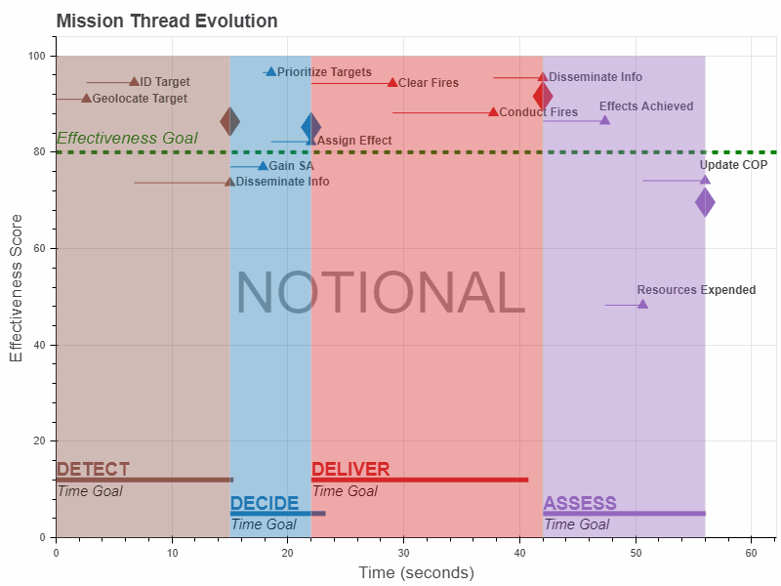
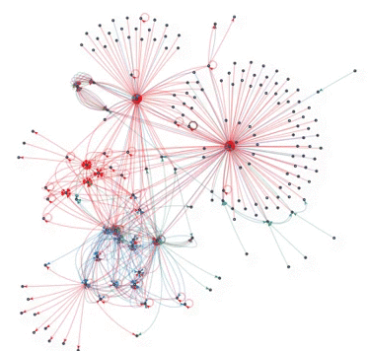
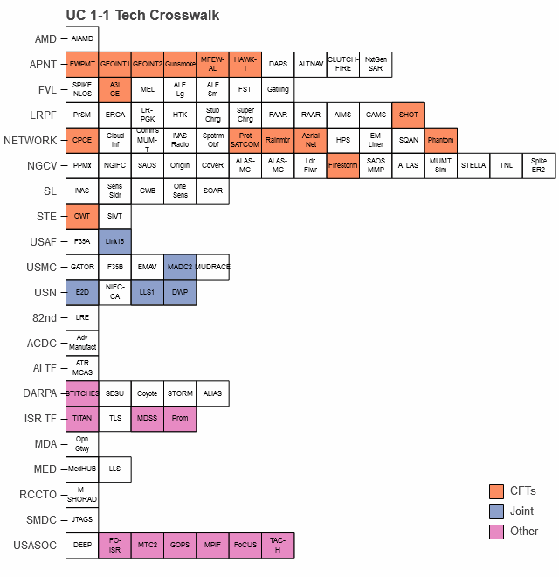
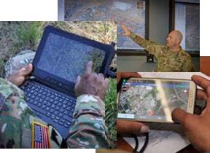
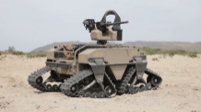
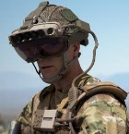
In Stride Data Analysis of Project Convergence Experiments
Sponsors/Stakeholders
Current Analytical Efforts
Potential Research Topics
Machine Learning – Use ML to infer the Tactical Data Link (TDL) type of network traffic, enabling automatic decoding and processing of messages.
Natural Language Processing – Given manually inputted text from observers and analysts, provide automated insights on system or technology performance?
Battlefield Geometry – Can the TRAC data collection and analysis team use the instrumented exercise data and range control data to visualize the composition and disposition of friendly forces and targetry in 2D or 3D?
Anomaly Detection – How can TRAC identify anomalies such as excessive network traffic flow or failed data collection to enable possible refinements to data collection strategy?
Network Analysis – How to identify nodes most critical to enabling data flow across the tactical network?
Digital Execution Checklist - How can TRAC develop a digital execution checklist connected to the Project Convergence network architecture, and automatically update the execution checklist to account for changes in the network?
Image Classification – What types of image classification algorithms perform well on repository of battlefield imagery data?
AI Assessments – How do you assess an AI agent that is able to make battlefield decisions or identify and classify targets?
US Army Futures Command (AFC)
US Army Test and Evaluation Command (ATEC)
Joint AI Center (JAIC); Joint Modernization Cmd (JMC)
Develop enhanced data analysis methods to deliver insights within 1-3 days rather than weeks.
ATEC
JAIC
JMC
AFC
Background
Project Convergence (PC) is annual Joint exercise to test emerging technologies.
PC centers on integrating AI and autonomous systems at the tactical level.
Example Technologies
Command Post Computing Environment (CPCE)
Combat Vehicle
Robotics (CoVeR)
Integrated Visual Augmentation System (IVAS)
Timing Analysis
Network Performance
Technology Assessments
Value Added:
Understand effectiveness of AI
Set modernization direction
Build trust in technologies

Slide 11
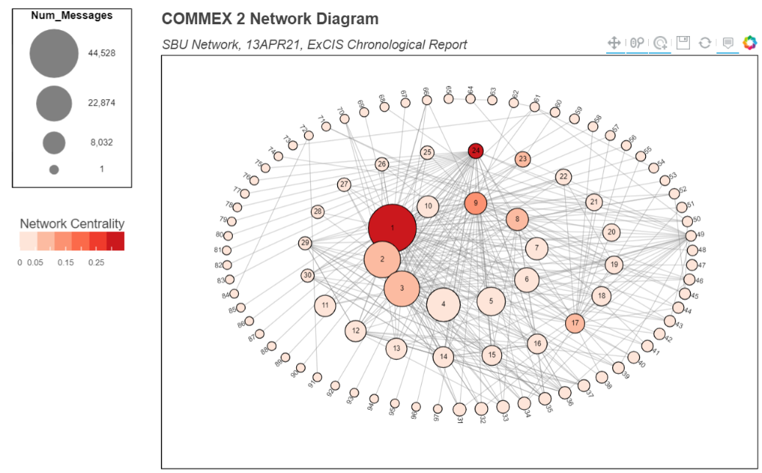
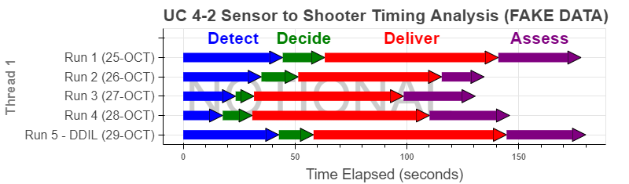
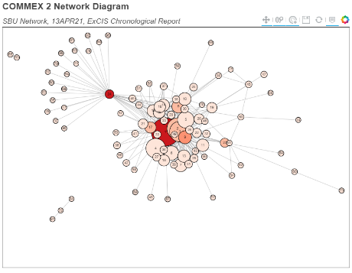
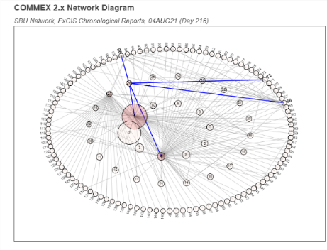
Project Convergence 21 Products
Arrow Charts yield intuitive and interactive displays of timing for each Sensor to Shooter Engagement.
Network diagrams and analysis yield interactive displays system’s communications.
Project Convergence (PC) Framework:
Detect
Decide
Deliver
Assess
Graphic measures two aspects of node criticality:
  Node Size = number of messages.
  Node Color = network betweenness centrality.
Receive and disseminate target info.
Generate and process call for fire order.
Attack target.
Perform Battle Damage Assessment.
View alternative layouts
Highlight key nodes and connections
Fake timing data for PC Use Case 4-2, AI-Enabled Air Assault.
Value:
  Assess performance of AI.
  Evaluate impact of DDIL environment.
  Identify exercise trends or issues.
  Available within 1 hour of PC events.
Value:
  Understand network health and performance.
  Identify critical nodes in AI-enabled battlefield.
  Understand impact of AI/ML on network bandwidth.

Slide 12

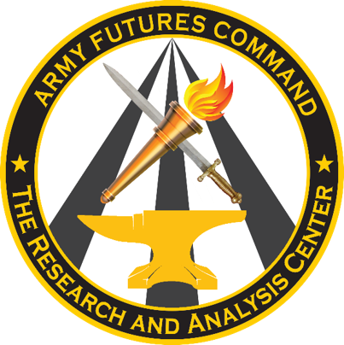



National Training Center (NTC) Analysis
Sponsors/Stakeholders
Potential Techniques & Methods
Value Added
CG, National Training Center (NTC)
US Army Forces Command (FORSCOM)
Machine Learning/Artificial Intelligence.
Predictive Analysis.
Survival Analysis.
Inform rotational unit assessments.
Identify and understand long term operational trends across rotations.
Data visualization applications to inform senior leader decisions.
Provide senior leader insights to inform budgeting, operational, and training decisions.
Methodology
Automation of Reoccurring Reports; Collection/Visualization of Sustainment and Fires Data. Develop an application to automate and better visualize the reports to increase Senior Leader Situational Awareness.
Long Term Trend Analysis: Trend analysis across rotations. Geospatial analysis of MILES data. Identifying operational insights.
Application Development: Deployment, Training, and transition of applications to NTC personnel for ownership and low-level maintenance.
Potential Research Topics
Background
Predictive Analysis – Do indicators exist that predict success of units or sub-units during an NTC rotation?
Factor Analysis - What collected fire mission factors most influence target location error?
Business Automation – Can current Operations Group practices at the NTC be improved to support future rotations?
Additional Topics
  Lethality Trends, Sustainment Analysis, NTC Success Metrics, etc.
CG NTC reached out to Army Futures Command (AFC) requesting assistance in enhancing data analytics at the NTC. As part of this effort, TRAC supports the NTC to aid in unit assessments, and trend analysis specifically with respect to fires, sustainment, and BCT Trainers.

Slide 13
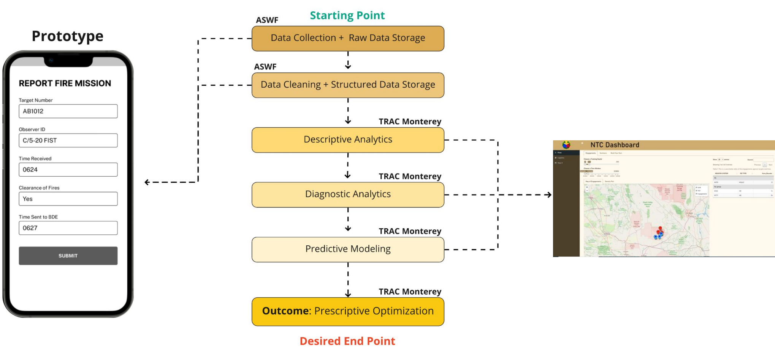
NTC Support Lines of Effort and Data
Lines of Effort
Data Sources:
Both Logistics and Fires:
Combat Training Center Information System (CTC-IS): location and engagement data.
Web-Enabled Timeline Analysis System (WebTAS): Event descriptions / context data.
Logistics:
Equipment Situation (EQUIPSIT): What a unit owns
Unit Deployment List (UDL): What a unit brings to NTC.
Pre-Position List (PREPO): What a unit signs for at NTC.
Equipment Status Report (ESR): What equipment is broken on a given day.
Fires:
Fire Mission Logs: Data for each fire mission
Emplacement Data: Observer, gun, and target locations
Timing Data: Processing times for fire missions
Collection/Visualization of Sustainment Data.
Application/Report Development.
Capstone Class.
Sustainment:
.
Collection/Visualization of Sustainment Data.
Application/Report Development.
Capstone Class.
Fires:
Analysis of Historic Rotations.
Establishment of Baseline success metrics.
Predictive Analytics.
Integration with Army Software Factory Web Application
Long Term Trend Analysis:
Project Convergence ‘22:
CTC-IS Data Analysis.
WebTAS Data Analysis.
Gain understanding of NTC data as applicable to PC analysis.

Slide 14
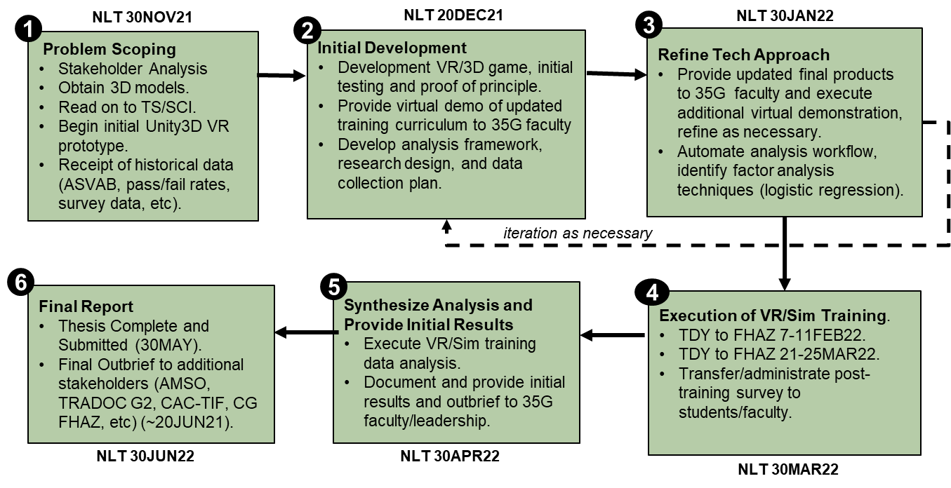

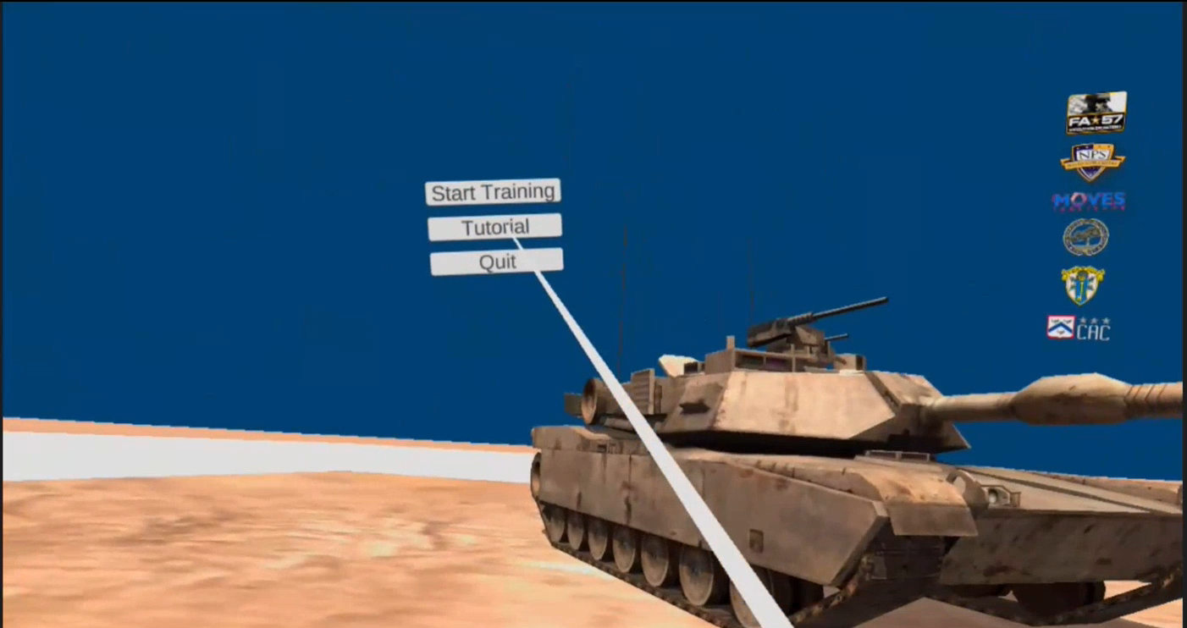
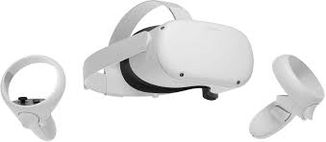
Virtual Reality Enhancement of Geospatial Intelligence Training
Sponsors/Stakeholders
Potential Techniques & Methods
Potential Thesis Topics
ICOE
CAC-TIF
TRADOC
AMSO
AFC / FCC
TRAC
DIA
3D Gaming Based Technologies.
Virtual Reality Technology.
What is the appropriate methodology to introduce new technology into existing programs of instruction?
How does employment of VR/3D gaming technologies affect additional AIT or Officer Basic Course programs (i.e., Forward Observer, Cavalry Scout, Aviator, etc)?
Can Unity Analytics be incorporated to better understand key learning metrics for trainees (i.e., time of retinal focus on targets, controller manipulation of environment metrics, etc)?
Given the lack of a detailed data collection plan for ICOE, what is a sustainable Data Strategy to inform future testing?
Methodology
Background
35G (Geospatial Intelligence Specialists) are a crucial component of providing Army battlefield commanders with real-time visual intelligence of enemy activities.
Armored tactical vehicle identification is a task that all Soldiers must complete, regardless of MOS.
TRAC POC1
MAJ Myles Durkin
myles.durkin@nps.edu
(831) 656-7575
TRAC POC2
MAJ Charlie Timm
charles.timm@nps.edu
(831) 656-7580

Slide 15
Questions and Contact
We work with:
Organizations across Department of Defense and the U.S. Government
Students, professors, and researchers
Our projects:
Are relevant to Soldiers
Have a potential for high return on investment
Require innovative methodologies
Contact us at:
Director
LTC Brian Wade
brian.wade@nps.edu
(831) 656-3086
Admin Support
Ms. Sandra Lackey
sdlackey@nps.edu
(831) 656-3086
Mil. Personnel S1
MAJ Candice Farney
candice.farney@nps.edu
(831) 656-7575
www.nps.edu/trac

Slide 16
Database Recommendation /
Search Engine
Sponsors/Stakeholders
Potential Techniques & Methods
Value Added
Futures and Concepts Center
Army Futures Command
Text analytics and image recognition.
Feature extraction/Data Preparation.
Supervised data classification.
Corpus development.
Indexing.
Recommendation engine.
  Collaborative.
  Content-based.
Enduring method to transform multiple data types (.xlsx, .pdf, .docx, etc) to structured searchable relational data.
Search tool or suite of tools optimized for accuracy and user experience.
Background
Methodology
Potential Thesis Topics
Forge is a structured modular and unified data environment facilitating the synchronization and integration of the Top-Down Modernization Process and ACIDS/JCIDS enabling Army Modernization Enterprise collaboration.
Users currently have limited abilities to search through data fields; however no document/business object search functionality.
Sponsor desires the ability to search through experimentation results; stored in semi-structured and un-structured documents.
Natural Language Processing – Given completed research and experimentation initiatives, automate insights to support senior leader decisions.
Recommendation engine – Using senior leader decisions, can you identify previous or projected analysis efforts that will address their concerns?
Reports
&
Analysis
Artifacts
Transform
Structured
Results Data
Search
Methods
Informs
Literature
Review
Concept
Development
Gap
Analysis

Slide 17


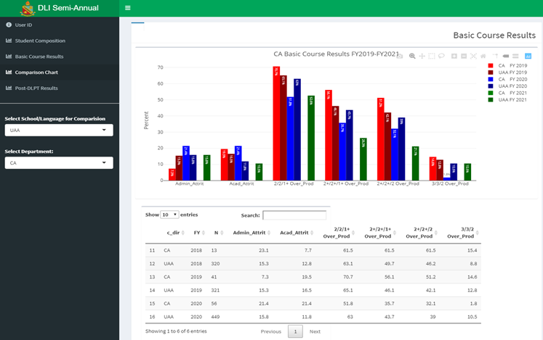
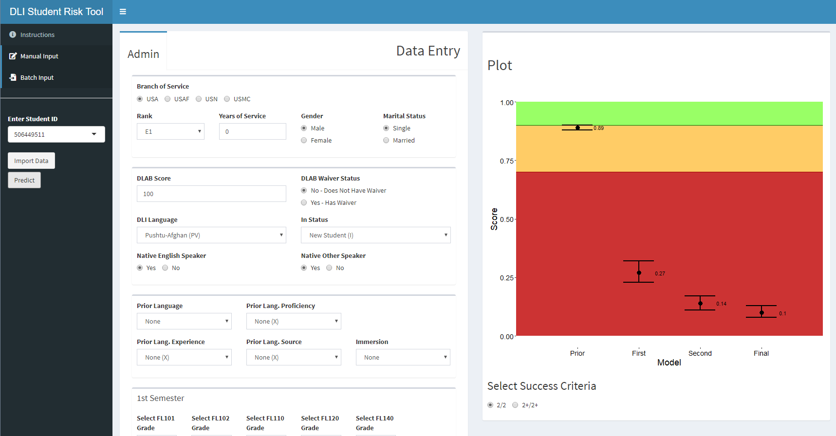
Defense Language Institute Student Success Analysis
Sponsors/Stakeholders
Potential Techniques & Methods
Value Added
Defense Language Institute (DLI)
Combined Arms Center (CAC)
Machine Learning/Artificial Intelligence.
Predictive Analysis.
Survival Analysis.
Inform recruitment and retention of linguists.
Understand student success factors to aid in curriculum, budget, and policy decision.
Data visualization applications to inform senior leader decisions.
Previous Efforts
Data Strategy: How can DLI identify, process, and provision enterprise data to enable data-driven decision making within its business processes?
Student Success Factors: What student, faculty, and curriculum factors contribute to success/failure at DLI?
Application Development: How can DLI leverage their data analysis to maximize student success, and inform curriculum, policy and resourcing decisions?
Cost Benefit Analysis: What are the cost-benefits of various DLI training events and retraining programs.
Background
NLT FY2023 DLI must increase its graduation requirements.
DLI leadership requires greater insights into the factors the contribute to student success to inform policies, programs, and curriculums.
Potential Research Topics
Statistical Modeling - What factors contribute to language retention on the DLPT after a student graduates from DLI?
Survival Analysis - What factors contribute to service member retention beyond their initial service obligation after they graduate from DLI?

Slide 18


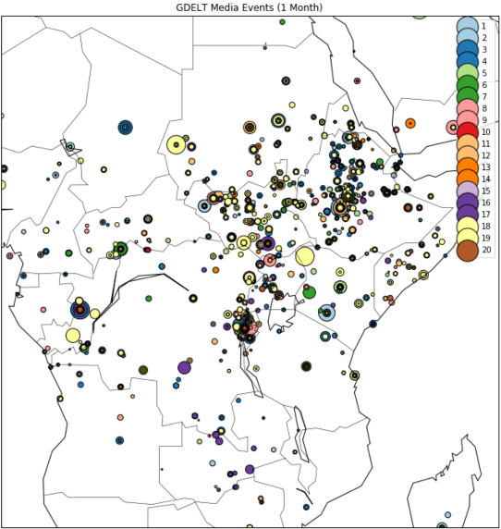

Threat Actor Activity Analysis
via Open-Source Event Data
Sponsors/Stakeholders
Methodology
Value Added
Defense Intelligence Agency (DIA)
Defense Combating Terrorism Center (DCTC)
Open-Source Event Data
Incorporate machine learning methods into an existing interactive dashboard to increase efficiency, improve situational awareness, and broaden threat understanding for DIA intelligence analysts.
Armed Conflict Location and Events Database
Threat Activity
Global Terrorism Database
Potential Research Topics
Background
Machine Learning – What machine learning methods exist to increase analyst understanding of threat actors, their activities, and potential future actions?
Network Analysis – Can threat actor network information be captured through media interactions?
Natural Language Processing – Does sentiment in traditional and social media impact threat actor activity?
Anomaly Detection – Do anomalies in global media data provide indications for threat actor activities?
Current DIA collection and information processing methodologies require intelligence analysts to manually scrape open-source media resources for event data to determine threat indicators, activities, and future actions.
To empower analysts, DIA requests the development of a data aggregation and visualization tool that displays violent extremist attacks or activity around the world and any associated information leading up to the event.
Potential Techniques & Methods
Web Scraping
  Traditional / Social Media
  Existing Databases
Machine Learning
  Threat Actor Networks
  Recommender Systems

Slide 19
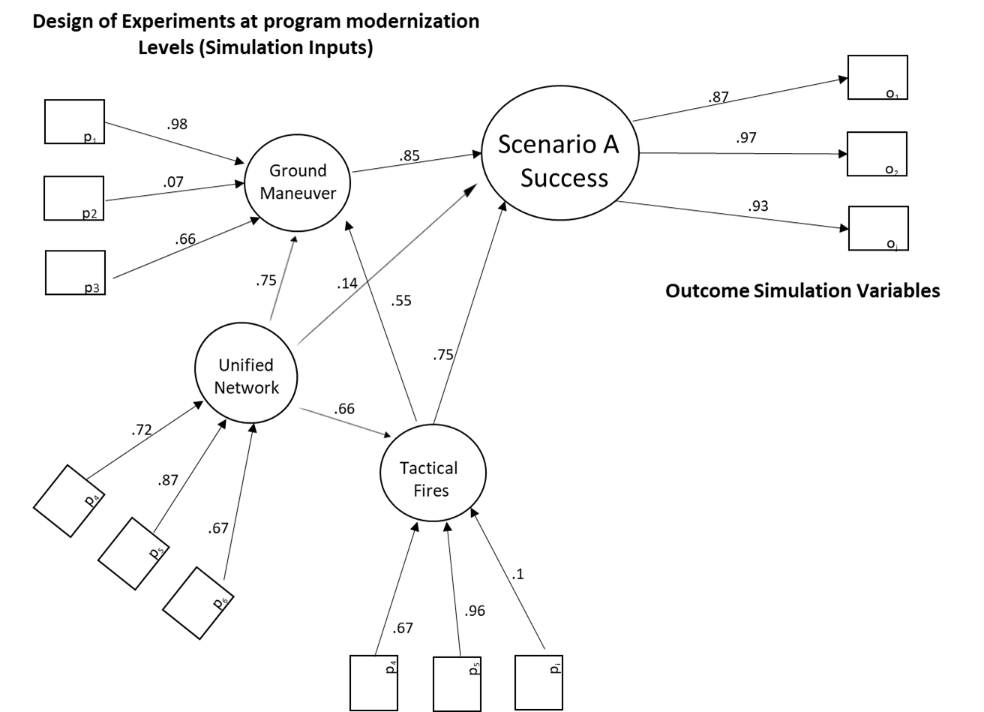
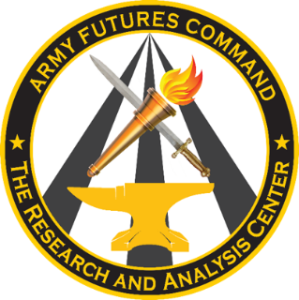
Latent Variable Assessment through Structural Equation Modeling
Sponsors/Stakeholders
Methodology
Value Added
TRAC Army Modernization Analysis
Develop a model based upon underlying SEM theory to answer research questions. (Example, what capabilities are most important to scenario success?).
Model fit, can be used to substantiate theory.
Mediation effects are displayed (Example, ground maneuver is supported by unified network and tactical fires).
Background
Cross-portfolio program analysis lacks an objective method to compare the importance of capability-sets through warfighting simulations.
Analysts often evaluate intangible or hard to define latent variables subjectively post-simulation run. This project focuses on the development of a more objective assessment of intangible variables through Structural Equation Modeling methods.
Potential Research Topics
Structural Equation Modeling - Is PLSPM or other SEM models appropriate for analysis questions related to simulation meta-analysis?
Design of Experiments - What are the considerations for designing experiments when using PLSPM for simulation meta-analysis?
Potential Techniques & Methods
Structural Equation Modeling
  Partial Least Squares Path Modeling
Multi-Criteria Decision Making
  TOPSIS, Analytical Hierarchy Process

Slide 20
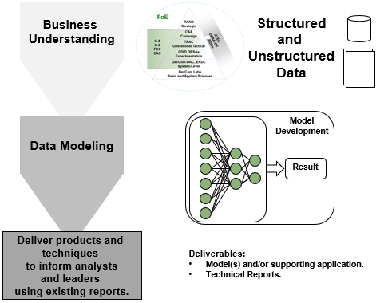
Text Analysis to support
Meta Analysis
Sponsors/Stakeholders
Potential Techniques & Methods
Value Added
TRAC
CAA
ATEC
DAC
ARL
FCC
Text analytics.
Feature extraction/generation.
Supervised and Un-supervised learning techniques.
Automate portions of the ACA meta-analysis workshops.
Generate a repeatable and documented process to save time to answer senior leader requests.
If successful, expedite systematic reviews or meta-analysis efforts in the future.
Methodology
Background
Potential Thesis Topics
The Army Continuum of Analysis (ACA) was created to ensure the right decision makers are armed with timely analysis answering the right questions.
Semi-annually, the Army Analytic Community (AAC) plans to conduct a meta-analysis workshop to address areas not directly addressed by the separate analytic efforts.
The meta-analysis efforts are designed to identify gaps and shape future focal areas for the AAC.
Augmented literature reviews to support future analytic efforts.
Automated systematic reviews and/or meta-analysis of analytic efforts.
Classify analytic reports to support metadata development.

Slide 21
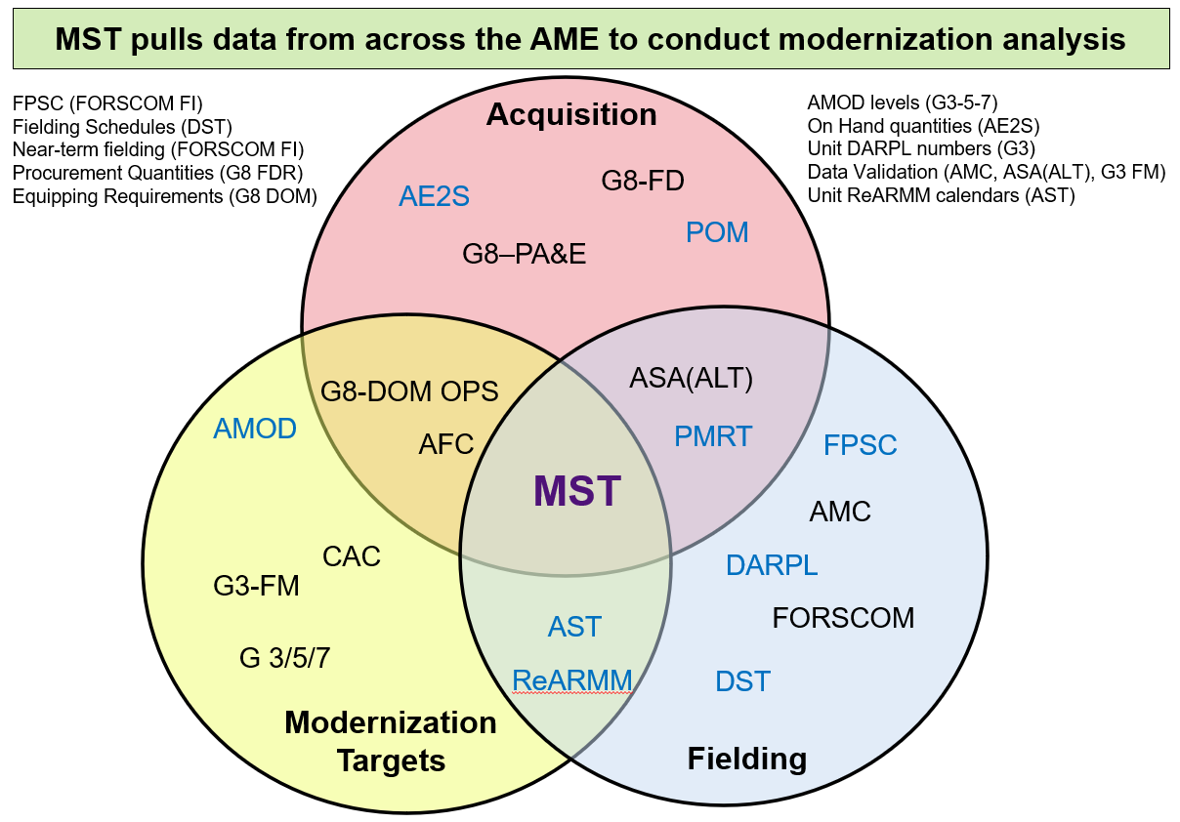
Army Modernization Analysis
Modernization Synchronization Tool
Stakeholders
Potential Techniques & Methods
Value Added
HQDA G-8.
HQDA G-3.
ASA(ALT).
AMC.
AFC.
Constrained optimization
Increased visibility of decision impacts
Provides “What-if” analysis
Consolidates many authoritative data sources into one reference point
Ongoing Efforts
Potential Research Topics
Optimizing sourcing decisions between production, unit prioritizations, and unit calendars
Optimizing cascading lateral transfers of modernization equipment
Optimizing manning for Army modernization
Classification/MCDM of Army units to establish equipping priorities
Background
Low visibility in Army modernization efforts.
Many data sources (varying degrees of authority).
Inability to see decision impacts beyond the next 2-3 years.
Alignment to ReARMM.
Approved by the VCSA & SO PTDO USA in Oct
Migrated to the cloud, onboarded users, & automated the data processing
Currently improving data quality/ transparency
Working to expand the scope (manning, training, units, and other compos)

