Slide 1
Monterey Phoenix Overview
Kristin Giammarco, PhD
NPS Department of Systems Engineering
MOVES Open House
24 may 2022

Slide 2
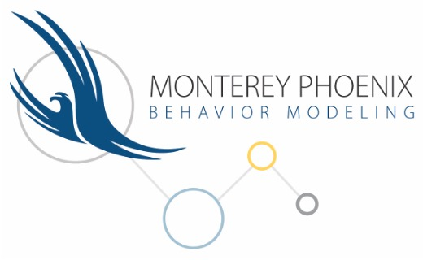
What is Monterey Phoenix?
Monterey Phoenix (MP) is an NPS-developed language, approach and tool for rapidly and formally modeling scope-complete sets of mission, system, and process behaviors.
MP supports the human cognitive process as users probe models for:
  what could go wrong that may not have otherwise occurred to them – or anyone – until it’s too late
  possible inefficiencies due to previously unconsidered exception cases
  examples of scenarios that could cause serious failures or waste, for early correction
  risks to cost, schedule, technical performance, safety and security
  assumptions they didn’t realize were being made and requirements they didn’t know were being overlooked, until realizing them in MP-generated examples.
  MP exposes “ human blind spots so decision makers can be confident they are considering all possible risks, not just those humans were able—or willing—to identify.”
  – Margaret Palmieri, SES and NPS Alumnus
Auguston, M. Software Architecture Built from Behavior Models. ACM SIGSOFT Softw. Eng. Notes 2009, 34, 1–15.

Slide 3

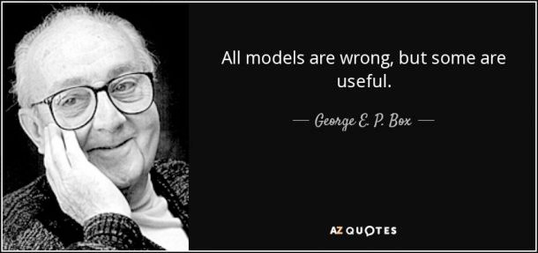
Why Model?
Good process and product design has good behavior at its foundation.
  Most of the challenges and risks associated with mission, system and process behaviors are found where separate behaviors interact and produce a new behavior.
We build behavior models to ask and answer questions.
  What is the intended sequence of events?
    How should the system handle disruptions?
  How many scenarios contain unexpected behaviors?
    What formal constraints / requirements will prevent unwanted behaviors?
  Which events must be managed as an enterprise risk?
    Which are the critical decision points?
    Which have the highest consequence?
  What is the expected duration of a behavior sequence (scenario)?
    What is the downstream consequence of an upstream disruption?
  What behavior patterns are present in the model?
    Is a presented pattern also applicable in other domains?
Behavior
Notes:
Most concerns we have about systems come down to the system's behavior. We want the system to behave according to our expectations, and we don't want the system to behave in unwanted or unexpected ways. We need automated tools to help us formally specify behavior and put possible scenarios in front of us to contemplate, reason about and finally decide upon which behaviors we will permit and under what circumstances, and which behaviors we want to reject with formally specified constraints. We do this in MP by first specifying what we think we want the system behaviors to be, in the context of other behaviors in the system's environment: users and other systems that can potentially interact with our system. Then we chisel or whittle away the unwanted behaviors that arise in the generated scenarios. This chiseling or whittling means we are adding constraints after we see examples of unwanted behaviors arising; which is part of the MP design process.

Slide 4
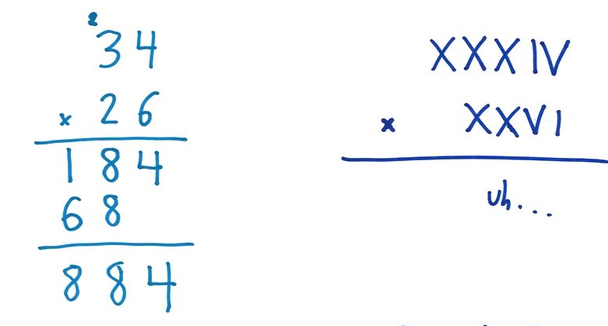
Why MP?
MP helps the modeler clarify and fix ambiguity in less formal representations of systems and processes.
  Other behavior modeling tools do not enforce the same degree of formality.
MP is unlike any other approach when it comes to scenario completeness and consistency.
  Event trace generation is automatic and exhaustive up to a user-defined scope, making quick work of a task that would be impractical for a human to perform manually and repeatedly and freeing the human to do what humans are good at.
The Small Scope Hypothesis: most flaws in models can be demonstrated on small counterexamples
Notes:
We taught the interns how to use Monterey Phoenix because has the following unique feature: MP is the only behavior modeling approach and tool that can be used to answer these types of questions over a complete set of all behavior combinations for system and environment that is exhaustive within a defined scope. We accept the analysis done at a limited scope because we have accumulated experience that shows most issues in a design can be demonstrated on small examples – this is known as the "small scope hypothesis." You will see today many small examples that exposed gaps in their respective designs – that is, scenarios in which the system is behaving in ways we did not expect, or do not want, or that we need to understand more, in order to control or exploit the behavior.

Slide 5
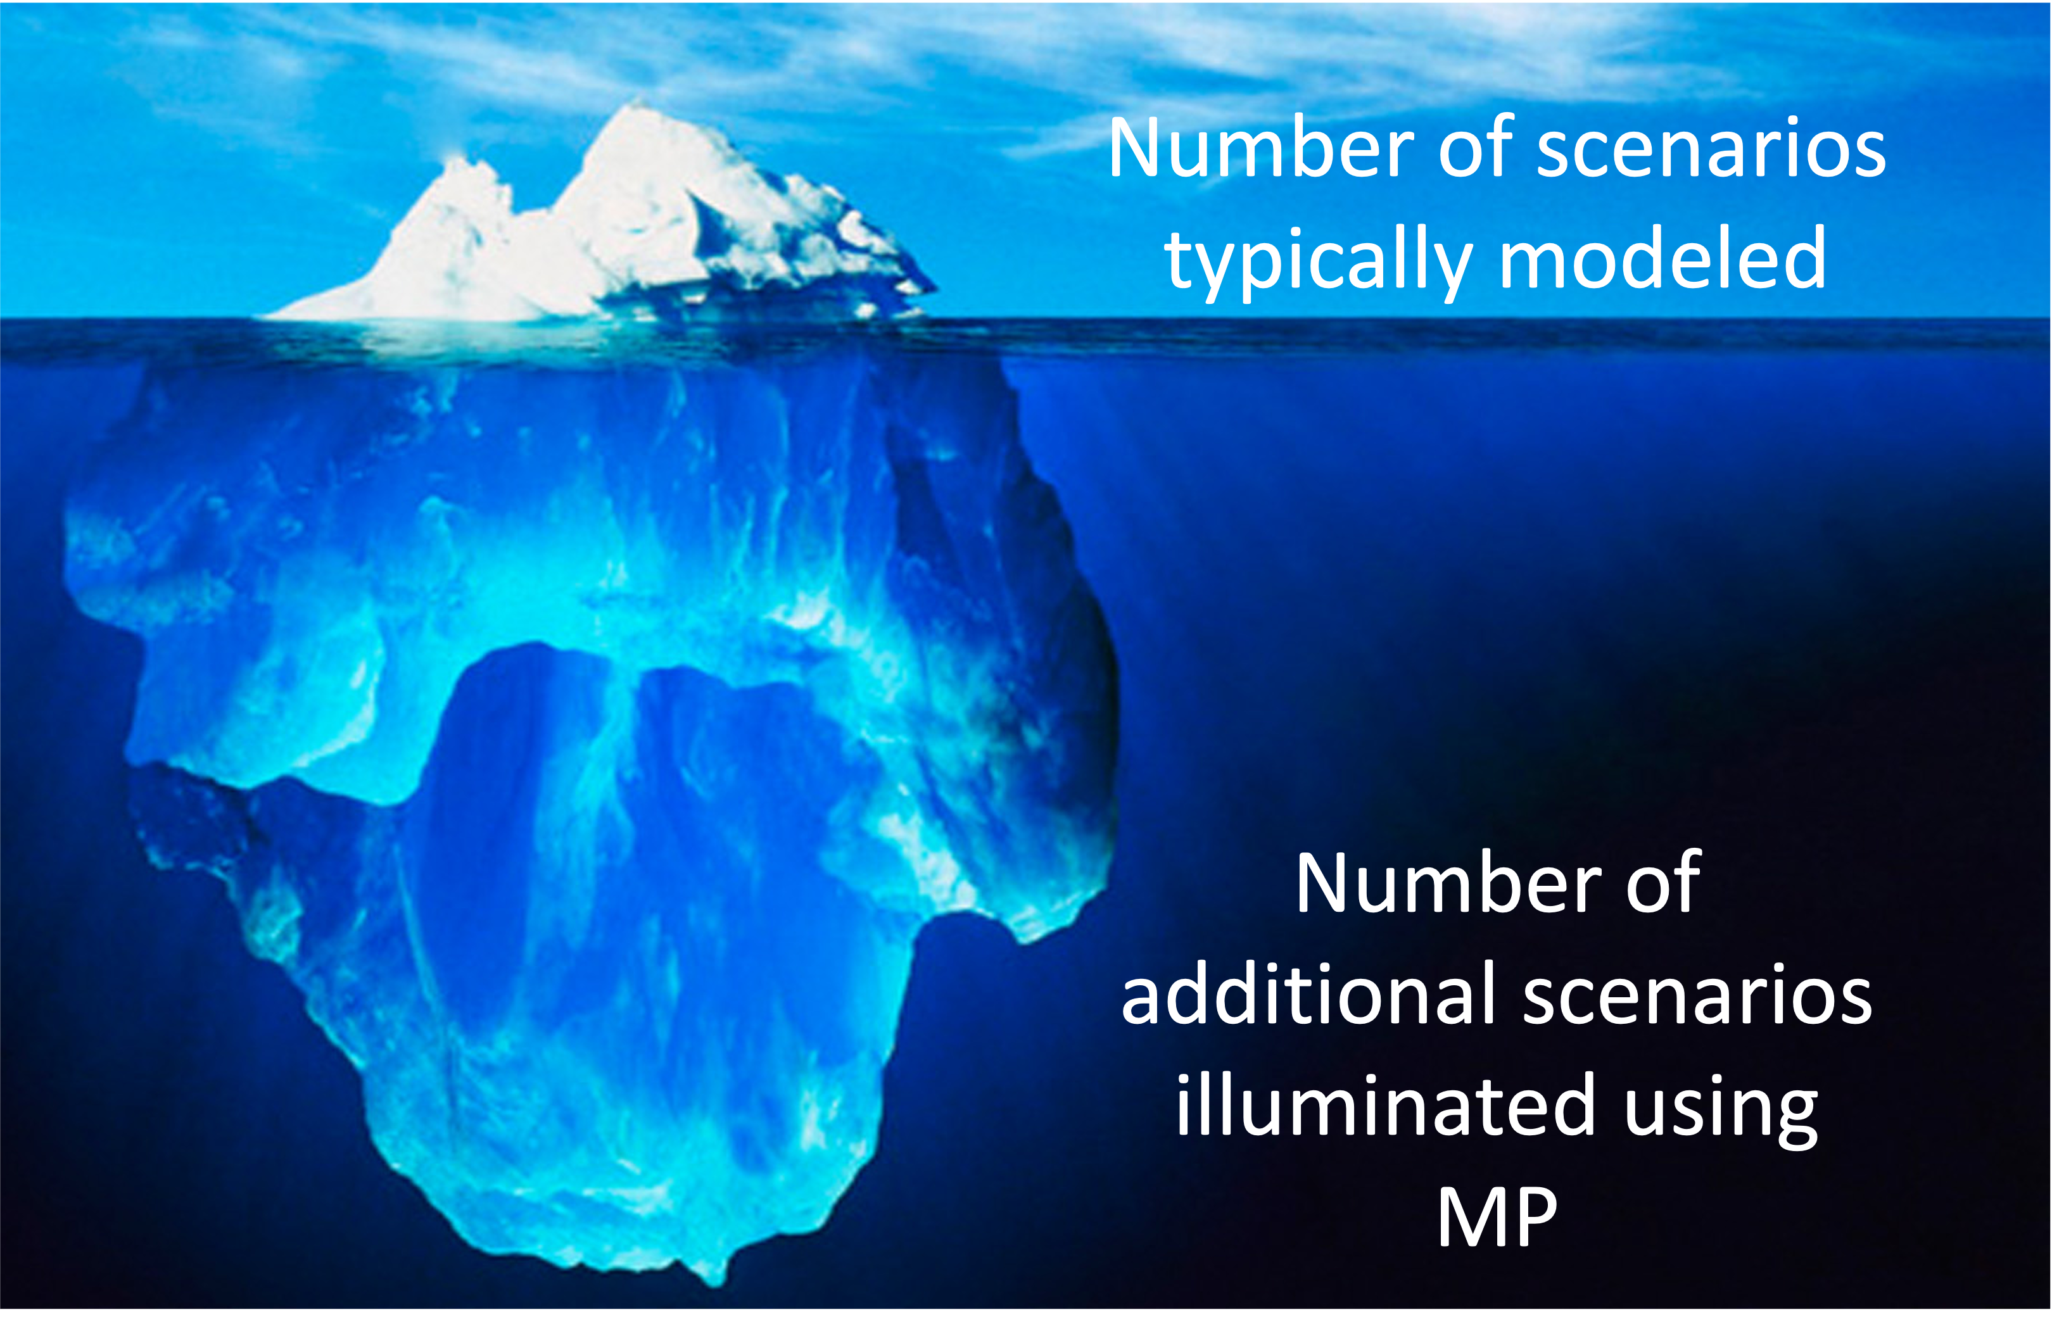

Slide 6
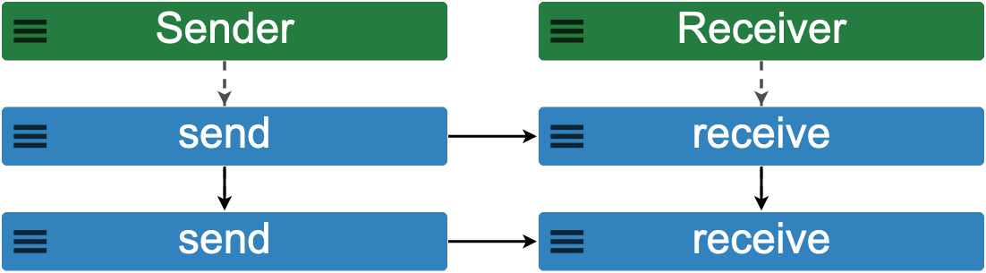
MP Basic Concepts
precedes
MP has events with two basic relations: PRECEDES and IN
Event_A
Event_B
includes
Behavior
Event_B1
concurrent events
IN
PRECEDES
Notes:
The abstract concepts in MP are events with two basic relations: precedence and inclusion. These concepts help to shape the way we think about the systems we are modeling, and put the focus on the most essential aspects of behavior modeling: event concurrency, event hierarchy, and event dependency - all of which are needed to discover emergent system behaviors before they happen in the actual system. This is an example MP event trace at the bottom – you will be seeing a lot of these in the presentations. The Green boxes are concurrent root events, in this case, a Sender and a Receiver. The Sender here includes two send events – one preceding the other, and the Receiver includes two receive events – one preceding the other. Each send event also precedes each receive event.

Slide 7
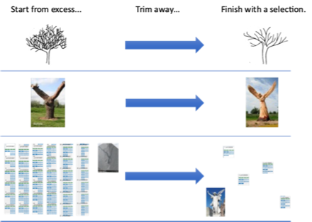
How It Works
High Level
Technical
Event traces emerge as a result of a derivation process guided by grammar rules and composition operations
Trace derivation is performed top-down and left to right following the event grammar rules
Composition operations add new relations to the trace under derivation or filter out some trace segments from the result
“The way in which one can divide up the original problem depends directly on the ways in which one can glue solutions together.” – John Hughes, 1989
Auguston, Mikhail. “System and Software Architecture and Workflow Modeling Language Manual(Version 4).” 2020. Available online: https://wiki.nps.edu/display/MP/Documentation (accessed on 21 Jan 2022)
Notes:
Augusto

Slide 8
Personal Protective Equipment (PPE) Supply Chain Analysis
Joshua P. Beaver
System of focus was the Agile Production Platform (APP), a marketplace that aspires to aggregate PPE systems and materials to solve COVID-19 supply issues
Used MP to find desired and undesired scenarios of PPE supply chains within the APP
Example of undesired but expected behavior
  A disconnect between the customer, the APP, and the delivery service results in a shipment not arriving as expected.
Examples of undesired and unexpected behaviors
  A counterfeit part makes its way into the APP supply chain
  Nonconforming material makes its way to the customer through miscommunication or lack of inspection
Resulted in recommendations to minimize the probability of occurrence in the actual system once it is deployed
  The APP should require suppliers to follow international standards ISO 16678 and ISO 9001 (for counterfeit avoidance and quality management, respectively),
  The APP should implement rating systems to verify that the products received perform as expected and to measure on time delivery and quality.
Beaver, Joshua. "Analyzing Emergent Behavior of Supply Chains for Personal Protective Equipment in Response to COVID-19." Master's Thesis, Naval Postgraduate School, September 2021.

Slide 9
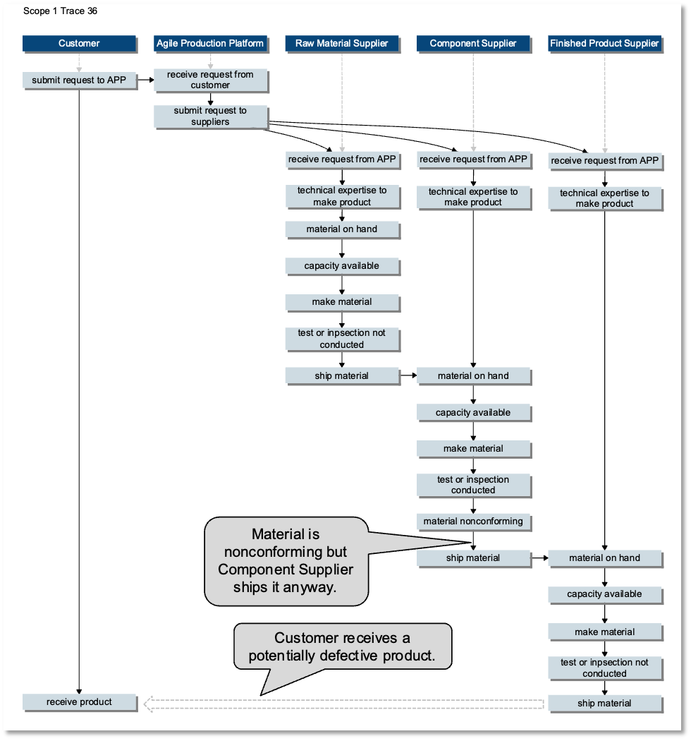
Personal Protective Equipment (PPE) Supply Chain Analysis
Joshua P. Beaver
Beaver, Joshua. “Agile_Production_Platform_Supply_Chain_Interaction.mp.” Available online: https://firebird.nps.edu, Import menu, Application_examples folder. September, 2020.

Slide 10
Supply Chain Cyber Attack Risk Analysis
Margaret Palmieri
The ransomware attack against the Colonial Pipeline in May 2021 highlighted the vulnerability of American infrastructure, specifically the fuel supply chain, to cyber-attack
Used MP to help decision makers assess, visualize, and prioritize cyber threats to a supply chain
Applied methodology published by Navy Lieutenant Commander Richard Moebius:
  create a behavior model of the intended operation
  add negative alternatives to the operation
  add risk attributes (e.g., impact and likelihood)
  calculate or assign impact to negative outcomes
  calculate or assign likelihood to negative outcomes
  use impact and likelihood to calculate risk
  output desired format of risk for decision makers
Extended methodology with global reporting of risk across all event traces
Palmieri, Margaret. "Assessing and Visualizing Risk in Monterey Phoenix through a Supply Chain Cyber-Attack Use Case." Master's Thesis, Naval Postgraduate School, September 2021.

Slide 11
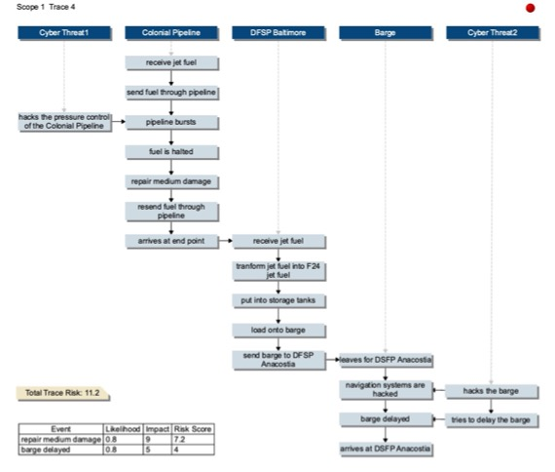
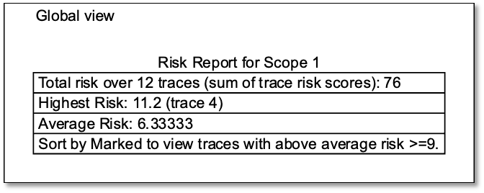
Supply Chain Cyber Attack Risk Analysis
Margaret Palmieri
Palmieri, Margaret. "Assessing and Visualizing Risk in Monterey Phoenix through a Supply Chain Cyber-Attack Use Case." Master's Thesis, Naval Postgraduate School, September 2021.

Slide 12
Summary of Distinguishing Features of MP
Relevant capability.
    Reliably, repeatably, and rapidly find exploitable unwanted behaviors latent in a design.
Scope-complete.
    Generate the exhaustive set of event traces from a given behavior model up to a specified scope (user-defined maximum on number of iterations).
Workforce-accessible.
    No expertise necessary in formal methods to use. Trace generation done automatically by two available tools: web-based MP-Firebird (https://firebird.nps.edu) and locally-installable MP-Gryphon (https://nps.edu/mp/gryphon).
Intuitive graphs.
    Sequence diagrams, activity diagrams, state diagrams and component diagrams are extracted from a single MP model for verification and validation of SysML and UAF models. Custom graphs also supported for showing dependencies of interest.
Support for queries and assertion checking.
    Manually inspect or automatically query the set of event traces for the presence or absence of properties of interest.
Event attributes to support quantitative reasoning.
    Model time, risk, cost, power, and other quantitative resources. Assign probabilities of occurrence for capturing conditional probabilities and whole trace probabilities. Use reports, tables, and charts summarize properties of interest at both the local event trace level and the global (across all traces) level.

Slide 13
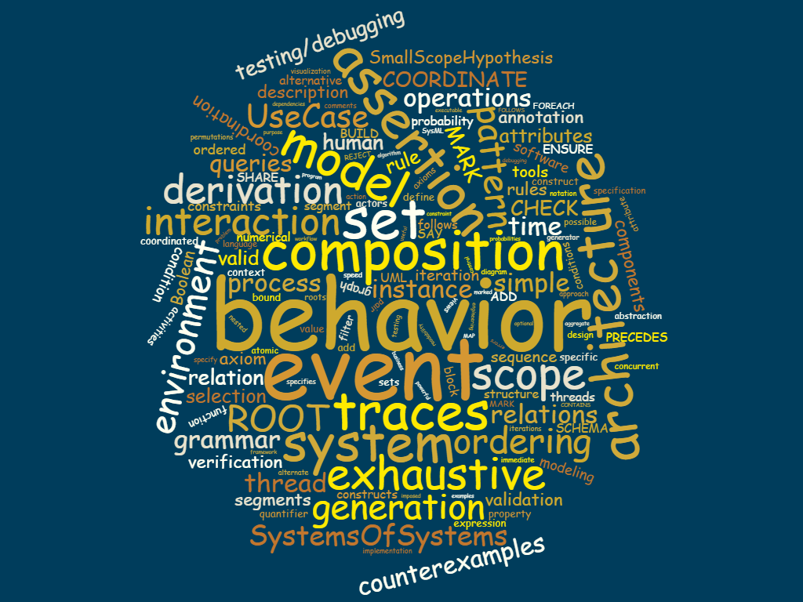

Questions?
Monterey Phoenix and Related Work:
https://nps.edu/mp
https://firebird.nps.edu
https://nps.edu/mp/gryphon
https://nps.edu/mp/models
Naval DEBoK Website (CAC):
https://wiki.lift.mhpcc.hpc.mil/confluence/display/ND/Monterey+Phoenix
MilSuite Website (CAC):
https://www.milsuite.mil/wiki/Monterey_Phoenix
Kristin Giammarco: kmgiamma (at) nps.edu

Slide 14
Modeling Mission Success for Autonomous Unmanned Undersea Vehicles
John H. Phillips
System of focus was a pair of Unmanned Undersea Vehicles (UUVs) conducting a survey mission
Used MP to model UUV failures, categorize possible outcomes, and expose unwanted emergent behaviors or undocumented requirements
Example of undesired but expected behavior
  A target of interest appeared in the survey area. This target was not detected by the second UUV, which then collided with the target and was rendered dead in the water.
Example of undesired and unexpected behavior
  Later in the mission, the first UUV moved to the planned rendezvous point. When the first UUV didn’t receive a status message from the second, it moved to complete the assumed incomplete survey and ended up dead in the water under the same circumstances.
These modeling outcomes raised useful questions about what else the detection algorithms might miss that could also lead to a collision—for example, if the first UUV follows an identical flight path through the water to the undetected target.

Slide 15
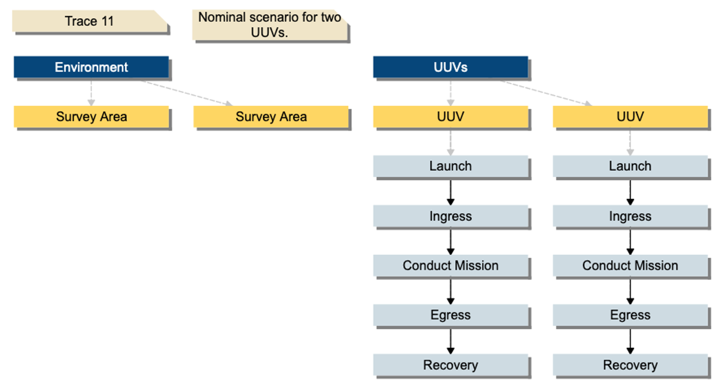
Modeling Mission Success for Autonomous Unmanned Undersea Vehicles
John H. Phillips
Notes:
In my two-UUV system scenario, each vehicle is launched from a platform of opportunity and then transits along an ingress path to a survey area. Once on-station, the UUVs conduct the survey mission. When the mission is complete, they egress to a planned recovery point and are recovered.

Slide 16
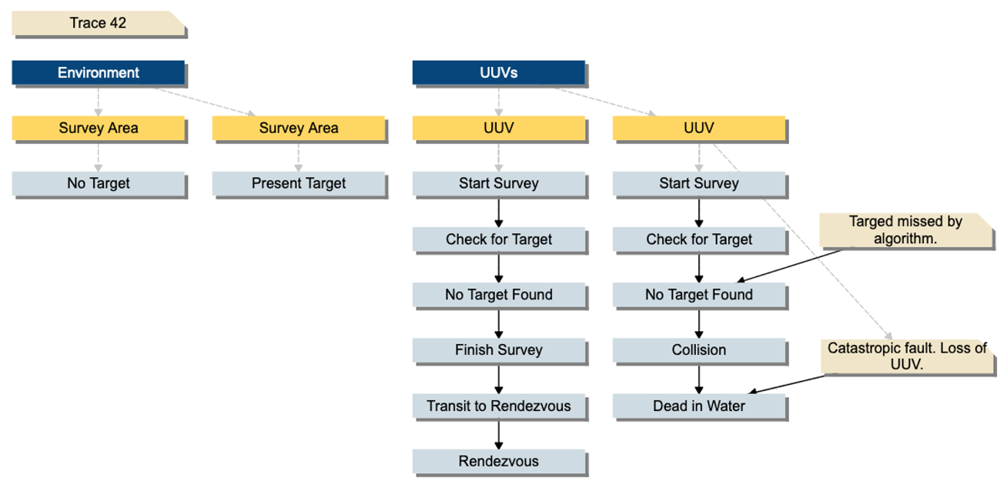
Modeling Mission Success for Autonomous Unmanned Undersea Vehicles
John H. Phillips

Slide 17
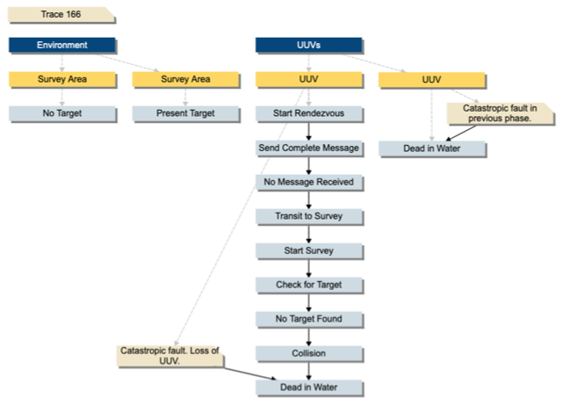
Modeling Mission Success for Autonomous Unmanned Undersea Vehicles
John H. Phillips

Slide 18
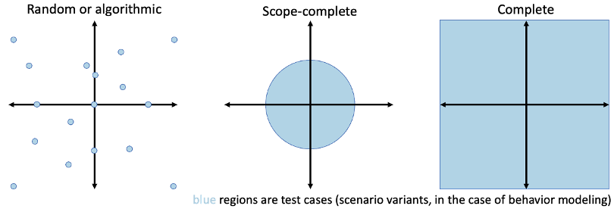
SysML v2 Submission Team Participation
Onboarded with SST on 21 February
Participating in the Execution Working Group
  Work on SysML behavior model execution semantics
Crosswalk MP and SysML v2 behavior specification semantics and make them interoperable where practical
  Enable conversion between MP and SysML models
Contribute MP concepts and behavior modeling lessons learned to SysML v2 where practical
Contribute library of 80+ behavior models for testing
  Sequence, activity, state transition
Benefit of MP-SysML Interoperability:
Scope-complete event trace generation capability
Notes:
Participate in the Execution Working Group
Work on SysML behavior model execution semantics
Crosswalk MP and SysML v2 behavior specification semantics and make them interoperable where practical
Enable conversion between MP and SysML models
Contribute MP concepts and behavior modeling lessons learned to SysML v2 where practical
Library of 80+ behavior models for testing
Sequence, activity, state transition

Slide 19
Take Aways
MP can help you find and communicate:
  what could go wrong that may not have otherwise occurred to you – or anyone – until it’s too late.
  possible inefficiencies due to previously unconsidered exception cases.
  examples of scenarios that could cause serious failures or waste, for early correction.
  risks to cost, schedule, technical performance, safety and security.
  assumptions you didn’t realize were being made and requirements you didn’t know were being overlooked, until realizing them in MP-generated examples.

