Slide 1
VEs for Warfighter Health
Barry Peterson
MOVES Open House
5/24/22

Slide 2
Overview
Introduction
Yoga Journey
VEs for Unstealable Peace
VEs for Sense-Making
Conclusion
BarryNPeterson@gmail.com

Slide 3
Self-Defining Memories*?
Let’s Pause and Reflect…
What are yours?
* Do you remember? The role of Self-defining memories and sensemaking in generating decisions, Kelsey Merlo,
International Conference on Naturalistic Decision Making 2019, San Francisco, California

Slide 4
Introduction
BarryNPeterson@gmail.com

Slide 5
Honored and Passionate
Homecoming for me…
What I am personally passionate about…
I hope you find it worthwhile…
BarryNPeterson@gmail.com

Slide 6
Not to Offend – Curious and Respectful
Maybe fifteen years ago, yes…
I genuinely believe this can help service members
Disclaimers
My military time was minuscule
I’m sure things have improved
My MOVES time was also miniscule
Still…
Some things about war endure
I am not here as an authority.
I’m here to seek your feedback and learn
BarryNPeterson@gmail.com

Slide 7
Yoga Journey
BarryNPeterson@gmail.com

Slide 8
“Build a Bikram Yoga Studio at West Point!”
If It’s Good for Veterans…
BarryNPeterson@gmail.com

Slide 9
Panama
Operation Just Cause
1989
My ‘Self-Defining’ Memories
BarryNPeterson@gmail.com

Slide 10
Panama + 9
1998
VR Conference
1999-2001
NPS, PhD
BarryNPeterson@gmail.com

Slide 11
Noncooperation!
2001
Yoga Teacher (Bikram Yoga, certified in 2002)
Severed Ties with All My Military Past
My Shallow Understanding of Yoga: Noncooperate (Gandhi)
BarryNPeterson@gmail.com

Slide 12
Noncooperation?
2011 (Panama +22)
Pitched Yoga School for Veterans to Bikram
“No”
“Yoga for service members…”
BarryNPeterson@gmail.com

Slide 13
Bikram Yoga at West Point
“Build a Bikram Yoga Studio at West Point!”
USMA Reunion
I love my brothers, sisters, non-binaries!
My classmates support the idea!
BarryNPeterson@gmail.com

Slide 14
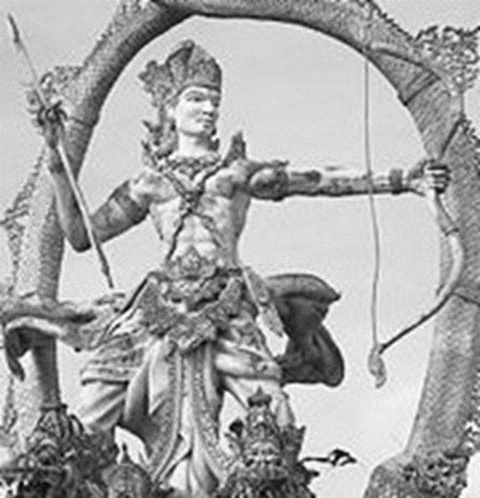
Bikram and the Bhagavad-Gita
“Study the Gita!”
Yoga principles support the soldiering principles of service, honor, duty, and leadership
BarryNPeterson@gmail.com

Slide 15
Benefits of Yoga for Service Members*
Yoga principles support the soldiering principles of service, honor, duty, and leadership
Unstealable Peace - practicing comfort in discomfort
Better Joint Health and Range of Motion >> wear and tear on the body of soldiers, engaged in a very physical profession >> Injury Prevention >> Injury recovery
* The Yogi Warrior: why yoga is good for soldiers

Slide 16
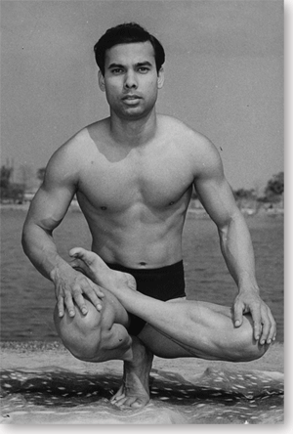
Bikram Choudhury
3-time All-India Yoga Champion
Smashed his knee in athletic training, told he would never again walk.
Ordered by his ‘commander’ to bring yoga to the U.S. States

Slide 17
Unstealable Peace
“Through training the body with rigor and determination we also train the mind to concentrate. The discipline of practice helps turn the mind, which for many of you is your worst enemy, into your best friend. With your new mental strength, no one and nothing outside of you will ever be able to bother you, harm you, or disrupt your mental peace. As I tell my students in class all the time: ‘Let no one steal your peace.’” – Bikram Choudhury

Slide 18
Panama + 26
2015 – USMA
Never Will Happen with Bikram Yoga…
BarryNPeterson@gmail.com

Slide 19
Never Will Happen with Bikram Yoga
2015 – USMA
So, how else can we cultivate unstealable peace?
BarryNPeterson@gmail.com

Slide 20
VEs for Unstealable Peace
BarryNPeterson@gmail.com

Slide 21
Unstealable Peace is Good for Veterans
Unstealable Peace…?
Clarity
Unperturbed by circumstances
“Mind and body control in crisis entails conditioning of our responses, clarity, and calming the "hyper adrenaline" that holds us hostage. Our mental armamentarium to focus in a crisis enhances mission success.” - Rocco Armonda
“Today, commanders can have data/ information overload…how do we turn that info into knowledge so leaders can be laser focused on what’s important?” – Craig Doescher
BarryNPeterson@gmail.com

Slide 22
Who is the Thief?
Physical Hardship
Physical Pain
Mental Distractions
Emotional Distress
Anxiety
Information Overload

Slide 23
Who is the Thief? (on the battlefield)
Physical Hardship
Physical Pain
Mental Distractions
Emotional Distress
Anxiety
Information Overload
The Enemy!

Slide 24
VEs for Unstealable Peace
VR/Sim for Training?
A safe place to practice skills that are risky
Why not for skills but are risky psychologically?
Practice developing comfort in discomfort (in a hot room?)
Breathe through discomfort…
VEs guided pre-deployment, routine, practice (bed of nails, buried, thermal stimuli, etc.)
BarryNPeterson@gmail.com

Slide 25
VEs for Sense-Making
BarryNPeterson@gmail.com

Slide 26
Read about History…
“…and you become aware that nothing starts with us. It started long ago. If you read enough biography and history, you learn how people have dealt successfully or unsuccessfully with similar situations or patterns in the past. It doesn’t give you a template of answers, but it does help you refine the questions you have to ask yourself.” – General James N. Mattis *
* https://www.historynet.com/interview-with-general-james-mattis/
BarryNPeterson@gmail.com

Slide 27
The Questions to ask Oneself…
“…and you become aware that nothing starts with us. It started long ago. If you read enough biography and history, you learn how people have dealt successfully or unsuccessfully with similar situations or patterns in the past. It doesn’t give you a template of answers, but it does help you refine the questions you have to ask yourself.” – General James N. Mattis *
Why do we have to ask ourselves?
* https://www.historynet.com/interview-with-general-james-mattis/
BarryNPeterson@gmail.com

Slide 28
Sense-making our Self-Defining Stories
PTSD? PTS?
MST?
Moral Injury?
BarryNPeterson@gmail.com

Slide 29
Sense-making Our Self-Defining Stories
PTSD? PTS?
MST?
Moral Injury?
Decisions about my unit?
Decisions about my career?
Decisions about my identity as a service member?
BarryNPeterson@gmail.com

Slide 30
Our Own Minds as Our Own Worst Enemies?
When the sense we make about our self-defining memories are negative and self-defeating
Can we make sense in a way that builds empathy?
Empathy towards other soldiers…?
Empathy toward ourselves…?

Slide 31
Can We Use VR to Enhance Sense-making?
Exposure Therapy in VR is being used to help trauma victims
Can we use VR earlier as a way to pre-empt negative mental-processing?
To help find the answers we should ask ourselves?
The history that matters
Our own personal memories
Not just reading, but reliving
BarryNPeterson@gmail.com

Slide 32
Conclusion
BarryNPeterson@gmail.com

Slide 33
Panama + 33
Just Last Week!
Vacation Trip to Florida
… and to have lunch with my old commander…
BarryNPeterson@gmail.com

Slide 34
Thank You
BarryNPeterson@gmail.com

Slide 35
CUT From Presentation

Slide 36
Who Pays the Toll?
“… a sense of duty that seemed to have no room for individual attachments at the expense of the collective, even as it registered the toll such an approach took on decision-makers.” – Elizabeth Samet *
* Samet, Elizabeth D.. Looking for the Good War (p. 67). Farrar, Straus and Giroux.
BarryNPeterson@gmail.com

Slide 37
BarryNPeterson@gmail.com

Slide 38
Comfortable Until…
“The dispositional analysis has the comforting side effect of enabling those who have not yet done wrong to righteously assert, ‘Not me. I am different from those kinds of people who did that evil deed.’” -Philip Zimbardo
* A situationist Perspective on the Psychology of Evil: Understanding How Good People Are Transformed into Perpetrators, by Philip Zimbardo, “Crimes of War” p. 367
BarryNPeterson@gmail.com

Slide 39
Personalized VR & Precision Medicine/VR
May not be economically feasible yet…
Vulnerability?
What is the specific combination of influences that might warp our moral compasses?
BarryNPeterson@gmail.com

Slide 40
Vulnerability to Social Influences
BarryNPeterson@gmail.com

Slide 41
Rocco
Differentiate signal from noise
Culture
Ukraine Stoicism
USA physically soft and mentally distracted
Armamentaria
We can increase pain thresholds – athletic training
We don’t know if it’s possible to enhance survivability with mental training
To NOT panic…
In the Army OR – no, we don’t train it enough…. Too common to see suboptimal performance
Mental powers – SEALS and Specia Ops… why not all service members

Slide 42
Doesch
Positivity
So much information coming at you in a TOC
Lebron James – ability to slow things down and see and choose
That’s what is Good Army training, Ranger School

Slide 43
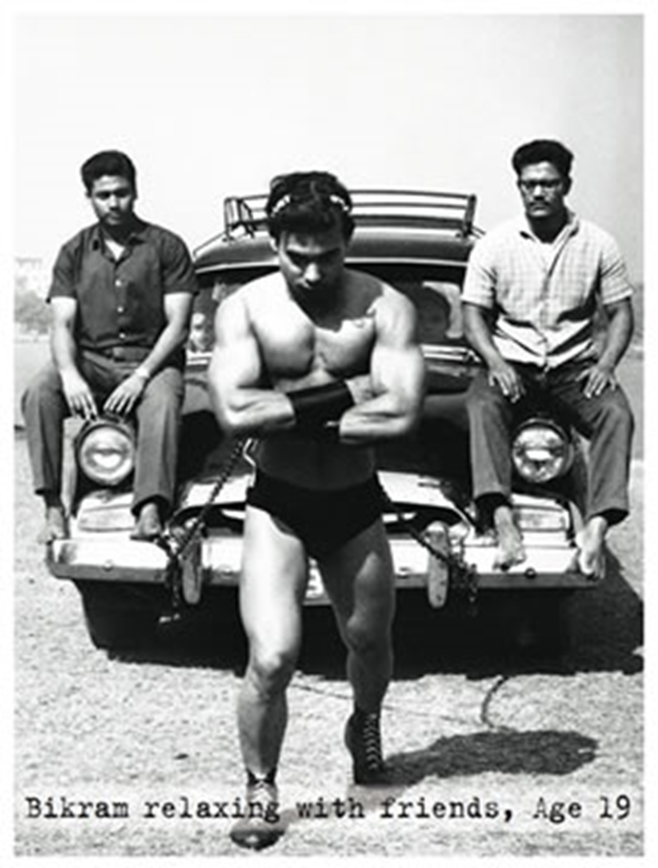
Why Not us VR?
BarryNPeterson@gmail.com

