Slide 1
The State of MOVES
Dr. Imre Balogh
24 May 2022
ilbalogh@nps.edu

Slide 2
Welcome Attendees!
Distinguished Guests and Keynote Speakers:
Mr. Hoffman
Mr. Mann
Mr. Loy
COL Verde
We appreciate your visit to our campus as we return to post-covid hybrid world

Slide 3
NPS Mission
“Provide defense-focused graduate education, including classified studies and interdisciplinary research, to advance the operational effectiveness, technological leadership and warfighting advantage of the Naval service.”
How does MOVES support this mission?

Slide 4
Objectives of MOVES
“Enhance the operational effectiveness of joint and coalition forces by providing superior education and research in the field of modeling and simulation”
— MOVES Mission
Provide relevant, state of the art education in M&S for our warrior-scholars
Support the fleet through 21st century wargaming, modeling, and simulation technologies
Create strong technological and intellectual collaboration between DOD and DoN with commercial technology leaders

Slide 5
Progress Keynotes

Slide 6
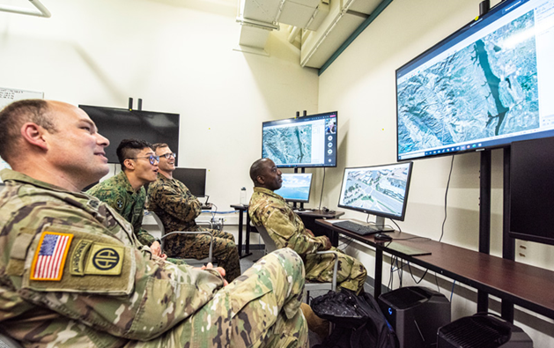
Live Virtual Constructive Lab
Started 2019
LVC Lab has become a core element of the MOVES curriculum
Expanding out to interdepartmental and interagency efforts
Distributed simulation network with Special Ops program in DA
Redstone Arsenal (The Army's Future Vertical Lift (FVL) simulation environment).
NATO’s Coalition Warfare Integration Exercise (CWIX) - since 2018
Moving towards a “Living Lab”
Creating an ecosystem for the rapid integration of the full spectrum of network enabled technologies for research, investigation, and experimentation.

Slide 7
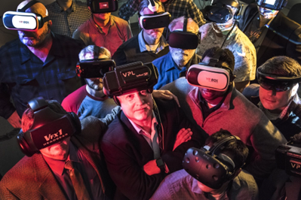
AR/VR
Multiple Theses in AR topics in MOVES and CS-MOVES track
Working with multiple commands looking at the full spectrum of problems that need to be addressed to enable the widespread adoption of AR/VR
3D content creation
Exploring the range of operational uses
Information visualization
…
Pushing the boundaries of the technology by leveraging embedded 3D information to solve real time problems using an integrated mesh of real-world AR/VR technologies
Patents
2 AR related patents awarded in the past year
6 Patents in Progress - some of these are with groups in NAVAIR, NAVWAR, and NAVSEA

Slide 8
AI/ML Reinforcement Learning
Utilizing AI/ML in training more advanced agents in existing and emergent simulations
Goals:
Improved agent behaviors in constructive sims
Support white cell actions in wargames
Discover new tactics in new and existing system employment
Finding new uses for AI/ML technologies to solve existing fleet problems
Multiple theses

Slide 9
NPS-Microsoft Cooperative Research Initiative
Microsoft and NPS working collaboratively to support senior leaders in the military, national security, and industry​ via a shared NPS-Microsoft research innovation lab​ based in Monterey, CA​
Support ideation, incubation, & prototyping in direct support of COMPACFLT mission​
Enable an extensible innovation pipeline for the Navy, Marine Corps, DoN, and DoD​

Slide 10
Microsoft and NPS Collaboration 4 Existing Projects
Cloud enabled network & intelligent edge
Leveraging Azure technologies to streamline, speed-up, and make possible new avenues of simulation and operations via clouds and edge router technologies.
Campus of the Future,
Investigate integration of emerging technologies into learning environments while utilizing distance and remote learning insights gleaned during COVID to expand educational opportunities into new delivery modalities.
21st Century Gaming, Experimentation, Modeling & Simulation (GEMS)​
Current area of focus: Moving Wargaming into the digital ecosphere to enable rapid game design, outcome adjudication and postgame analysis leveraging AI/ML and other cutting edge analytical tool.
Digital Enterprise and Field Experimentation
Investigating how cloud and other technology can support fleet access to JIFX and other field experiments
More projects expected to be added as future research needs emerge.

Slide 11
Interdisciplinary Efforts
MOVES faculty have played a significant role in other important NPS interdisciplinary projects
Support for multi-departmental research projects
Work with CS, OR, DA, IS, MAE, SE, PHY, MET
Center for Additive Manufacturing (CAM)
MOVES faculty played critical role in establishing and leading CAM
CAM facilitated CRADA with Xerox for metal printing
Helped secure $50M congressional appropriation for NPS to create and run an AM consortium focused on the expanded adoption of AM throughout the DoD

Slide 12
Changing World for MOVES
Changes at NPS - NPS Next
Refocus on responsiveness to Fleet needs
Ensure Curricula meet changing Fleet Requirements
Enable problem focused interdisciplinary research addressing current fleet challenges
Naval Warfare Studies Institute (NWSI)
Key component of way forward
Centralized contact to facilitate interactions with the Fleet and DoD
Changes in M&S management structure in the DON
DON Enterprise lead moved to CHENG
Establishing close working relationship (as is shown by Mr. Mann and Mr. Loy attendance at Open House)
Goal is to become key partner in the formulation of future DON M&S policy and workforce education

Slide 13
Future Directions of MOVES
Continue expanding ties to Fleet and Industry
Expanded role in enterprise-wide M&S at NPS
MOVES Institute Director will report to Provost’s office (VPAL)
MOVES Institute and curriculum remain part of CS
Expand educational offerings to address broad M&S educational needs across the fleet
Certificates
Compressed degree programs
Integration of MOVES research efforts into cohesive mutually supporting threads

